Slide 1
Off-Policy Deep RL for Continuous Action Space
Yunke Ao

Slide 2
Recap: Benefits of off-policy algorithms
Reuse previous data to train:
higher sample efficiency!
training
memory
experiences
Agent
interaction
environment

Slide 3
The Off-policy algorithm we already know:
DQN:
$$Q(s, a_{1})$$
Inputs: State
$$Q(s, a_{2})$$
Outputs:
Q-values for each action
$$Q(s, a_{3})$$
hidden layers
$$…$$
$\max_{a}{Q′(s^{′},a)}$?
Continuous action space → Infinite outputs

Slide 4
Off-policy DRL algorithms for continuous action space
DDPG
Deterministic Policy
TD3
Improvements for DDPG
SAC
Stochastic Policy
Maximum Entropy Framework
…

Slide 5
Deep Deterministic Policy Gradient (DDPG): Intuition
Policy Gradient
On-Policy
Off-Policy
Stochastic Policy
$$π_{θ}(a|s)$$
Deterministic Policy
$$μ_{θ}(s)$$
require less samples
state space $×$ action space
state space

Slide 6
DDPG: Deterministic Policy Gradient
Deterministic Policy Gradient:
Q-function for a fixed state
$J\left(μ_{θ}\right)=E_{s\sim p}\left[V_{μ_{θ}}\left(s\right)\right]=$ $E_{s\sim p}\left[Q_{μ_{θ}}\left(s, μ_{θ}(s)\right)\right]$
$Q(s, a)$
P: dist of initial state
$$∇_{θ}J\left(μ_{θ}\right)=E_{s\sim p}\left[{∇_{θ}Q}_{μ_{θ}}\left(s, μ_{θ}(s)\right)\right]$$
$=$ $E_{s\sim ρ^{μ}}\left[ ∇_{θ}μ_{θ}\left(s\right) ∇_{a}Q\left(s,a\right)|_{a=μ_{θ}\left(s\right)} \right]$
$$ρ^{μ}\left(s^{′}\right)=\sum_{t=0}^{∞}{p\left(s_{t}=s′\right)γ^{t}}$$
$$μ_{θ}\left(s\right)$$
$$a^{∗}$$
$$a$$

Slide 7
DDPG: Why Deterministic Policy Gradient is off-Policy?
Intuition: for fixed Q-function:
On-policy DPG:
$$∇_{θ}J\left(μ_{θ}\right)=E_{s′\sim ρ^{μ_{θ}}}[{ ∇}_{θ}μ_{θ}\left(s^{′}\right){ ∇}_{a}Q_{μ_{θ}}\left(s^{′},a\right)|_{a=μ_{θ}\left(s^{′}\right)}]$$
$Q(s_{1}, a)$
$Q(s_{2}, a)$
Off-policy DPG:
$$μ_{θ}\left(s_{1}\right)$$
$$a_{1}^{∗}$$
$$a$$
$$a_{2}^{∗}$$
$$a$$
$$μ_{θ}\left(s_{2}\right)$$
$$∇_{θ}J_{β}\left(μ_{θ}\right)≈E_{s′\sim ρ^{β}}[{ ∇}_{θ}μ_{θ}\left(s^{′}\right){ ∇}_{a}Q_{μ_{θ}}\left(s^{′},a\right)|_{a=μ_{θ}\left(s^{′}\right)}]$$
For each state / each set of states:
Always update closer to optimal action
Different behavior policy: Same form
No need to always choose sets of states for policy update with current policy.
Off-Policy! → Can use replay buffer

Slide 8
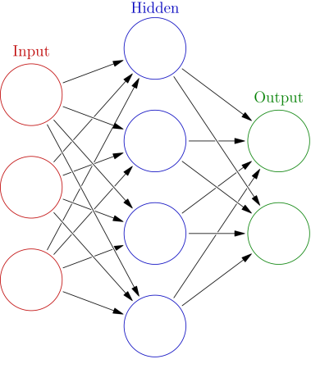
DDPG: Actor-Critic Networks
For each data in the batch ($S_{t}$, $A_{t}$, $R_{t}$, $S_{t+1}$, done):
Value estimation: Q-learning
Policy upgrade: policy gradient
Critic network
Actor network
input
$$A_{t}$$
Output
$$Q_{ω}(S_{t},A_{t})$$
Input
$$S_{t}$$
Output
$μ_{θ}(S_{t}$)
input
$$S_{t}$$
Y-input: $R_{t}+γQ_{ω′}\left(S_{t+1},μ_{θ′}(S_{t+1}\text{)} \right)$
Training: MSE
Target network
Apply gradient:
$${ ∇}_{θ}μ_{θ}\left(S_{t}\right){ ∇}_{a}Q_{ω}\left(S_{t},a\right)|_{a=μ_{θ}\left(S_{t}\right)}$$

Slide 9
DDPG: algorithm
Agent
Actor NN $μ_{θ}$
Critic NN $Q_{ω}$
Target Action NN $μ_{θ′}$
Target Q value NN $Q_{ω′}$
Interaction
policy
Policy:${ μ}_{θ}\left(s\right)$+noise
target
Replay Buffer
Update
networks
Learning
Critic: Q-learning
$$\frac{1}{N}\sum{{\left(R_{t}+γQ_{ω^{′}}\left(S_{t+1}^{i},μ_{θ^{′}}(S_{t+1}^{i}\text{)}\right)−Q_{ω}\left(S_{t}^{i},A_{t}^{i}\right)\right)}^{2}}$$
Actor: DPG
$$\frac{1}{N}\sum{{ ∇}_{θ}μ_{θ}\left(S_{t}^{i}\right){ ∇}_{a}Q_{ω}\left(S_{t}^{i},a\right)|_{a=μ_{θ}\left(S_{t}^{i}\right)}}$$
Batch of Off-line data

Slide 10
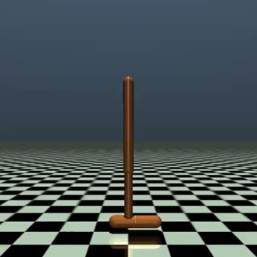
DDPG: Performance Comparation
Stable dynamics: very fast and well Unstable dynamics: easy to fail

Slide 11
Why does DDPG fail in harder environments?
Problems
Q-learning
Over-estimation
Critic
TD3
Interplay of policy & value update
DDPG
Actor
Deterministic Policy: brittle, simple
Exploration noise: sudden failure
DPG
SAC

Slide 12
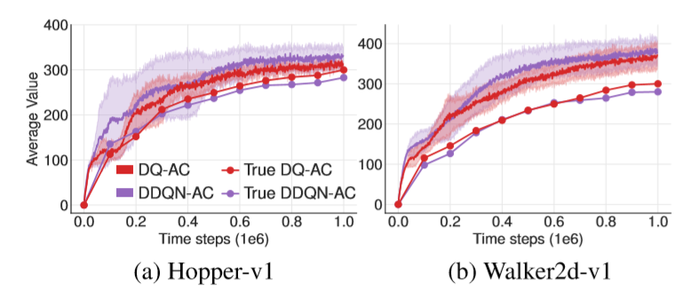
Overestimation of Q-learning
Intuition in discrete case:
Continuous action space experiment result:
$$Q_{ω}\left(s_{t},a_{t}\right)←r_{t}+γ\max_{a′}{Q_{ω^{′}}(s_{t+1},a′)}$$
If we get some error:
$ε=$ $Q_{ω^{′}}(s_{t+1},a′)−Q^{∗}\left(s_{t+1},a^{′}\right)$
With property of max function:
$$E\left(\max\left(Q^{∗}+ε\right)\right)≥\max{E\left(Q^{∗}+ε\right)}=\max{[E(}Q^{∗})+E(ε)]$$
So even with $E\left(ε\right)=0$, We still get: ${E(Q}_{ω})≥E(Q^{∗})$
Over-estimation!

Slide 13
How to reduce overestimation?
$Q(s, a)$
$Q_{ω}$
Over-estimation: take risky actions → fail
risky
$$Q^{∗}$$
$$a$$
Remove max: Double-Q learning
$$Q_{ω}\left(s_{t},a_{t}\right)←r_{t}+γ\max_{a′}{Q_{ω^{′}}(s_{t+1},a′)}$$
$$Q_{ω_{1}}\left(s_{t},a_{t}\right)←r_{t}+γQ_{ω_{2}}(s_{t+1},argmax_{a′}(Q_{ω_{1}}\left(s_{t+1},a′ \right))){}$$
Underestimate: take minimum:
$$Q_{ω_{1}}\left(s_{t},a_{t}\right)←r_{t}+γ\min_{i=1,2}{Q_{ω_{i}^{′}}(s_{t+1},μ_{θ′}(s_{t+1}))}$$
$$Q_{ω_{2}}\left(s_{t},a_{t}\right)←r_{t}+γ\min_{i=1,2}{Q_{ω_{i}^{′}}(s_{t+1},μ_{θ′}(s_{t+1}))}$$
Clipped double-Q network (1st)

Slide 14
Interplay between policy and value update
value divergence to overestimation
Poor policy
Inaccurate value function
wrong policy update direction
Recall policy iteration & value iteration to solve MDP:
One step: VI
Policy evaluation
One step
Policy update
Inf step: PI
Guarantee policy improvement
Delayed policy update (2nd)
Several value update between policy update

Slide 15
Twin Delayed Deep Deterministic policy gradient (TD3)
Agent
Actor NN $μ_{θ}$
Critic NN $Q_{ω_{1}}$ $Q_{ω_{2}}$
Target Action NN $μ_{θ′}$
Target Q value NN $Q_{ω_{1}^{′}}Q_{ω_{2}′}$
Interaction
policy
Policy:${ μ}_{θ}\left(s\right)$+noise
target
Replay Buffer
Update
networks
Learning
Critic: Clipped double Q-learning
$$y_{Q_{i}}=r_{t}+γ\min_{i=1,2}{Q_{ω_{i}^{′}}(s_{t+1},μ_{θ′}\left(s_{t+1}\right))}$$
Actor: DPG (delayed update)
$$\frac{1}{N}\sum{{ ∇}_{θ}μ_{θ}\left(S_{t}^{i}\right){ ∇}_{a}Q_{ω}\left(S_{t}^{i},a\right)|_{a=μ_{θ}\left(S_{t}^{i}\right)}}$$
Batch of Off-line data

Slide 16
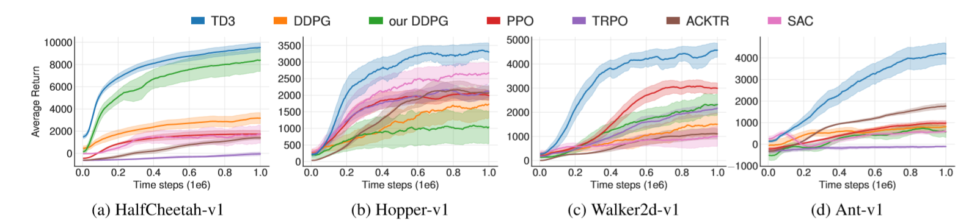
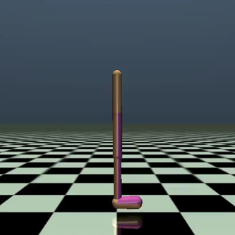
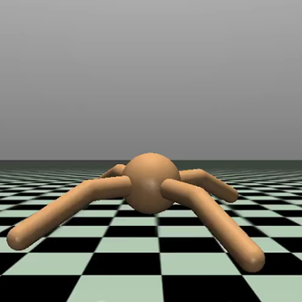
TD3: Performance
Stochastic actor-critic
Perform much better
Especially more unstable environments

Slide 17
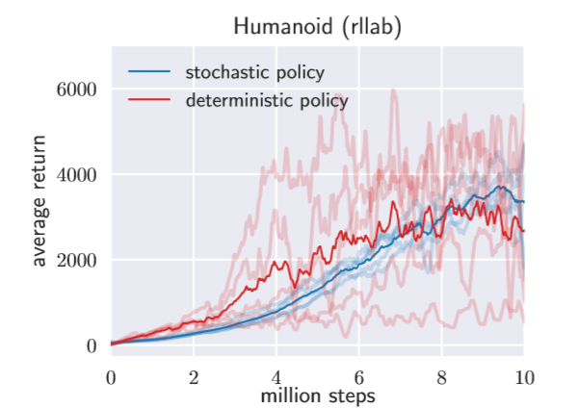
Intuition of Soft Actor-Critic (SAC):
Recall:
Brittle to hyperparameter
Random exploration: sudden failure
Deterministic PG
But:
More stable, can explore
On-policy: inefficient
Stochastic PG
SAC:
Off-policy
Maximum Entropy Framework
Stochastic policy
Exploration

Slide 18
Maximum Entropy Framework-Soft Critic Update
Introduce entropy in the reward to improve exploration:
$$J\left(π\right)=E_{τ\sim π}[\sum_{t=0}^{∞}{γ^{t}(r\left(s_{t},a_{t}\right)+H(π(∙|s_{t}))}]$$
Exploration
Entropy: $H\left(p\left(∙\right)\right)={−E}_{x\sim p}[\log{p(x)}]$
Aware of future risk
$$π\left(a | s\right)$$
$$V^{MEF}\left(s\right)=E_{a\sim π}[Q^{MEF}\left(s,a\right)−\log{π\left(a | s\right)}]$$
-100
$$Q^{MEF}\left(s,a\right)=r\left(s,a\right)+{γE}_{s^{′}\sim p}[V^{MEF}\left(s^{′}\right)]$$
+1000
-100
Soft Critic Update
$$a$$

Slide 19
Maximum Entropy Framework-Soft Actor Improvement
How to improve a stochastic policy:
Policy gradient
Update policy in the direction of improving the performance evaluation
Alternative:
Policy update
Minimize KL divergence between policy and a good policy
What is a good policy (action distribution)?
$Q(s, a)$
$π^{∗}(a|s)$
$π_{1}(a|s)$
$π_{softmax}(a|s)$
$$V(s)$$
$$a^{∗}$$
$$a$$
$$a^{∗}$$
$$a$$
$$a$$
$$a$$
$π^{∗}\left(a | s\right)=δ(a−a^{∗})$
$$π_{1}(a|s)=U(A\left(s,a\right)>0)$$
$$π_{softmax}(a|s)=\frac{exp⁡(Q\left(s,a\right))}{Z}$$

Slide 20
Maximum Entropy Framework-Soft Policy Improvement
$Q(s, a)$
$π_{new}(a|s)$
Target distribution: ($Q$ is $Q^{MEF}$)
$$π_{target}(a|s)=\frac{exp⁡(Q\left(s,a\right))}{Z}$$
$$a$$
$$a$$
…
$$π_{new}=argmin_{π} { D}_{KL}(π(∙|s)||\frac{exp⁡(Q\left(s,a\right))}{Z})$$
$Q^{∗}(s, a)$
$$π^{∗}(a|s)$$
Proved to converge to optimal for soft critic
Off-policy: always update closer to target policy
$$a$$
$$a$$
Soft→
Not deterministic

Slide 21
Soft Actor-Critic (SAC)
Agent
Actor NN $π_{θ}$
Critic NN $Q_{ω}, V_{φ}$
Target critic NN $V_{φ′}$
Interaction
Policy:${ π}_{θ}\left(a|s\right)$
policy
target
Replay Buffer
Learning
Critic V: $y_{φ}^{i}=Q_{ω}\left(S_{t}^{i},A_{t}^{i}\right)−{\log{π}}_{θ}\left(A_{t}^{i} | S_{t}^{i}\right)$
Critic Q: $y_{ω}^{i}=r_{t}^{i}+γV_{φ^{′}}(S_{t+1}^{i})$
Actor: -$\frac{1}{N}\sum{{\hat{∇}}_{θ}D_{KL}(π||π_{target})}$
Update
networks
Batch of Off-line data

Slide 22
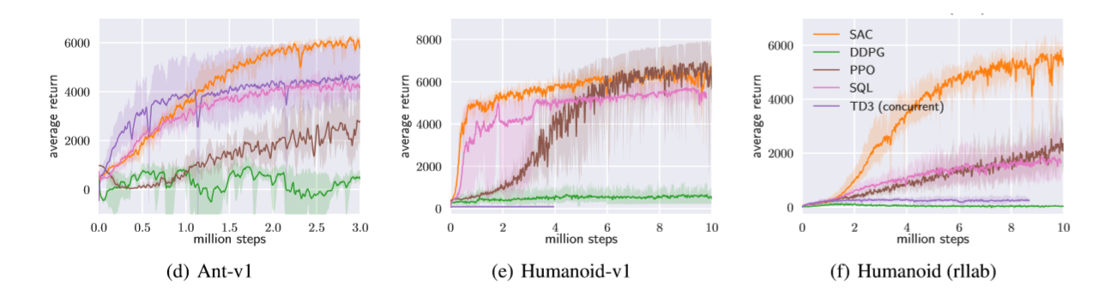
Soft Actor-Critic (SAC)
Higher performance for unstable environment
Low variance of performance compared with others
Faster than previous algorithms for stochastic policy

Slide 23
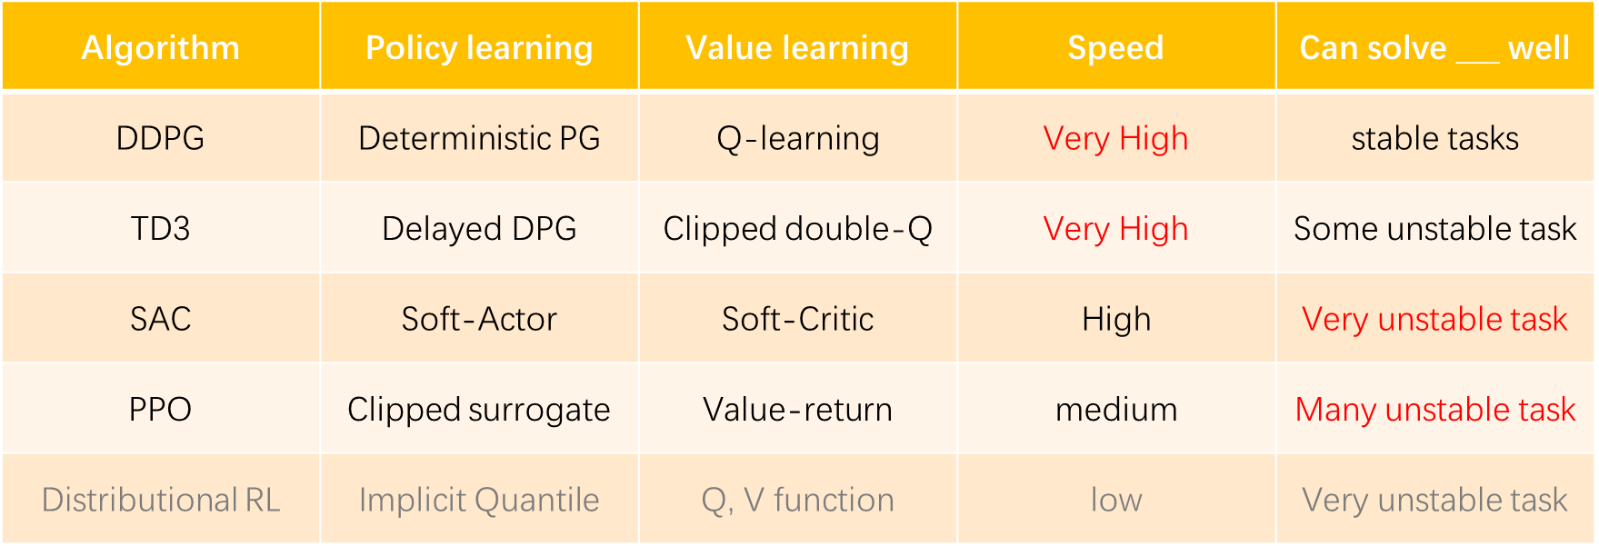
Conclusion: comparison between algorithms
Other algorithms: Soft Q-Learning, Distributional RL, ACKTR, ACER, HER …

Slide 24
Conclusion: some methods that can be combined
Efficiency
Stabilize training
Performance
Replay buffer
Max Entropy RL
(Off-line)
Parallel (Multi-agent)
Max Entropy RL
Delayed update
Value-Critic
Advantage
Trust Region Surrogate opt
Parallel (Multi-agent)
Target network
Max Entropy RL
Clipped double Q
Advantage
Distributional RL
Combine everything together like:
“Asynchronous Twin Delayed SAC”

Slide 25
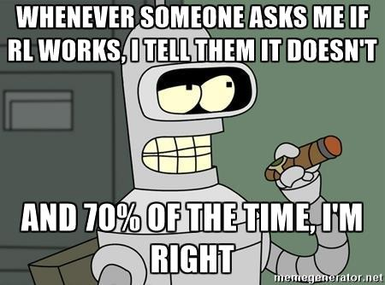
Can our algorithms solve real control tasks? --Still have problems
First seminar:
Very sample inefficient:
Mujoco: ${10}^{5}−{10}^{7}$ steps
Easily beaten by model-based method:
MPC quite good
Overfit to local optima and specific environment
Sim to real
Result is unstable
MPC in 2012
Always possible to fail
https://www.alexirpan.com/2018/02/14/rl-hard.html

Slide 26
To solve these problems, here are good directions to combine:
Inverse RL & imitation learning: learn the reward
Model based RL: sample efficiency
Add learning signals: sparse reward problem
Start with good prior (transfer learning, multi-tasks, continual learning): learn faster
Environments with variations: not overfit
……
https://www.alexirpan.com/2018/02/14/rl-hard.html

Slide 27
Reference:
Silver, D., Lever, G., Heess, N., Degris, T., Wierstra, D., and Riedmiller, M. Deterministic policy gradient algorithms. InInternationalConferenceonMachineLearning (ICML), 2014.
Lillicrap, T. P., Hunt, J. J., Pritzel, A., Heess, N., Erez, T., Tassa, Y., Silver, D., and Wierstra, D. Continuous control with deep reinforcement learning. arXiv preprint arXiv:1509.02971, 2015.
Fujimoto, S., van Hoof, H., and Meger, D. Addressing function approximation error in actor-critic methods. arXiv preprint arXiv:1802.09477, 2018.
Haarnoja T, Zhou A, Abbeel P, Levine S. Soft actor-critic: Off-policy maximum entropy deep reinforcement learning with a stochastic actor. arXiv preprint arXiv:1801.01290, 2018.
Henderson P, Islam R, Bachman P, Pineau J, Precup D, Meger D. Deep reinforcement learning that matters. InThirty-Second AAAI Conference on Artificial Intelligence, 2018.
Tessler C, Tennenholtz G, Mannor S. Distributional policy optimization: An alternative approach for continuous control. InAdvances in Neural Information Processing Systems, 2019 (pp. 1350-1360).
Degris, T., White, M., and Sutton, R. S. (2012b). Linear off-policy actor-critic. In 29th International Conference on Machine Learning.
https://spinningup.openai.com/
https://www.alexirpan.com/2018/02/14/rl-hard.html

Slide 28
Thanks for listening!
Q & A

Slide 29
DDPG: Why Deterministic Policy Gradient is off-Policy?
Deterministic Policy Gradient:
Policy evaluation:
Take gradient:
$$J\left(μ_{θ}\right)=\int{p\left(s\right)V_{μ_{θ}}\left(s\right)ds}$$
$$∇_{θ}J\left(μ_{θ}\right)=∇_{θ}\int{p\left(s\right)V_{μ_{θ}}\left(s\right)ds=}\int{p\left(s\right){∇_{θ}V}_{μ_{θ}}\left(s\right)ds}$$
Expected Return: $E[\sum_{t=0}^{∞}{γ^{t}r_{t}}|s]$
Initial state, not influenced by policy
${∇_{θ}V}_{μ_{θ}}\left(s\right)={∇_{θ}Q}_{μ_{θ}}\left(s, μ_{θ}(s)\right)=$ $∇_{θ}\left( r\left(s,μ_{θ}\left(s\right)\right)+γ\int{p(s^{′}|s,μ_{θ}(s)}) V_{μ_{θ}}\left(s′\right) ds\right)$
$$=∇_{θ}μ_{θ}\left(s\right) ∇_{a}r\left(s,a\right)|_{a=μ_{θ}(s)}$$
$$+∇_{θ}μ_{θ}\left(s\right) γ\int{∇_{a}p(s^{′}|s,a})|_{a=μ_{θ}(s)}V_{μ_{θ}}\left(s′\right) ds+\int{p(s^{′}|s,μ_{θ}(s)}){∇_{θ}V}_{μ_{θ}}\left(s′\right)ds$$
$$=∇_{θ}μ_{θ}\left(s\right) ∇_{a}Q\left(s,a\right)|_{a=μ_{θ}(s)}+\int{γ p(s^{′}|s,μ_{θ}(s)}) {∇_{θ}V}_{μ_{θ}}\left(s′\right)ds$$

Slide 30
DDPG: Why Deterministic Policy Gradient is off-Policy?
Value gradient:
$${∇_{θ}V}_{μ_{θ}}\left(s\right)=∇_{θ}μ_{θ}\left(s\right) ∇_{a}Q\left(s,a\right)|_{a=μ_{θ}(s)}+\int{p(s^{′}|s,μ_{θ}(s)}){∇_{θ}V}_{μ_{θ}}\left(s′\right)ds=…$$
Repeat to e$xpend {∇_{θ}V}_{μ_{θ}}\left(s′\right)$
$$=\int{\sum_{t=0}^{∞}{γ^{t} p\left(s_{t}=s^{′} | s_{0}=s\right)}}∇_{θ}μ_{θ}\left(s′\right) ∇_{a}Q\left(s′,a\right)|_{a=μ_{θ}(s′)} ds′$$
So the policy gradient is:
$$∇_{θ}J\left(μ_{θ}\right)=\int{p\left(s\right){∇_{θ}V}_{μ_{θ}}\left(s\right)ds=}\int{ρ^{μ_{θ}}(s^{′})}∇_{θ}μ_{θ}\left(s′\right) ∇_{a}Q\left(s′,a\right)|_{a=μ_{θ}(s′)} ds′$$
Substitute $\sum_{t=0}^{∞}{p\left(s_{t}=s′\right)γ^{t}}$
$∇_{θ}J\left(μ_{θ}\right)=E_{s\sim ρ^{μ_{θ}}}[∇_{θ}μ_{θ}\left(s\right) ∇_{a}Q\left(s,a\right)|_{a=μ_{θ}(s)}$]
$≠E_{s\sim ρ^{μ_{θ}}}[{∇_{θ}Q}_{μ_{θ}}\left(s, μ_{θ}(s)\right)$]
Update policy in the direction to improve Q-value

Slide 31
DDPG: Why Deterministic Policy Gradient is off-Policy?
Off-policy performance evaluation:
On-policy evaluation:
Behavior policy
$$J_{β}\left(μ_{θ}\right)=\int{{ ρ}^{β}\left(s\right)V_{μ_{θ}}(s)ds}$$
Modified evaluation
$$J\left(μ_{θ}\right)=\int{p\left(s\right)V_{μ_{θ}}\left(s\right)ds}$$
$$=\int{ρ^{μ}\left(s\right)r(s,μ_{θ}\left(s\right))ds}$$
$$=\int{{ ρ}^{β}\left(s\right)Q_{μ_{θ}}(s,μ_{θ}(s))ds}$$
Policy gradient
Approximate Policy gradient,
justified to improve $J_{β}\left(μ_{θ}\right)$
$$∇_{θ}J_{β}\left(μ_{θ}\right)≈E_{s\sim ρ^{β}}[{ ∇}_{θ}μ_{θ}\left(s^{′}\right){ ∇}_{a}Q_{μ_{θ}}\left(s^{′},a\right)|_{a=μ_{θ}\left(s^{′}\right)}]$$
$$∇_{θ}J\left(μ_{θ}\right)=E_{s\sim ρ^{μ_{θ}}}[{ ∇}_{θ}μ_{θ}\left(s^{′}\right){ ∇}_{a}Q_{μ_{θ}}\left(s^{′},a\right)|_{a=μ_{θ}\left(s^{′}\right)}]$$
Same form for different behavior policies, avoid importance sampling
Off-Policy! → Can use replay buffer

Slide 32
Conclusion: some methods that can be combined
methods
problems
evaluation
Asynchronous multi agent
Asynchronous multi agent
Estimation bias & variance
efficiency
Deterministic policy
Low sample efficiency
Clipped double-Q
Clipped double-Q
performance
Value & policy interplay
Delayed policy update
Delayed policy update
Exploration & exploitation
stability
Maximize Entropy Framework
Maximize Entropy Framework
Optimize in distribution space
local & global optimal
Combine everything together:
Trust region
Performance corrupt
“Asynchronous Twin Delayed SAC”

Slide 33
DDPG: Why Deterministic Policy Gradient is off-Policy?
Another Way to write Performance Objective (for stochastic policy):
$$J\left(π_{θ}\right)=E_{τ\sim π_{θ}}\left[\sum_{t=0}^{∞}{γ^{t}r\left(s_{t}, a_{t}\right)}\right]=\sum_{t=0}^{∞}{{E_{τ\sim π_{θ}}[γ}^{t}r\left(s_{t}, a_{t}\right)]}=\int{\int{\sum_{t=0}^{∞}{p\left(s_{t}=s\right) π\left(a_{t}=a | s\right){ γ}^{t}r(s, a)}}}dads$$
$τ:$trajectory
Can be reduced to $E_{s_{t}, a_{t}}$
Put sum inside again
$$= \int{\int{ (\sum_{t=0}^{∞}{p\left(s_{t}=s\right)γ^{t}) π\left(a | s\right) r(s, a)}}}dads=\int{ρ^{π}(s)}\int{π\left(a | s\right) r(s, a)}dads=E_{s\sim ρ^{π},a\sim π}[r(s, a)]$$
Move $γ$ forward
Substitute $\sum_{t=0}^{∞}{p\left(s_{t}=s\right)γ^{t}}$
discounted state distribution

Slide 34
DDPG: Why Deterministic Policy Gradient is off-Policy?
Compare between deterministic and stochastic policy gradient
Stochastic policy:
$$J\left(π_{θ}\right)=E_{s\sim ρ^{π_{θ}},a\sim π_{θ}}\left[r\left(s, a\right)\right]=\int{ρ^{π_{θ}}(s)}\int{π\left(a | s\right) r(s, a)}dads$$
$$J\left(μ_{θ}\right)=E_{s\sim ρ^{μ_{θ}}}\left[r\left(s,μ_{θ}(s)\right)\right]=\int{ρ^{μ_{θ}}\left(s\right)} r\left(s,μ_{θ}\left(s\right)\right) ds$$
Deterministic policy:
discounted state distribution

Slide 35
DDPG: Why Deterministic Policy Gradient is off-Policy?
Different representation of Deterministic Policy Gradient: $∇_{θ}J\left(μ_{θ}\right)$
$$∇_{θ}\int{p\left(s\right)V_{μ_{θ}}\left(s\right)ds}$$
=
=
$$\int{{ ρ}^{μ_{θ}}(s^{′})} ∇_{θ}μ_{θ}\left(s′\right) ∇_{a}Q_{μ_{θ}}\left(s′,a\right)|_{a=μ_{θ}(s′)} ds^{′}$$
=
$$E_{τ\sim μ_{θ}}[{ ∇}_{θ}μ_{θ}\left(s^{′}\right){ ∇}_{a}Q_{μ_{θ}}\left(s^{′},a\right)|_{a=μ_{θ}\left(s^{′}\right)}]$$
Discounted state distribution: $\sum_{t=0}^{∞}{p\left(s_{t}=s\right)γ^{t}}$
$τ:$ trajectory ($s_{0:∞}, a_{0:∞}$ )

Slide 36
Maximum Entropy Framework-Soft Policy Improvement
Target distribution: ($Q$ is $Q^{MEF}$)
$$π_{target}(a|s)=\frac{exp⁡(Q\left(s,a\right))}{Z}$$
$$π_{new}=argmin_{π} { D}_{KL}(π(∙|s)||\frac{exp⁡(Q\left(s,a\right))}{Z})$$
Proved to converge to optimal
Lost function:
$J\left(π_{θ}\right)={E_{s\sim ρ}[D}_{KL}(π_{θ}(∙|s)||\frac{exp⁡(Q_{ω}\left(s,a\right))}{Z})$]
$$=E_{s\sim ρ,a\sim π}[\log{π_{θ}\left(a | s\right)}−Q_{ω}(s,a))]$$
Reparametrize trick:
$$a=f_{θ}(s;ε)$$
$ε\sim d:$ a know distribution like a spherical Gaussian
$$J\left(π_{θ}\right) =E_{s\sim ρ,ε\sim d}[\log{π_{θ}\left(f_{θ}(s;ε) | s\right)}−Q_{ω}(s,f_{θ}(s;ε)))]$$
Just like DDPG, it is off-policy
$Q^{′}\left(s,θ\right)=$ $E_{ε\sim d}[\log{π_{θ}\left(f_{θ}(s;ε) | s\right)}−Q_{ω}(s,f_{θ}(s;ε)))]$
Then can take gradient：
$${\hat{∇}}_{θ}J\left(π_{θ}\right)=∇_{θ}log{π_{θ}\left(a_{t} | s_{t}\right)}+∇_{θ}f_{θ}(s;ε){(∇_{a_{t}}log{π_{θ}\left(a_{t} | s_{t}\right)}−∇_{a_{t}}Q}_{ω}(s_{t},a_{t}))$$
$${=E}_{s\sim ρ}[{∇_{θ}Q}^{′}\left(s,θ\right)]$$

