Slide 1
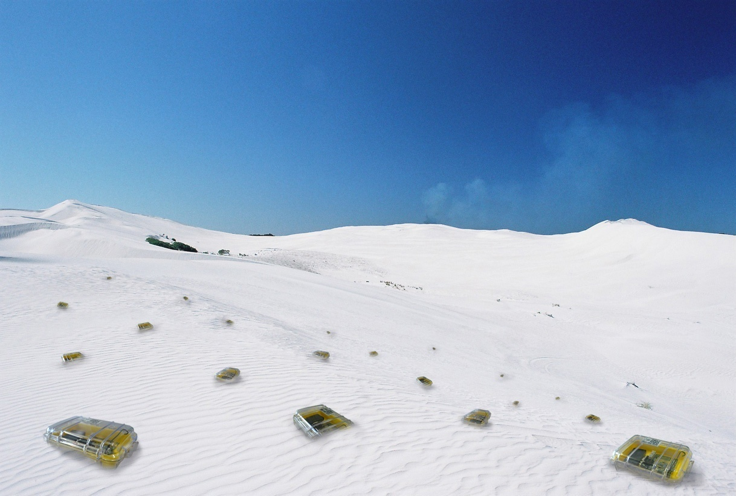

Mobility
Chapter 13

Slide 2
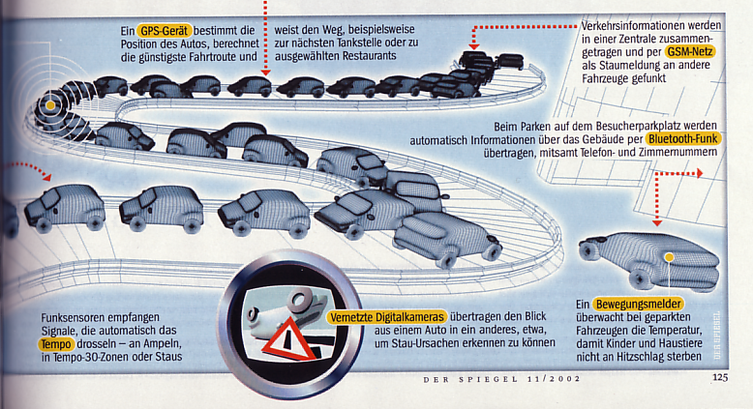
More Car Network Ideas
  CAR2CAR Consortium: Audi, BMW, Daimler, Fiat, GM, Honda, Renault, VW

Slide 3
Rating
Area maturity
Practical importance
Theoretical importance
First steps Text book
No apps Mission critical
Not really Must have

Slide 4
Overview
Mobile IP
GSM Networks
Location Services
Mobility Models

Slide 5


Basics of static routing
Domain Name System
DNS
www.my.ch = 18.3.3.1
www.ethz.ch = 3.5.2.4
………
ISP
www.my.ch
18.3.3.1
15.3.4.5
DHCP: gets IP, DNS servers & gateway from ISP
ISP: Internet service provider

Slide 6




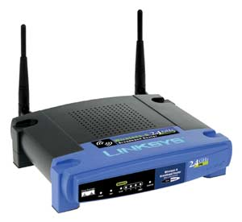
NAT
to: 18.3.3.1:77
from:15.3.4.5:601
192.168.1.6
192.168.1.5
www.my.ch
18.3.3.1
192.168.1.4
ISP
192.168.1.3
to: 15.3.4.5:601
from:18.3.3.1:77
15.3.4.5
to: 192.168.1.2:80
from:18.3.3.1:77
192.168.0.1
Network Address Translation
to: 18.3.3.1:77
from:192.168.1.2:80
NAT
IP 18.3.3.1 port 601 ↔ 192.168.1.2:80
…….
192.168.1.2

Slide 7


Reachability behind a NAT
Skype Super Node
Olga
Nicolas -> 15.3.4.5:660
1
to: 77.4.5.6:70
from:15.3.4.5:660
77.4.5.6
www.my.ch
18.3.3.1
2
ISP
15.3.4.5
3
192.168.0.1
Network Address Translation
NAT
to: 77.4.5.6:70
from:192.168.1.2:80
IP 77.4.5.6 port 660 ↔ 192.168.1.2:80
empty
IP 18.3.3.1 port 661 ↔ 192.168.1.2:80
192.168.1.2
Nicolas

Slide 8
Mobile IP
DNS
www.my.ch = 18.3.3.1
www.ethz.ch = 3.5.2.4
………
www.my.ch
18.3.3.1
- Update routers & keep IP?
- New IP & update DNS?
www.my.ch
???

Slide 9
Motivation for mobile IP
Routing
  based on IP destination address, network prefix (e.g. 129.132.13) determines physical subnet
  change of physical subnet implies change of IP address to have a topological correct address (standard IP) or needs special entries in the routing tables
Changing the IP-address?
  adjust the host IP address depending on the current location
  almost impossible to find a mobile system, DNS updates are too slow
  TCP connections break
  security problems
Change/Add routing table entries for mobile hosts?
  worldwide!
  does not scale with the number of mobile hosts and frequent changes in their location

Slide 10
Requirements on mobile IP (RFC 4721)
Compatibility
  support of the same layer 2 protocols as IP
  no changes to current end-systems and routers required
  mobile end-systems can communicate with fixed systems
Transparency
  mobile end-systems keep their IP address
  continuation of communication after interruption of link possible
  point of connection to the fixed network can be changed
Efficiency and scalability
  only little additional messages to the mobile system required (connection typically via a low bandwidth radio link)
  world-wide support of a large number of mobile systems
Security
  authentication of all registration messages

Slide 11
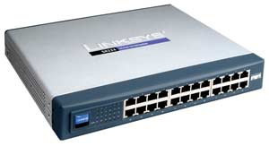
Contacting a mobile node
11.2.3.0
22.5.7.0
HA
FA
11.2.3.4
Router
MN
Router
foreign network
WLAN
WLAN
home network
(physical home network of MN)
MN
11.2.3.4
Mobile Node
Router
(mobile end-system)
CN
User
(end-system)

Slide 12
Contacting a mobile node
11.2.3.0
COA
22.5.7.0
HA
FA
Router
2
Router
foreign network
3
WLAN
WLAN
home network
(physical home network of MN)
MN
11.2.3.4
1
Mobile Node
Router
(mobile end-system)
1. Sender sends to the IP of MN,
HA intercepts packet (proxy ARP)
2. HA tunnels packet to FA by encapsulation
3. FA forwards packet to the MN
CN
User
(end-system)

Slide 13
Direct answer
11.2.3.0
22.5.7.0
HA
FA
Router
Router
foreign network
WLAN
WLAN
home network
(physical home network of MN)
MN
11.2.3.4
Mobile Node
Router
(mobile end-system)
CN
User
(end-system)

Slide 14
Terminology
Mobile Node (MN)
  system (node) that can change the point of connection
  to the network without changing its IP address
Home Agent (HA)
  system in the home network of the MN, typically a router
  registers the location of the MN, tunnels IP datagrams to the COA
Foreign Agent (FA)
  system in the current foreign network of the MN, typically a router
  typically the default router for the MN
Care-of Address (COA)
  address of the current tunnel end-point for the MN (at FA or MN)
  actual location of the MN from an IP point of view
  can be chosen, e.g., via DHCP
Correspondent Node (CN)

Slide 15
Overview
11.2.3.0
COA
22.5.7.0
HA
FA
Router
2
Router
foreign network
3
WLAN
WLAN
home network
(physical home network of MN)
MN
11.2.3.4
1
Mobile Node
Router
(mobile end-system)
CN
HA tunnels packets to the COA of the FA
User
(end-system)

Slide 16
How it works…
Agent Advertisement
  HA and FA periodically send advertisement messages into their physical subnets
  MN listens to these messages and detects if it is in the home or a foreign network (standard case for home network)
  MN reads a COA from the FA advertisement messages
Registration (always limited lifetime!)
  MN signals COA to the HA via the FA, HA acknowledges via FA to MN
  these actions have to be secured by authentication
Advertisement
  HA advertises the IP address of the MN (as for fixed systems), i.e. standard routing information
  routers adjust their entries, these are stable for a longer time (HA responsible for a MN over a longer period of time)
  packets to the MN are sent to the HA
  independent of changes in COA/FA

Slide 17
Direct answer may not work
11.2.3.0
22.5.7.0
HA
FA
Router
Router
foreign network
WLAN
WLAN
home network
(physical home network of MN)
MN
11.2.3.4
Mobile Node
Problems:
Firewall at CN
TTL
Multicast
Router
(mobile end-system)
CN
User
(end-system)

Slide 18
Reverse tunneling (RFC 2344)
11.2.3.0
22.5.7.0
HA
FA
Router
Router
2
foreign network
1
WLAN
WLAN
home network
(physical home network of MN)
MN
11.2.3.4
3
Mobile Node
MN sends to FA
FA tunnels packets to HA by encapsulation
HA forwards the packet to the receiver (standard case)
(mobile end-system)
Router
CN
User
(end-system)

Slide 19
Mobile IP with reverse tunneling
Router accept often only “topologically correct“ addresses (firewall!)
  a packet from the MN encapsulated by the FA is now topologically correct
  furthermore multicast and TTL problems solved (TTL in the home network correct, but MN is too far away from the receiver)
Reverse tunneling does not solve
  problems with firewalls, the reverse tunnel can be abused to circumvent security mechanisms (tunnel hijacking)
  optimization of data paths, i.e. packets will be forwarded through the tunnel via the HA to a sender (double triangular routing)
Reverse tunneling is backwards compatible
  the extensions can be implemented easily and cooperate with current implementations without these extensions

Slide 20



Optimization of packet forwarding
Triangular Routing
  sender sends all packets via HA to MN
  higher latency and network load
“Solutions”
  sender learns the current location of MN
  direct tunneling to this location
  HA informs a sender about the location of MN
  big security problems
Change of FA
  packets on-the-fly during the change can be lost
  new FA informs old FA to avoid packet loss, old FA now forwards remaining packets to new FA
  this information also enables the old FA to release resources for the MN

Slide 21






Cellular Networks
GSM (Global System for Mobile Communications)
  Standard for a Public Land Mobile Network (PLMN)
  Specification of the GSM standard in 1991
  More than 3 billion subscribers worldwide
  Over 850 GSM network operators
GSM in Switzerland
  8 million mobile phone users (2007)
  5 GSM network operators active:

Slide 22
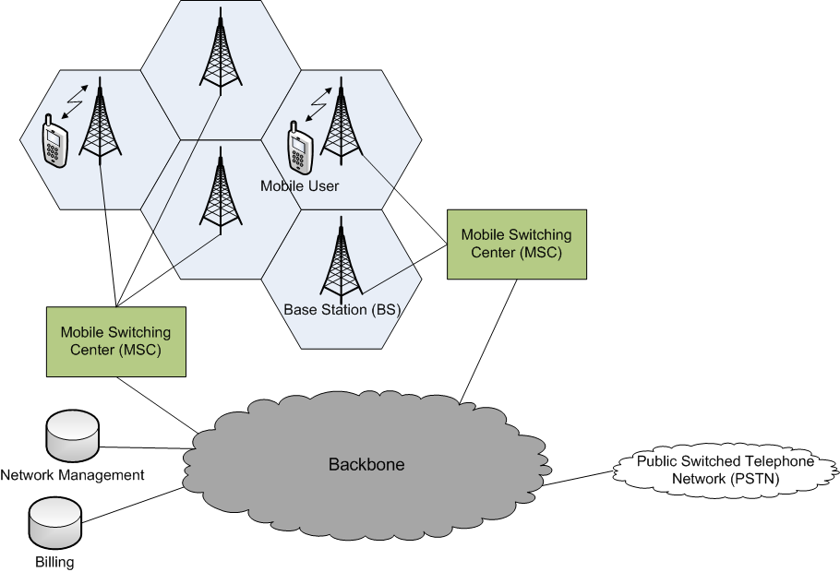
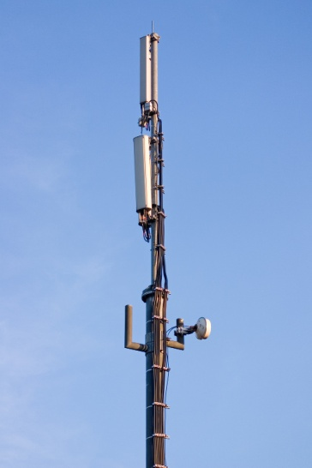
GSM Architecture
GSM is a combination of wireless and fixed network systems
  Base station covers mobile users in a cell
  Different base stations are connected through a backbone network

Slide 23
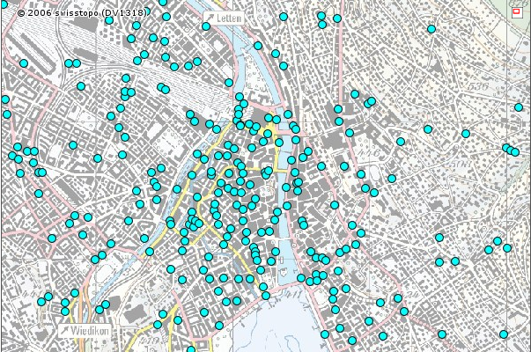
GSM Coverage
Coverage in Switzerland is nearly 99.8% of the populated area
  Approx. 11‘000 base stations (antennas) placed all over the country
Cell sizes can vary from a few hundred meters up to 30 km
  Depends on the number of users, geography, transceiver power
Example: Zurich City
  Source: funksender.ch, BAKOM

Slide 24
Handling Mobility in Cellular Networks
GSM designed for high mobility of users
  GSM evolved from former car telephony standards (e.g. Natel C)
Home network:
  Network of your service provider (e.g. Swisscom, Orange, …)
  Home Location Register (HLR) : stores profile information (services, billing, preferences) of all customers of a network operator
Visited network:
  Network in which mobile user currently resides
  Visitor Location Register (VLR): contains an entry for each user currently in the network, entry for a mobile user is copied from the HLR of your home network

Slide 25
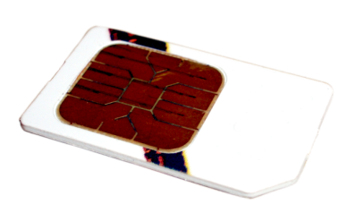
Addressing Scheme for Cellular Subscribers
Global addressing scheme for mobile users
  Mobile phone numbers need to be globally unique
  Hierarchical addressing (country, operator, subscriber)
International Mobile Subscriber Identity (IMSI)
  Stored on the Subscriber Identity Module (SIM) card
  3 digits Mobile Country Code (MCC)
  2 digits Mobile Network Code (MNC)
  Max. 10 digits mobile station identification number
  Example for an IMSI:
    228 01 1234567
    (228 = Switzerland, 01 = Swisscom, 1234567 = identification number)
    Corresponds to the international phone number +41 79 123 45 67

Slide 26
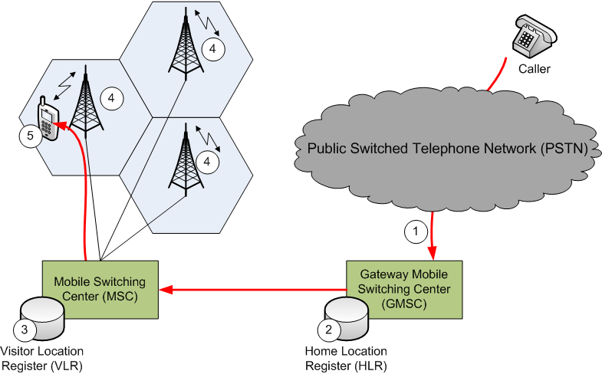
Mobile Terminated Call
Calling a GSM subscriber, call is forwarded to the GMSC
Look-up of the current location in the HLR
Call is forwarded to the responsible MSC
All base stations controlled by the MSC start paging the subscriber
Mobile subscriber answers, security checks, call setup

Slide 27
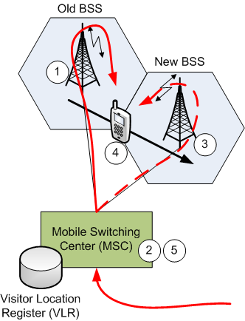
GSM Handover
Intra-network mobility:
  User changes between different base stations (BSS) of the same network operator (handover)
Seamless handover (no call drop)
  Old BSS informs MSC of pending handover
  MSC sets up path (resources) to new BSS
  New BSS signals to MSC and old BSS: ready
  Old BSS tells subscriber to perform handover
  MSC re-routes call to the new BSS,
  old BSS releases resources
Sometimes it is even necessary to perform
a handover between different MSCs

Slide 28
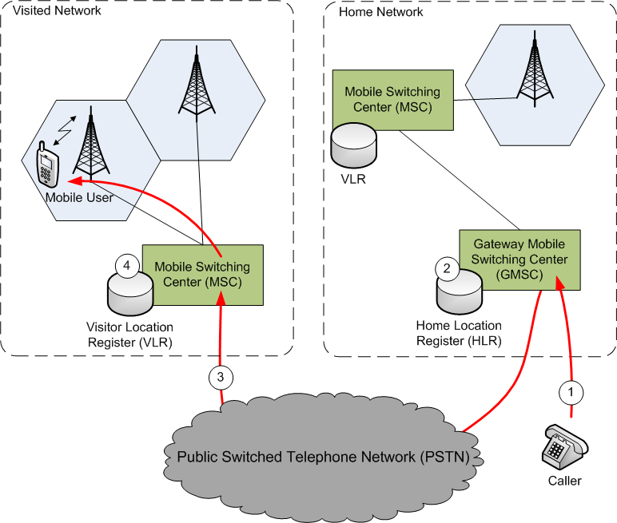
GSM Roaming
Inter-network mobility:
  Home Location Register(HLR) keeps track of the current location
  Mobile user can be addressed by a temporary Mobile Station Roaming Number (MSRN)
  Call is forwarded to
  home network GMSC
  Location look-up in HLR,
  obtain temporary MSRN
  Call is forwarded to
  visitor MSC over PSTN
  Lookup location in VLR,
  forward call to user

Slide 29
Mobility: IP versus GSM
Mobile IP | GSM | Comment
Home Agent (HA) | Gateway Mobile Switching Center (GMSC) and Home Location Register (HLR) | Point of contact to obtain the current address (IP) or roaming number (GSM) of the mobile user
Foreign Agent (FA) | Visited Mobile Switching Center (MSC) and Visitor Location Register (VLR) | Stores temporary information about the mobile user
Care-of Address (COA) | Mobile Station Roaming Number (MSRN) | Temporary address (IP) or number (GSM) for the mobile user

Slide 30
Location services
Service that maps node names to (geographic) coordinates
  Should be distributed (no require for specialized hardware)
  Should be efficient
Lookup of the position (or COA) of a mobile node
  Mobile IP: Ask home agent
  Home agent is determined through IP (unique ID) of MN
  Possibly long detours even though sender and receiver are close
  OK for Internet applications, where latency is (normally) low
Other application: Routing in a MANET
  MANET: mobile ad hoc network
  No dedicated routing hardware
  Limited memory on each node: cannot store huge routing tables
  Nodes are mostly battery powered and have limited energy
  Nodes route messages, e.g. using georouting

Slide 31
Home based georouting in a MANET
How can the sender learn the current position of another node?
  Flooding the entire network is undesirable (traffic and energy overhead)
Home based approach
  Similar to Mobile IP, each node has a home node, where it stores and regularly updates its current position
  The home is determined by the unique ID of the node t. One possibility is to hash the ID to a position p_{t} and use the node closest to p_{t} as home.
  Thus, given the ID of a node, every node can determine the position of the corresponding home.
h_{t}
Home based routing
Route packet to h_{t}, the home of the destination t
Read the current position of t
Route to t
p_{t}
s
t

Slide 32
Home based location service – how good is it?
Visiting the home of a node might be wasteful if the sender and receiver happen to be close, but the home far away
The routing stretch is defined as
We want routing algorithms with low stretch.
Simultaneous message routing and node movement might cause problems
Can we do better?
h_{t}
p_{t}
t
length of route
stretch :=
length of optimal route
s
h_{t}
p_{t}
s
t

Slide 33
Classification of location services
Proactive
  Mobile node divulges its position to all nodes whenever it moves
  E.g. through flooding
Reactive
  Sender searches mobile host only when it wants to send a message
  E.g. through flooding
Hybrid
  Both, proactive and reactive.
  Some nodes store information about where a node is located
  Arbitrarily complicated storage structures
  Support for simultaneous routing and node mobility

Slide 34
Location services: Lookup & Publish
Any node A can invoke to basic operations:
  Lookup(A, B): A asks for the position of B
  Publish(A, x, y): A announces its move from position x to y
Open questions
  How often does a node publish its current position?
  Where is the position information stored?
  How does the lookup operation find the desired information?
Goal
  Minimize
length of route
stretch =
length of optimal route

Slide 35
Location Service: Goals
Publish cost should depend only on moved distance
Lookup cost should depend only on the distance between the sender and receiver (bounded stretch)
Nodes might move arbitrarily at any time, even while other nodes issue lookup requests
Determine the maximum allowed node speed under which delivery is still guaranteed

Slide 36
Location Service: Initial observations
Cannot get reasonable stretch with a single home. Therefore, use several homes (location servers).
If the sender s is close to the destination t, a location server should be close
h_{t}
p_{t}
s
t
t
s
If the sender is further away, its OK to walk a bit longer until finding a location server
s
t
location server which stores the location of t

Slide 37
Location Service: Initial observations
Many location servers close to the node
Sparser distribution of location servers the further away we are
Boundary of the network
t
Location server for node t

Slide 38
MLS: Location Service for Mobile Ad Hoc Networks
Geometric decomposition of the network into quadratic cells on several levels
Level-M
Level-1
(2^{M},2^{M})
M-1
…
2
1
(0,0)

Slide 39
Location pointers (aka location servers)
On every level, t stores one location pointer in the cell containing t
  denotes the quadratic cell on level M containing t
  On level k, the location pointer for t is called

Slide 40
Location pointer & Notation
Notation:
  Location pointer for node t on level-k
  Level-k cell that contains node t
The location pointers are placed depending on the ID of the node, as in the home-based lookup system.
The position of is obtained by hashing the ID of node t to a position in . The location pointer is stored on the nearest node.

Slide 41
Routing in MLS
Routing from a node s to a node t consists of two phases:
  Find a location pointer
  Once a first location pointer is found on level-k, we know in which of the 4 sub-squares t is located and thus in which
  t has published its location pointer .
  Recursively, the message is routed towards location pointers on lower levels until it reaches the lowest level, from where it can be routed directly to t.

Slide 42
Routing in MLS (2)
When a node s wants to find a location pointer of a node t, it first searches in its immediate neighborhood and then extends the search area with exponential growing coverage.
  First, try to find a location pointer in or one of its 8 neighboring levels.
  Repeat this search on the next higher level until a is found
The lookup path draws a spiral-like shape
with exponentially increasing radius until it
finds a location pointer of t.
Once a location pointer is found, the lookup
request knows in which sub-square it can
find the next location pointer of t.
s

Slide 43
Support for mobility in MLS
A location pointer only needs to be updated when the node leaves the corresponding sub-square.
  is OK as long as t remains in the shaded area.
  Most of the time, only the closest few location pointers need to be updated due to mobility.
Not enough: If a node moves across a level boundary, many pointers need to be updated. E.g. a node oscillates between the two points a and b.

Slide 44
Lazy publishing
Idea: Don’t update a level pointer as long as t is still somewhat close to the level L_{k} where points.
Breaks the lookup: points to a level that does not contain

Slide 45
Lazy publishing with forwarding pointers
No problem, add a forwarding pointer that indicates in which neighboring level the location pointer can be found.

Slide 46
Concurrency in MLS
Allowing for concurrent lookup requests and node mobility is somewhat tricky, especially the deletion of pointers.
Note that a lookup request needs some time to travel between location pointers. The same holds for requests to create or delete location (or forwarding) pointers.
Example:
  A lookup request follows , and
  node t moves as indicated
  t updates its and and
  removes the and the old
  The lookup request fails if it arrives after
  the has been removed

Slide 47
Concurrency in MLS (2)
No problem either: Instead of removing a location pointer or forwarding pointer, replace it with a temporary pointer that remains there for a short time until we are sure that no lookup request might arrive anymore on this outdated path.
Similar to the forwarding pointer, a temporary pointer redirects a lookup to the neighbor level where the node is located.

Slide 48
Properties of MLS
Constant lookup stretch
  The length of the chosen route is only a constant longer than the optimal route
Publish cost is O(d log d) where moved distance is d
  Even if nodes move considerably, the induced message overhead due to publish requests is moderate.
Works in a concurrent setup
  Lookup requests and node movement might interleave arbitrarily
Nodes might not move faster than 1/15 of the underlying routing speed
  We can determine the maximum node speed that MLS supports. Only if nodes move faster, there might arise situations where a lookup request fails.

Slide 49
MLS Conclusions
It’s somewhat tricky to handle concurrency properly
  Use of temporary forwarding pointers
MLS is the first location service that determines the maximum speed at which nodes might move
  Without the speed limitation, no delivery guarantees can be made!
Drawbacks
  MLS utilizes an underlying routing algorithm that can deliver messages with constant stretch given the position of the destination
  MLS requires a relatively dense node population

Slide 50
History of location services
Grid Location Service (GLS) by Li et al. (2000)
  No bound on the stretch
Locality Aware Location Service (LLS) by Abraham et al. (2004)
  Similar to MLS
  No concurrency support
MLS: Location Service for Mobile Networks by Flury et al. (2006)
… Still many open problems to solve

Slide 51
Mobility Models
Mobility is an important aspect when designing protocols for wireless ad-hoc networks
  Node density depends highly on the mobility pattern
  Links break more frequently when the node mobility is high
When studying mobility, one might resolve to models
  Simulations of mobility models are fast, cheap and repeatable
  Real-world experiments are often infeasible
Mobility models specify how nodes move in a certain area of interest
  Many different ideas how to model mobility (e.g. physics, road traffic)
  Only key features are taken into account to keep the model simple (but often too simplified)
  Should match the real-world behavior of nodes as good as possible

Slide 52
Mobility Model Classification
Random entity-based mobility models
  Each node acts independently of other nodes
  (e.g. Brownian motion, Random waypoint, Random trip)
Group-based mobility models
  Simulate the behavior of nodes moving together towards a common destination (e.g. Reference Point Group Mobility model)
Survey-based mobility models
  Street maps, augmented with info what kind of people live/work/shop/… in which areas, and how do they move between these areas
  This is also popular in research about viruses and diseases
Vehicular mobility models
  Model the behavior of vehicles participating in road traffic
  Driver models, intersections, congestion
  Traffic simulators

Slide 53
The Random Waypoint Model
[following slides by JY Le Boudec, EPFL]
In its simplest form:
  Mobile picks next waypoint M_{n} uniformly in area
  Mobile picks next speed V_{n} uniformly in [v_{min}; v_{max}]
  Both independent of past and present
  Mobile moves towards M_{n} at constant speed V_{n}
M_{n-1}
M_{n}

Slide 54
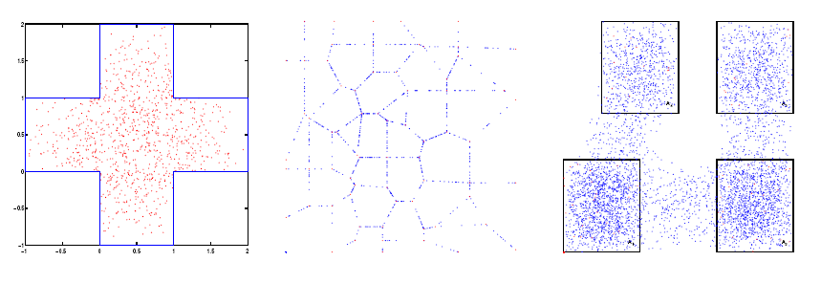
The Random Trip model
Random Waypoint is a special case of Random Trip:
  Mobile picks a path in a set of paths and a speed
  At end of path, mobile picks a new path and speed
  Mobiles may decide to wait and sleep at destinations before going on the next leg
  E.g. shortest Euclidean path in non-convex area, or shortest path on street map

Slide 55
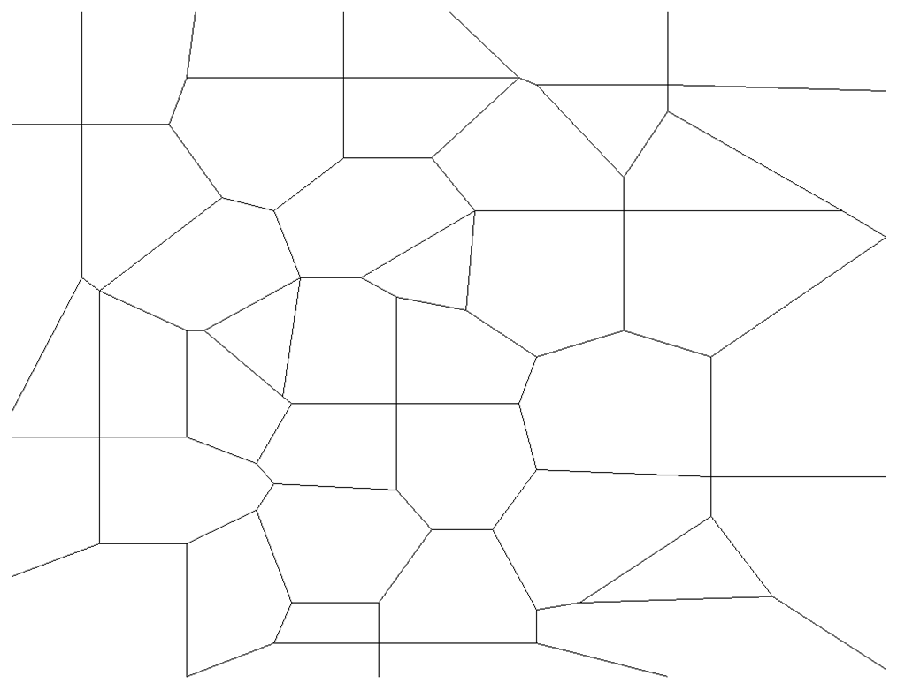
Example: Random Trip

Slide 56
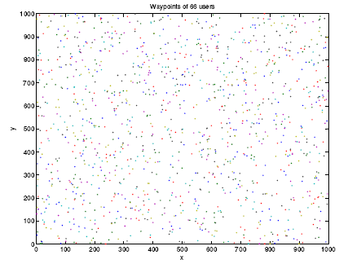
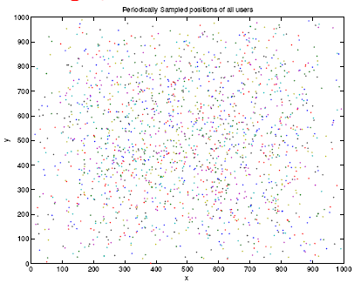
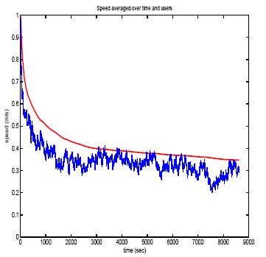
Simulation problems
If you simulate mobility, you need to take care about system
leveling off…
The problem is that the steady-state is in the infinite…
Samples of location at times 0s and 2000s
Average node speed

Slide 57
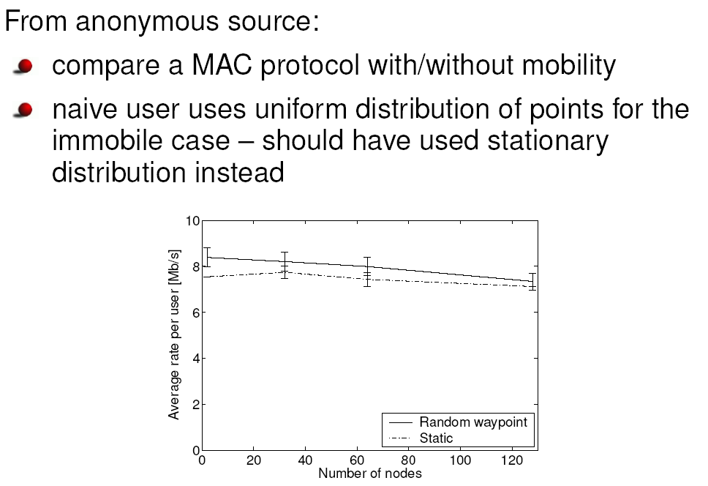
Simulation “solutions”
The problem is that your
simulations may show results
which differ from “reality”.
A simple rule of thumb (which is wrong, but somehow “acceptable”): If you want to simulate for time T, you really need to simulate time 2T, and throw the first half of your simulation away.
Another (also wrong) solution is to start each node at a position p which is uniformly random between uniformly random points s and t, and with velocity according to the distribution 1/v. However, also this is not correct…

Slide 58
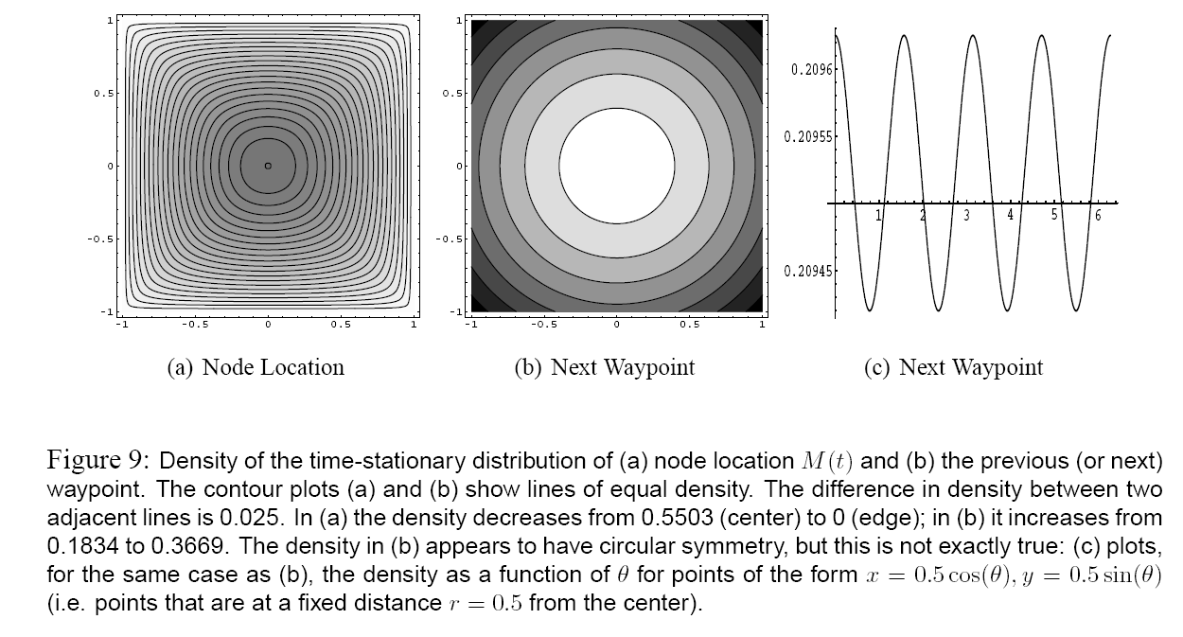
Simulation solution
The correct solution is to simultaneously draw position and velocity from the steady-state distribution (see work by Le Boudec for details.)

Slide 59
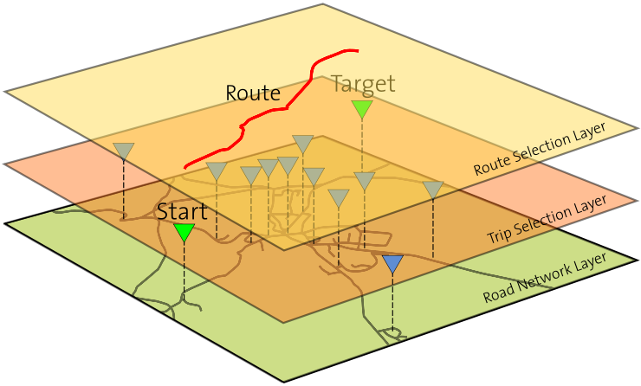
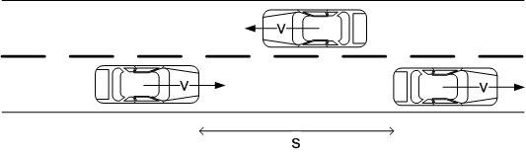
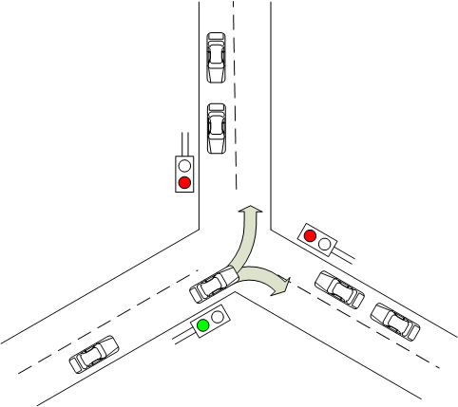
Vehicular Mobility Models
Global behavioral rules
  Random trips constrained
  to a realistic road network (GIS)
Local behavioral rules
  Speed adjustement and car-following (keep minimal distance to the car in front)
  Intersection management (stop at red traffic
  lights, then start to accelerate again on green
  light)

Slide 60
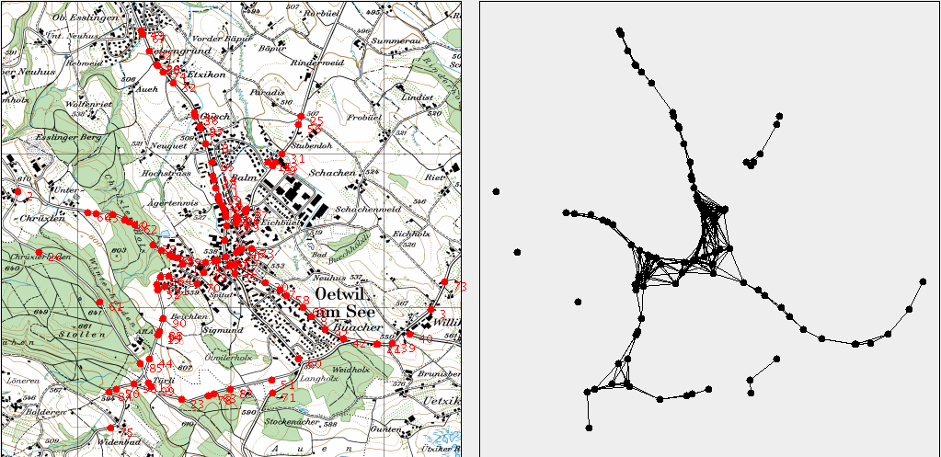
Example: Vehicular Mobility using GIS data
Use the road topology from a geographic information system (GIS) to model vehicular mobility for a simulation area
  Information about road category, speed limits
  Very detailed geographical data available (resolution is around 1m)
Map
Network graph

Slide 61
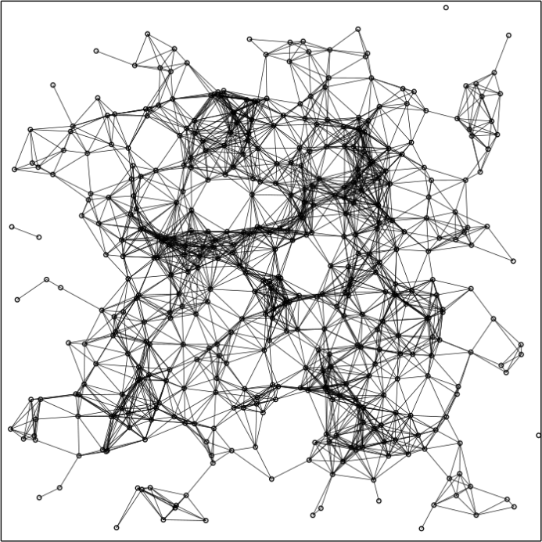
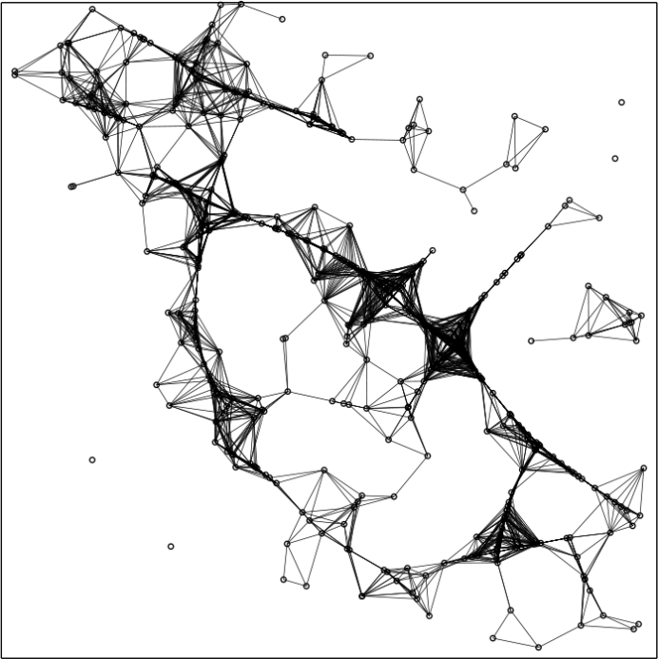
Impact of the Mobility Model on the Network Topology
Choosing the „right“ mobility model is important
  Should match the reality as close as possible
  Mobility model has a large impact on the node distribution and therefore also on the network topology
Example: Network topolgy for Random Waypoint (left) and a vehicular mobility model(right)

Slide 62
Open problem
Even systems like MLS still make way too many simplifying assumptions. So there is the obvious question about a location service which is practical.
Essentially a good location service system needs to
  work in dynamic environments
  give acceptable memory and communication loads
  provide stretch guarantees
  neither make funny assumptions about node distributions …
  … nor about mobility patterns
  be secure

