Slide 1
Asynchronous Byzantine Agreement in Incomplete Networks
Ye Wang and Roger Wattenhofer
ETH Zurich

Slide 2
Send Message from Zurich to New York…
Ye@Zurich
AFT@New York

Slide 3
Send Message from Zurich to New York…
Basel
Paris
Ye@Zurich
London
AFT@New York

Slide 4
Incomplete Network

Slide 5
Incomplete Network

Slide 6
Byzantine Agreement in Incomplete Networks

Slide 7
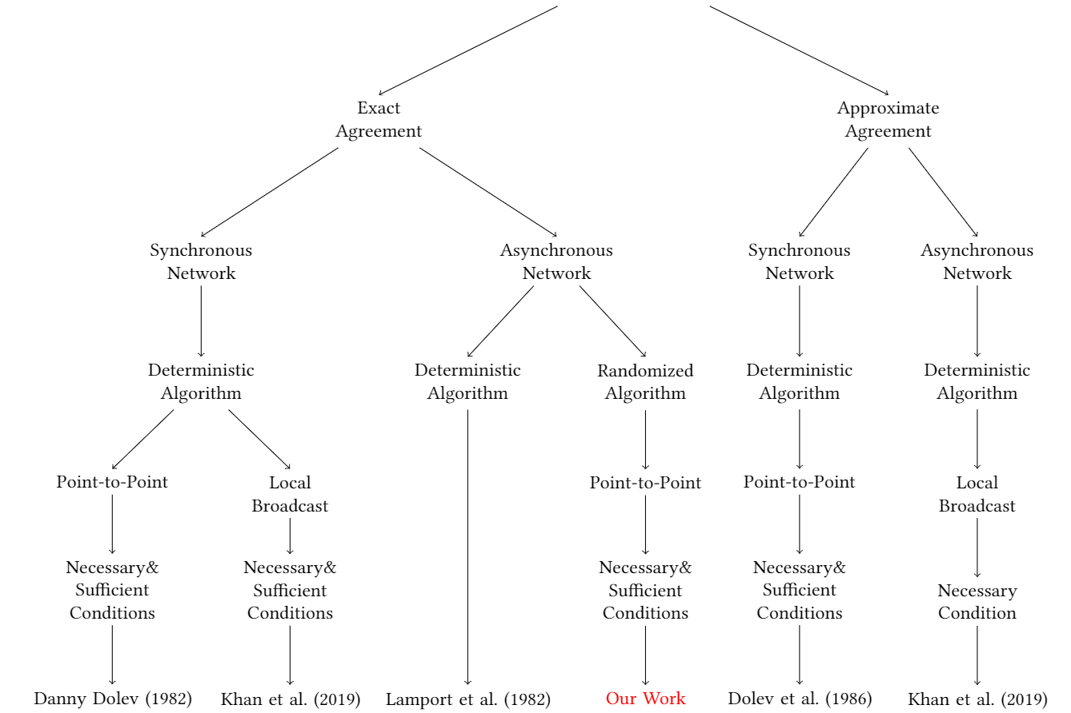
Byzantine Agreement in Incomplete Networks

Slide 8
Byzantine Agreement in Incomplete Networks

Slide 9
Byzantine Agreement in Incomplete Networks

Slide 10
Byzantine Agreement in Incomplete Networks

Slide 11
Byzantine Agreement in Incomplete Networks

Slide 12
Byzantine Agreement in Incomplete Networks

Slide 13
Asynchronous Byzantine Agreement in Incomplete Networks
An undirected network $G$ with $n$ nodes, where $f$ nodes are Byzantine.

Slide 14
Asynchronous Byzantine Agreement in Incomplete Networks
Necessary & Sufficient Conditions for Asynchronous Byzantine Agreement
$G$ is $2f+1$ connected

Slide 15
Hierarchy of the Algorithms
Byzantine Agreement Algorithm
Byzantine Reliable Broadcast
Message Delivery in Incomplete Networks

Slide 16
Hierarchy of the Algorithms
Byzantine Agreement Algorithm
Byzantine Reliable Broadcast
Message Delivery in Incomplete Networks

Slide 17
Sufficient Condition
sender
$$v$$
intermediate
$$u$$
receiver
$$w$$

Slide 18
Sufficient Condition
$$2k+1$$
Disjoint paths

Slide 19
Sufficient Condition
sender
$$v$$
intermediate
$$u$$
receiver
$$w$$

Slide 20
Asynchronous Byzantine Agreement in Incomplete Networks
An undirected network $G$ with $n$ nodes, where $f$ nodes are Byzantine.
Necessary & Sufficient Conditions for Asynchronous Byzantine Agreement
$G$ is $2f+1$ connected

Slide 21
Necessary Condition
If the connectivity of $G$ is smaller than $2f+1$…
$$X$$
$$T$$
$$R$$
$$\left|T\right|≤f$$
$Y$
$$\left|R\right|≤f$$

Slide 22
Necessary Condition
If the connectivity of $G$ is smaller than $2f+1$…
$$X$$
$$R$$
$$T$$
$$Y$$

Slide 23
Necessary Condition
If the connectivity of $G$ is smaller than $2f+1$…
$$X$$
$$X_{0}$$
$$Y_{1}$$
$$R$$
$$T$$
$$R_{0}$$
$$T_{0}$$
$$T_{1}$$
$$R_{1}$$
$$Y$$
$$Y_{0}$$
$$X_{1}$$

Slide 24
Necessary Condition
If the connectivity of $G$ is smaller than $2f+1$…
$$X_{0}$$
$$Y_{1}$$
$$X_{0}$$
$$R_{0}$$
$$T_{0}$$
$$T_{1}$$
$$R_{1}$$
$$R_{0}$$
$$T_{1}$$
$$T_{0}$$
$$Y_{0}$$
$$X_{1}$$
$$Y_{0}$$

Slide 25
Necessary Condition
If the connectivity of $G$ is smaller than $2f+1$…
$$X_{0}$$
$$Y_{1}$$
$$X_{1}$$
$$R_{0}$$
$$T_{0}$$
$$T_{1}$$
$$R_{1}$$
$$R_{1}$$
$$T_{0}$$
$$T_{1}$$
$$Y_{0}$$
$$X_{1}$$
$$Y_{1}$$

Slide 26
Necessary Condition
If the connectivity of $G$ is smaller than $2f+1$…
$$X_{0}$$
$$Y_{1}$$
$$X_{0}$$
$$R_{0}$$
$$T_{0}$$
$$T_{1}$$
$$R_{1}$$
$$R_{0}$$
$$T_{1}$$
$$R_{1}$$
$$Y_{0}$$
$$X_{1}$$
$$Y_{1}$$

Slide 27
Byzantine Agreement in Incomplete Networks

Slide 28
Thanks! Questions & Comments?

