Slide 1

Acoustic Monitoring using
Wireless Sensor Networks
Presented by:
Farhan Imtiaz
Seminar in Distributed Computing

Slide 2
Wireless Sensor Networks
Wireless sensor network (WSN) is a wireless network consisting of spatially distributed autonomous devices using sensors to cooperatively monitor physical or environmental conditions, such as temperature, sound, vibration, pressure, motion or pollutants, at different locations (Wikipedia).
Seminar in Distributed Computing

Slide 3
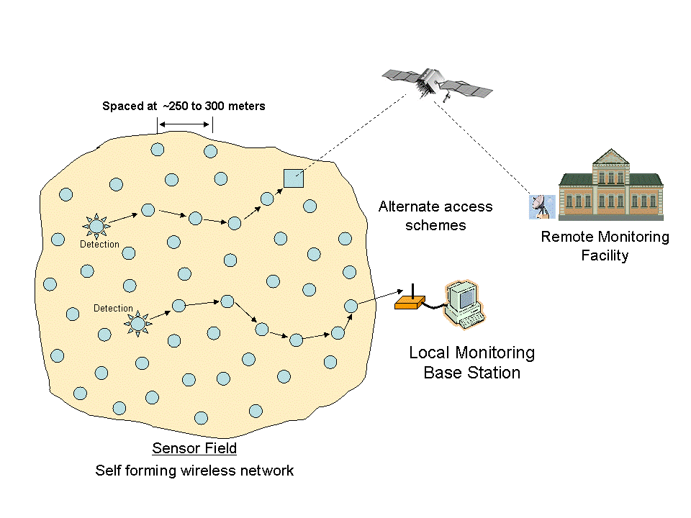
Wireless Sensor Networks
Seminar in Distributed Computing

Slide 4

What is acoustic source localisation?
Estimate distance or angle to acoustic source at distributed points (array)
Calculate intersection of distances or crossing of angles
Given a set of acoustic sensors at known positions and an acoustic source whose position is unknown, estimate its location
X
Seminar in Distributed Computing
Notes:
Estimation of the position of an unknown acoustic source
Could be done by estimating range, angle of arrival, etc

Slide 5
Applications
Gunshot Localization
Acoustic Intrusion Detection
Biological Acoustic Studies
Person Tracking
Speaker Localization
Smart Conference Rooms
And many more
Seminar in Distributed Computing

Slide 6
Challenges
Acoustic sensing requires high sample rates
  Cannot simply sense and send
  Implies on-node, in-network processing
  Indicative of generic high data rate applications
A real-life application, with real motivation
  Real life brings deployment and evaluation problems which must be resolved
Seminar in Distributed Computing

Slide 7
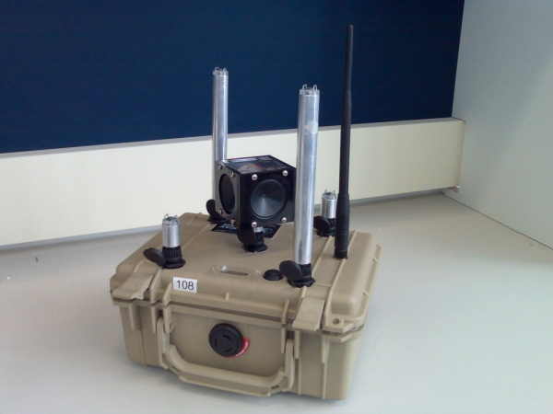
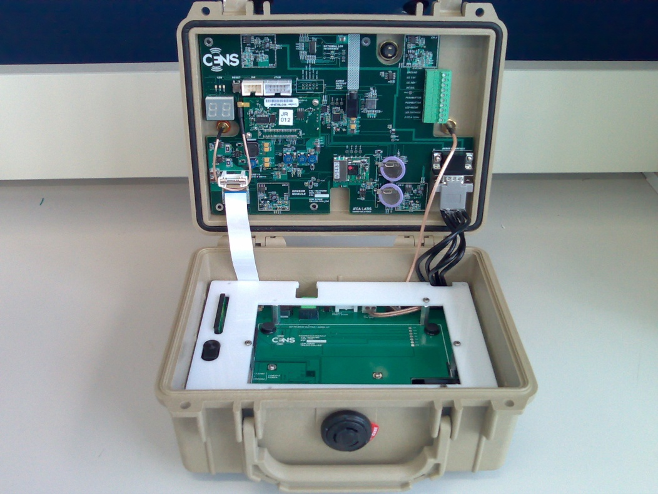
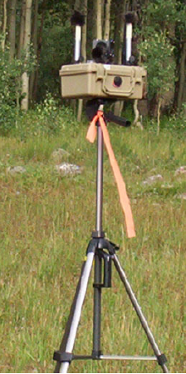
Acoustic Monitoring using VoxNet
VoxNet is a complete hardware and software platform for distributing acoustic monitoring applications.
Seminar in Distributed Computing

Slide 8
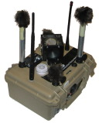




VoxNet architecture
On-line operation
Off-line operation and storage
Mesh Network of Deployed Nodes
Storage Server
Gateway
Internet or
Sneakernet
Compute Server
In-field PDA
Control Console
Seminar in Distributed Computing
Notes:
Animation here, run as narrative, similar to usage model – what we have here is the network deployed, you run an application, and then you can record the data and pass it back over the network, running the same things you did in the field
Give overview on how to use VoxNet
MAKE THE NARRATIVE!!

Slide 9

Programming VoxNet
Programming language: Wavescript
  High level, stream-oriented macroprogramming language
  Operates on stored OR streaming data
User decides where processing occurs (node, sink)
  Explicit, not automated processing partitioning
Source
Source
Endpoint
Source
Seminar in Distributed Computing
Notes:
Wavescript programs follow the macroprogramming approach; that is that the user treats the programming in terms of the result he or she wants from the platform as a whole, rather than each individual node’s contribution to the overall goal.
Programs are written as scripts, which define the flow of data from the source (nodes in our case) toward the sink. The data flows through stream processing operators (signal processing operators, or user-defined functions), which change or reduce it. The data arriving at the endpoint of the program is the final stream output of the program (i.e. a stream of energy calculations).
These programs are continuous: the data is continuously flowing through the operators, creating new streams of data.
As such, Wavescript is agnostic of the details of the data source – it can operate on stored data in exactly the same way as it would live data.
Wavescript has a library of useful operators, but also allows users to define their own.

Slide 10
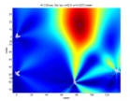
VoxNet on-line usage model
// acquire data from source, assign to four streams
(ch1, ch2 ch3, ch4) = VoxNetAudio(44100)
// calculate energy
freq = fft(hanning(rewindow(ch1, 32)))
bpfiltered = bandpass(freq, 2500, 4500)
energy = calcEnergy(bpfiltered)
Node-side part
Write
program
Optimizing
compiler
Sink-side part
Development cycle happens in-field, interactively
Run program
Disseminate
to nodes
Seminar in Distributed Computing
Notes:
Tell the story here:
Make more narrative..
User defined processing boundaries, but easy to change..

Slide 11
Hand-coded C vs. Wavescript
EVENT DETECTOR
DATA ACQUISITION
‘SPILL TO DISK’
Extra resources mean that data can be archived to disk as well as processed (‘spill to disk’, where local stream is pushed to storage co-processor)
30% less CPU
C
C
WS = Wavescript
Seminar in Distributed Computing
Notes:
We tested the resource usage of the local part of the acoustic localization program – i.e. event detection, in wavscope and also hand-coded C, created using the EmStar framework. This graph shows the relative break down in memory and CPU usage for the event detector, and the data acquisition code (interleaving samples, timestamping, putting data in correct format, disseminating to relevant parts of program).
We found that the Wavescript implementation used 30% less CPU and 12% less memory than the hand-coded C version. This was because we didn’t take advantage of EmStar’s inter-process communication mechanisms, instead compiling the relevant code straight into the Wavescript application. Whilst this reduces visibility as far as debugging was concerned, the original code was well tested and debugged, representing a solid base on which to build the software (i.e. we didn’t need it..).
Whilst the extra memory was not a huge gain, the extra processing cycles allowed us to implement an application level ‘spill-to-disk’, where the node could also save the full stream of data to disk, as well as apply processing to it. This was not possible in EmStar, due to the overhead.
We should also note that the network doesn’t provide significant overhead..
We also did some other benchmarks, but we don’t show those here.

Slide 12
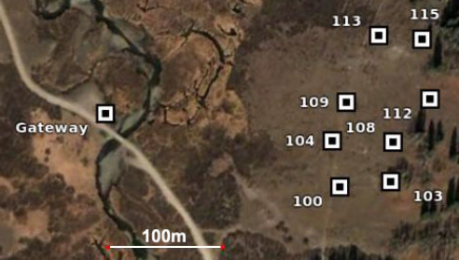
In-situ Application test
One-hop network-> extended size antenna on the gateway
Multi-hop network -> standard size antenna on the gateway
Seminar in Distributed Computing

Slide 13
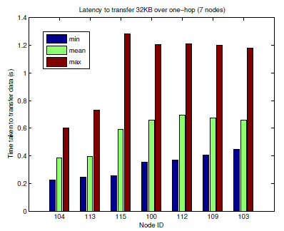
Detection data transfer latency for one-hop network
Seminar in Distributed Computing

Slide 14
Detection data transfer latency for multi-hop network
Network latency will become a problem if scientist wants results in <5 seconds (otherwise animal might move position)
Seminar in Distributed Computing

Slide 15
General Operating Performance
To examine regular application performance -> run application for 2 hours
  683 events by mermot vocalization
  5 out of 683 detections dropped(99.3% success rate)
  Failure due to overflow of 512K network buffer
Deployment during rain storm
  Over 436 seconds -> 2894 false detections
  Successful transmission -> 10% of data generated
  Ability to deal with overloading in a graceful manner
Seminar in Distributed Computing

Slide 16
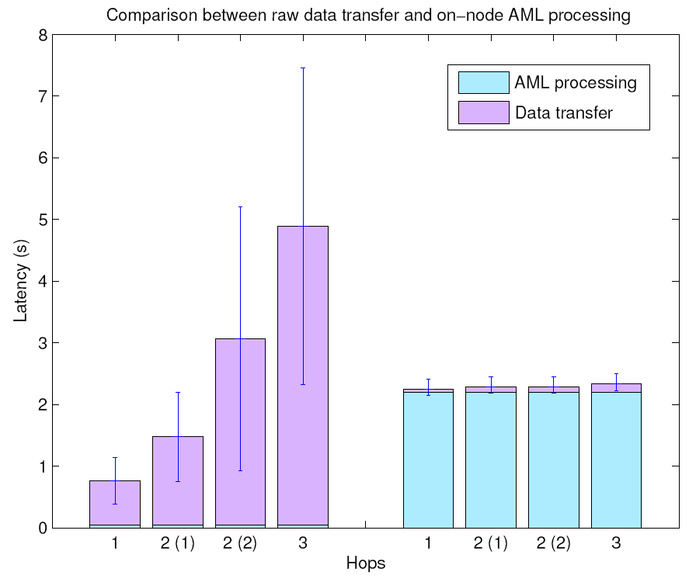
Local vs. sink processing trade-off
NETWORK LATENCY
Data PROCESSING TIME
Send raw data, process at sink
Process locally, send 800B
As hops from sink increases, benefit of processing Data locally is clearly seen
Data processing
Seminar in Distributed Computing
Notes:
Make text larger!! ADD A PUNCHLINE!!!
For a multi-hop network, the right thing to do is process locally, but if buffer overflows then we send over the network and hope for the best

Slide 17
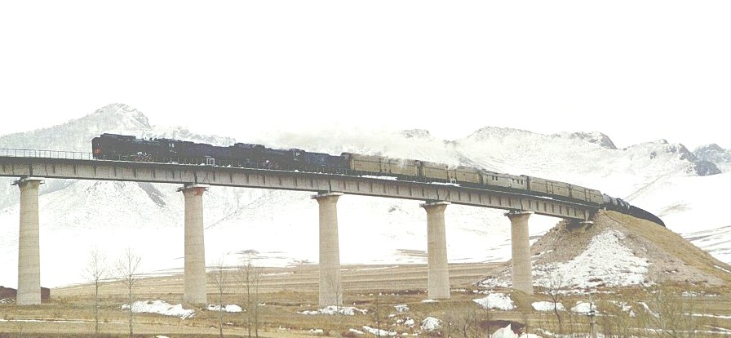
Motivation for Reliable Bulk data Transport Protocol
Power Efficiency
Interference
Bulky Data
sink
Source
Seminar in Distributed Computing

Slide 18
Goals of Flush
Reliable delivery
  End-to-End NACK
Minimize transfer time
  Dynamic Rate Control Algo.
Take care of Rate miss-match
  Snooping mechanism
Seminar in Distributed Computing

Slide 19
Challenges
Links – Lossy
Interference
  Interpath (more flows)
  Intra-path (same flow)
Overflow of queue of intermediate nodes
A
B
A
B
C
C
D
Intra-path interference
Interpath interference
Seminar in Distributed Computing

Slide 20
Assumptions
Isolation The sink schedule is implemented so inter-path interference is not present. Slot mechanism.
Snooping
Acknowledgements Link layer ack. are efficient
Forward routing Routing mechanism is efficient
Reverse Delivery For End-to-End acknowledgements.
1
2
3
4
5
6
7
8
9
0
Seminar in Distributed Computing

Slide 21
How it works
Red – Sink (receiver)
Blue – Source (sensor)
4 Phases
  Topology query
  Data transfer
  Acknowledgement
  Integrity check
Request the data
Sends the data as reply
Sends selective negative ack. if some packet is not received correctly
Sends the packets not received correctly.
Seminar in Distributed Computing

Slide 22
Reliability
Source
Sink
1
2
3
4
5
6
7
8
9
2, 4, 5
1
2
3
4
5
6
7
8
9
2
4
5
1
2
3
4
5
6
7
8
9
4, 9
1
2
3
4
5
6
7
8
9
4, 9
1
2
3
4
5
6
7
8
9
4
9
1
2
3
4
5
6
7
8
9
Seminar in Distributed Computing

Slide 23
Rate control: Conceptual Model Assumptions
Nodes can send exactly one packet per time slot
Nodes can not send and receive at same time
Nodes can only send and receive packets from nodes one hop away
Variable range of Interference I may exist
Seminar in Distributed Computing

Slide 24
Rate control: Conceptual Model
For N = 1
Rate = 1
Node 1
Base- Station
Packet Transmission
Interference
Seminar in Distributed Computing

Slide 25
Rate control: Conceptual Model
For N = 2
Rate = 1/2
Node 2
Node 1
Base- Station
Packet Transmission
Interference
Seminar in Distributed Computing

Slide 26
Rate control: Conceptual Model
For N >= 3 Interference = 1
Rate = 1/3
Node 3
Node 2
Node 1
Base- Station
Packet Transmission
Interference
Seminar in Distributed Computing

Slide 27
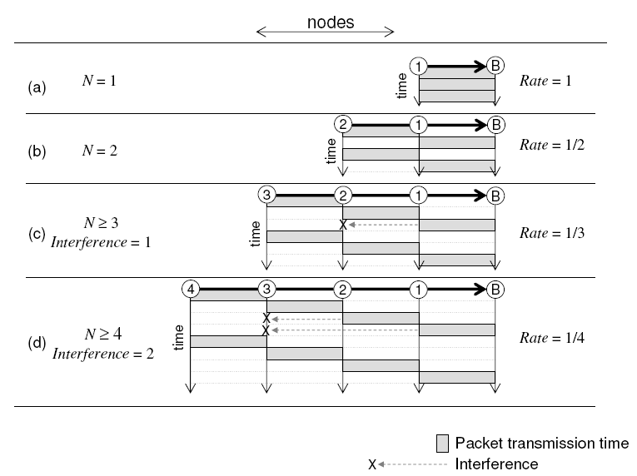
Rate control: Conceptual Model
Seminar in Distributed Computing

Slide 28
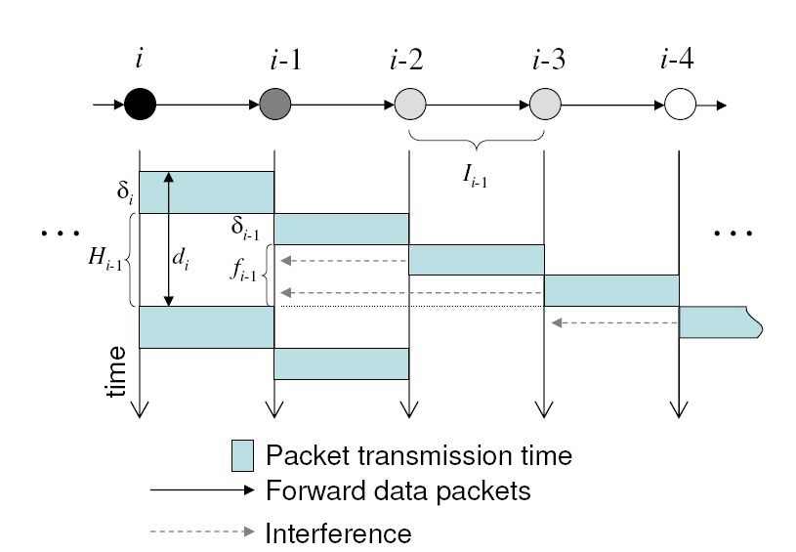
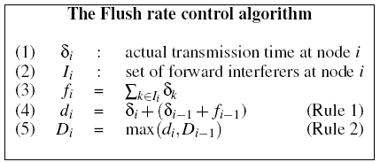
Dynamic Rate Control
Rule – 1
A node should only transmit when its successor is free from interference.
Rule – 2
A node’s sending rate cannot exceed the sending rate of its successor.
Seminar in Distributed Computing

Slide 29
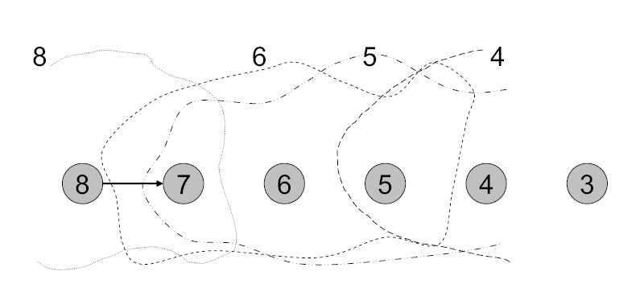
Dynamic rate Control (cont…)
D_{i} = max(d_{i}, D_{i-1})
Seminar in Distributed Computing

Slide 30
Performance Comparison
Fixed-rate Algorithm: In such an algorithm data is sent after a fixed interval.
ASAP(As soon as Possible): It’s a naïve transfer algorithm that sends a packet as soon as last packet transmission is done.
Seminar in Distributed Computing

Slide 31
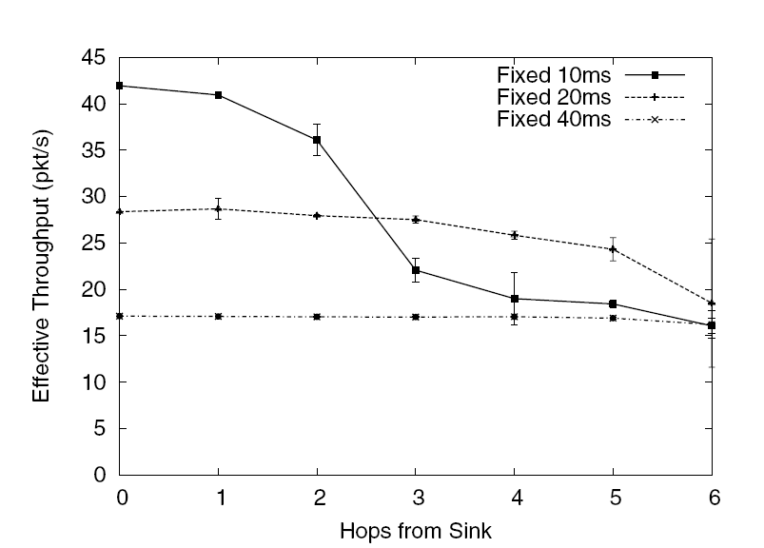
Preliminary experiment
Throughput with different data collection periods.
Observation
There is tradeoff between the throughput achieved to the period at which the data is sent.
Because of queue overflow
Mittwoch, 10. März 2010
Seminar in Distributed Computing

Slide 32
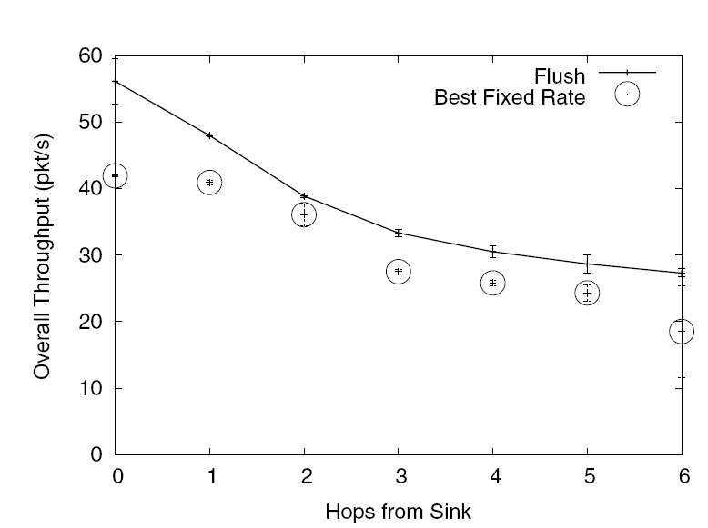
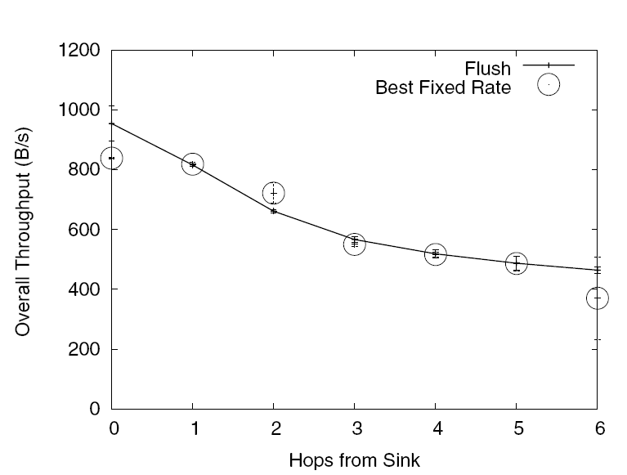
Flush Vs Best Fixed Rate
Because of protocol overhead
The delivery of the packet is better then fixed rate, but because of the protocol overhead some times the byte throughput suffers.
Seminar in Distributed Computing

Slide 33
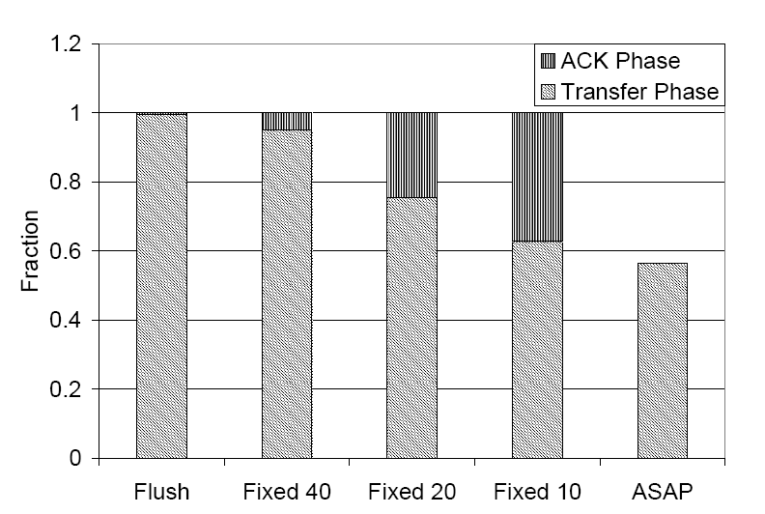
Reliability check
99.5 %
95 %
Hop – 6th
77 %
62 %
47 %
Seminar in Distributed Computing

Slide 34
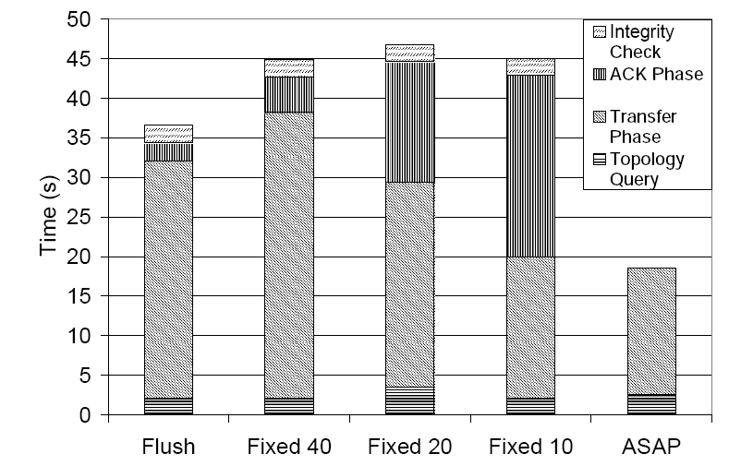
Timing of phases
Seminar in Distributed Computing

Slide 35
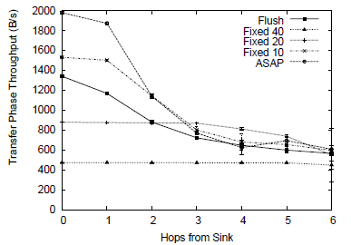
Transfer Phase Byte Throughput
Transfer phase byte throughput. Flush results
take into account the extra 3-byte rate control
Header. Flush
achieves a good fraction of the throughput of “ASAP”, with a 65% lower loss rate.
Seminar in Distributed Computing

Slide 36
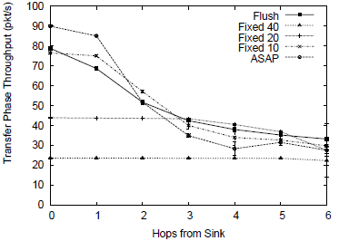
Transfer Phase Packet Throughput
Transfer phase packet throughput. Flush provides
comparable throughput with a lower loss rate.
Seminar in Distributed Computing

Slide 37
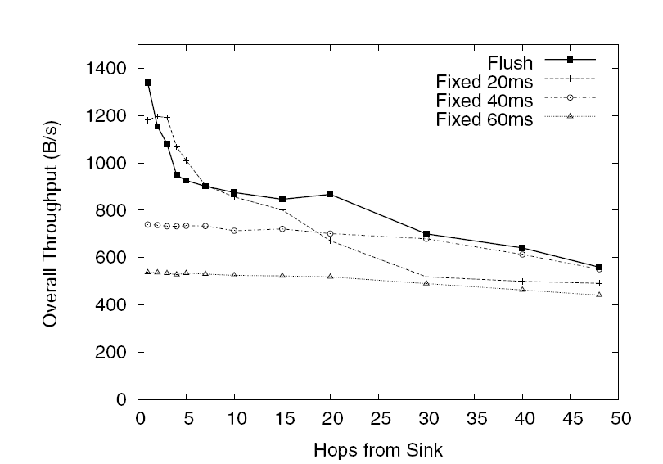
Real world Experiment
Real world experiment
79 nodes
48 Hops
3 Bytes Flush Header
35 Bytes payload
3/10/2010
Seminar in Distributed Computing
Notes:
In paper it is written diagram of network is given in figure 20, but there is no figure 20 in paper… if possible I would like to show this figure.

Slide 38
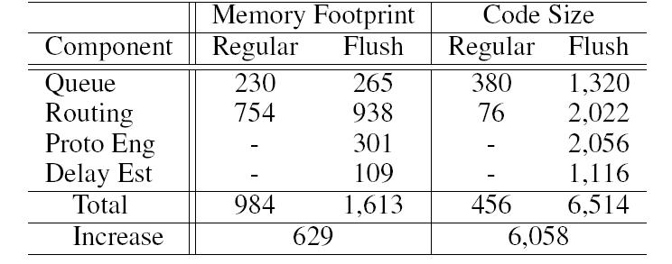
Evaluation – Memory and code footprint
3/10/2010
Seminar in Distributed Computing

Slide 39
Conclusion
VoxNet is easy to deploy and flexible to be used in different applications.
The usage of rate based algorithms are better than the window based algorithms.
Flush is one of the good algorithms when the nodes are somewhat in chain topology
Seminar in Distributed Computing

Slide 40
Refrences
VoxNet: An Interactive Rapidly Deployable Acoustic Monitoring Protocol By
  Michel Allen Cogent Computing ARC Coventry University
  Lewis Girod, Ryan Newton, Samuel Madden, MIT/CSAIL
  Daniel Blumstein, Deborah Estrin, CENS, UCLA
Flush: A Reliable Bulk Transport Protocol for Multihop Wireless Networks By
  Sakun Kim, Rodrigo Fonsecca, Prabal Dutta, Arsalan Tavakoli, David Culler, Philip Levis, Computer Science Division, UC Berkeley
  Scott Shenker, ICSI 1947 Center Street Berkeley, CA 94704
  Ion Stoica, Computer Systems Lab, Satnford University
Seminar in Distributed Computing

Slide 41
Questions?
Seminar in Distributed Computing

