Slide 1
SpiderBat: Augmenting Wireless Sensor Networks with Distance and Angle Information
Georg Oberholzer, Philipp Sommer, Roger Wattenhofer

Slide 2
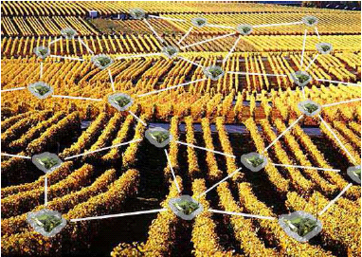
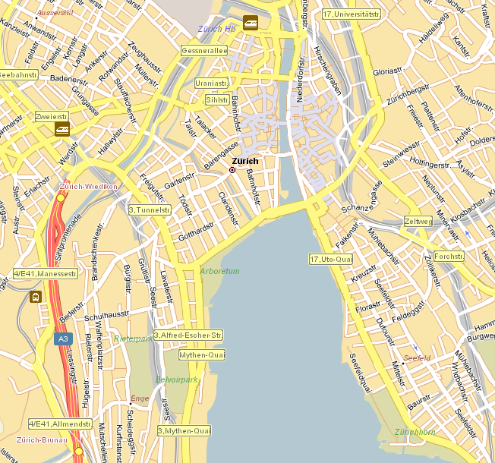
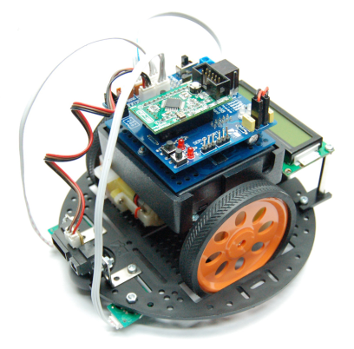
Location in Wireless Sensor Networks
Context of sensor readings
<location, time, value>
Leverage location information
Network layer: geographic routing
Physical layer: transmission power control
Learn about the current node position
Nodes might be attached to moving objects
Alice
Bob

Slide 3
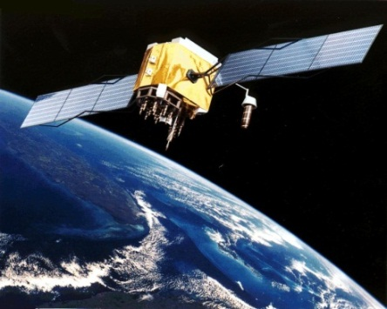
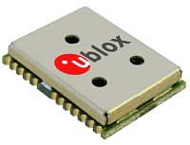
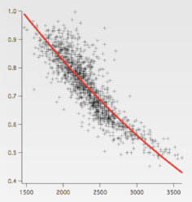
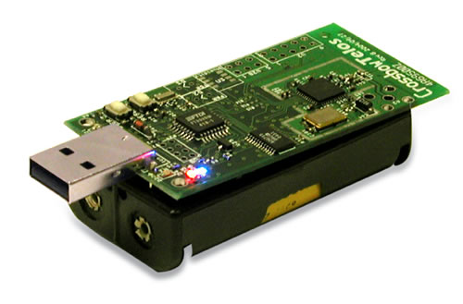
Learning the Position of Sensor Nodes
Global Positioning System (GPS)
Not for indoor applications
Special hardware required
High power consumption
Radio-based (connectivity/signal strength)
High node density required
Limited accuracy (multipath effects)

Slide 4
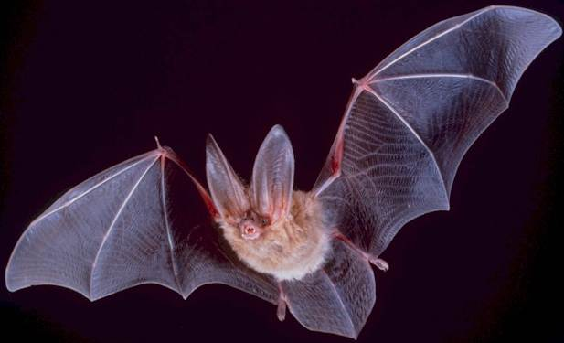
Positioning with Ultrasound
Inspired by nature ...
Human hearing range: 20 – 20,000 Hz
20 – 120,000 Hz

Slide 5
Ultrasound meets Sensor Networks
High accuracy
Speed of sound c = 343 m/s
Low complexity
Simple analog circuits for signal processing and peak detection
Energy efficiency
Short pulses (e.g. 250 microseconds)
Duty-cycling ultrasound transmitter/receivers
 | TelosB/Tmote Sky | MicaZ/IRIS
Clock speed | 32 kHz | 1 MHz
Resolution | 1.04 cm | 0.343 mm

Slide 6
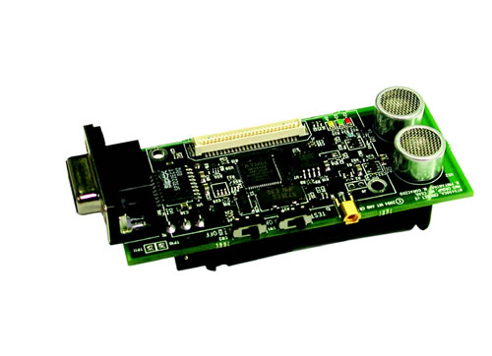
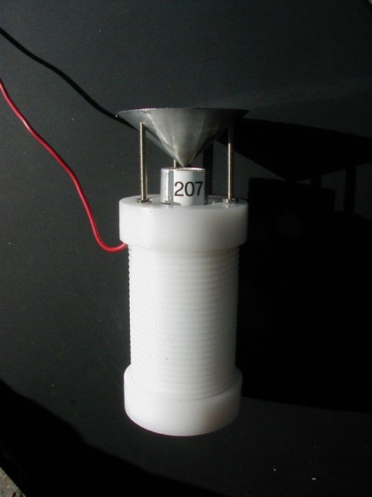
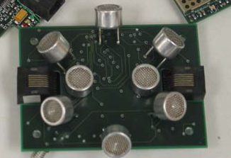
Related Work
Cricket
[Priyantha et al., 2000]
Calamari
Medusa
[Savvides et al., 2001]
[Whitehouse et al., 2004]

Slide 7
Ultrasound Ranging
Time difference of arrival (TDoA) between radio and ultrasound:
Radio packet wakes up ultrasound receivers
Ultrasound pulse is sent after a constant delay
Sender
Receiver
t

Slide 8
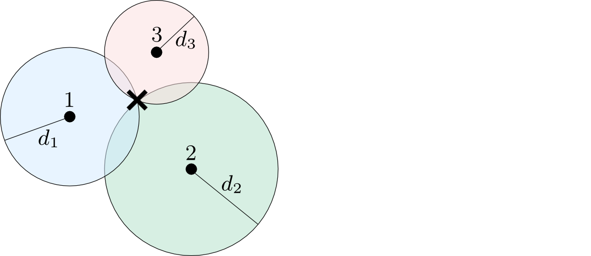
Distance based Positioning in Sensor Networks
Determine position based on distances to anchor nodes (trilateration)
3 anchor nodes

Slide 9
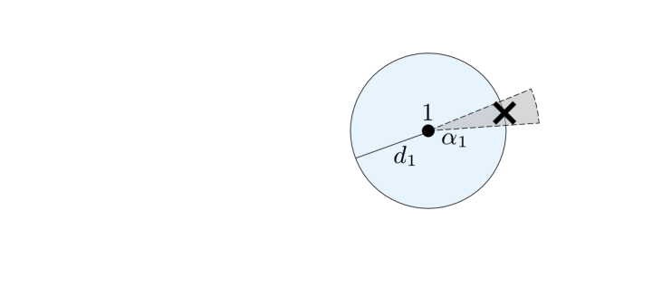
Positioning in Sparse Networks
How does angle information help to position nodes?
3 anchor nodes
1 anchor node

Slide 10
The SpiderBat Ultrasound Platform
4x Ultrasound Receivers @ 40 kHz
6.5 cm (2.56 inches)
4x Ultrasound Transmitters @ 40 kHz
Digital Compass

Slide 11
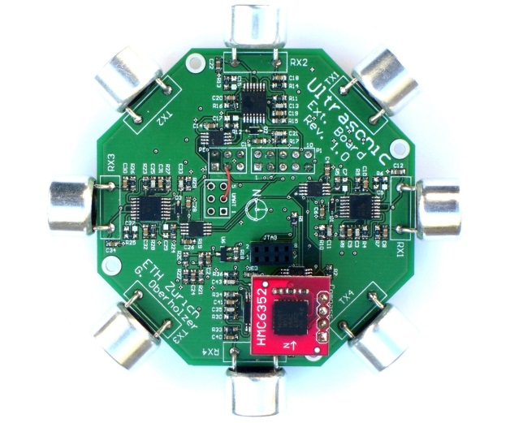
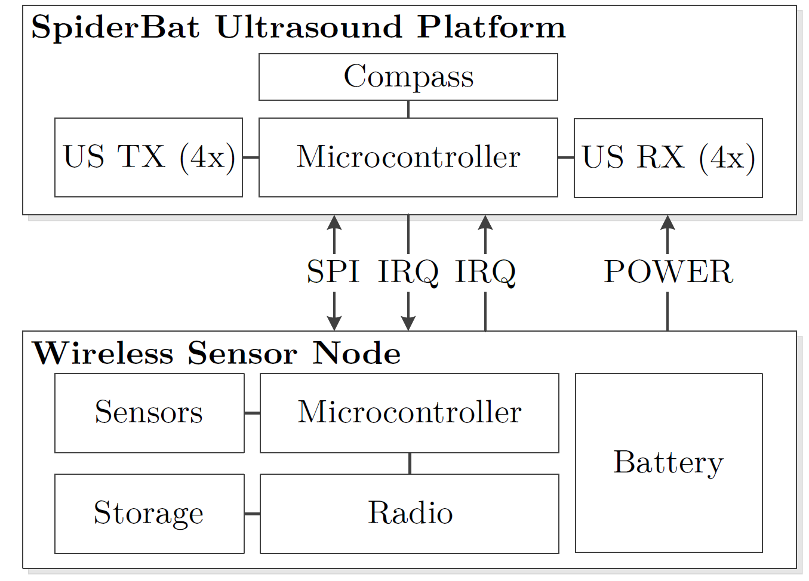
System Architecture
SpiderBat is an extension board for wireless sensor nodes

Slide 12
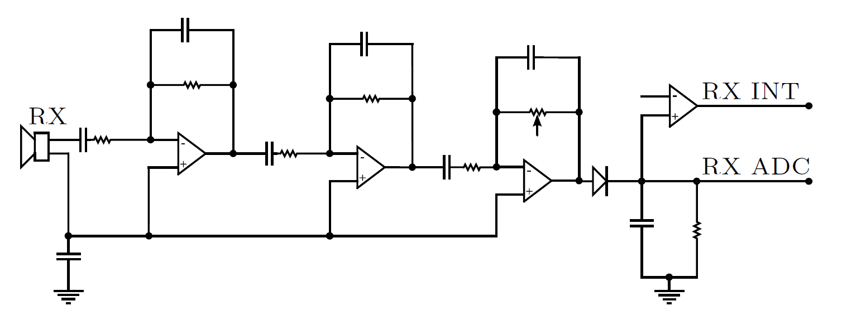
Ultrasound Receiver Circuits
Three amplification stages with a total gain of 58-75 dB
Each receiver provides two output signals:
Digital comparator output generates an interrupt signal (RX_INT)
Analog signal output (RX_ADC)

Slide 13
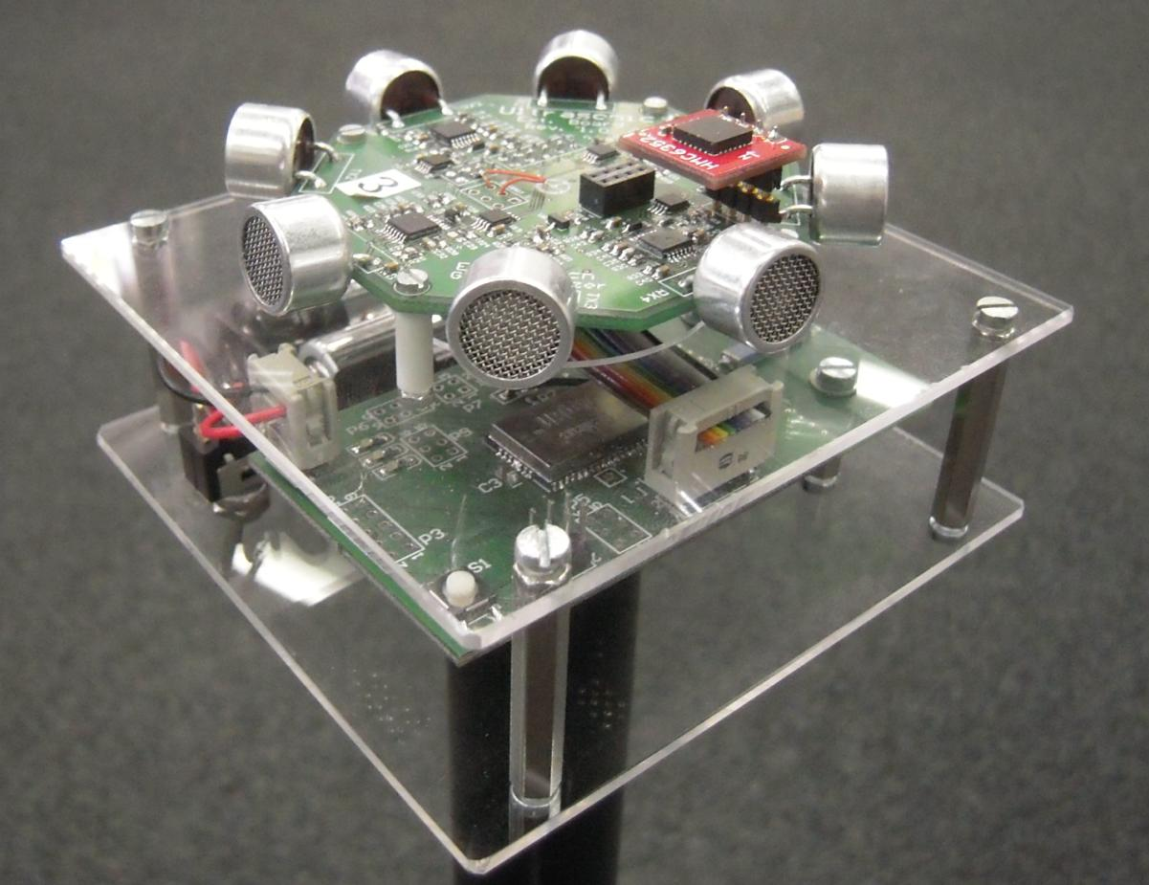
Experimental Evaluation
Prototype Hardware
SpiderBat extension board
Atmel ZigBit900 (Atmega1281 MCU + RF212 radio)
Software
Ultrasound ranging application implemented in TinyOS 2.1
Distance/angle/compass information forwarded to a base station

Slide 14
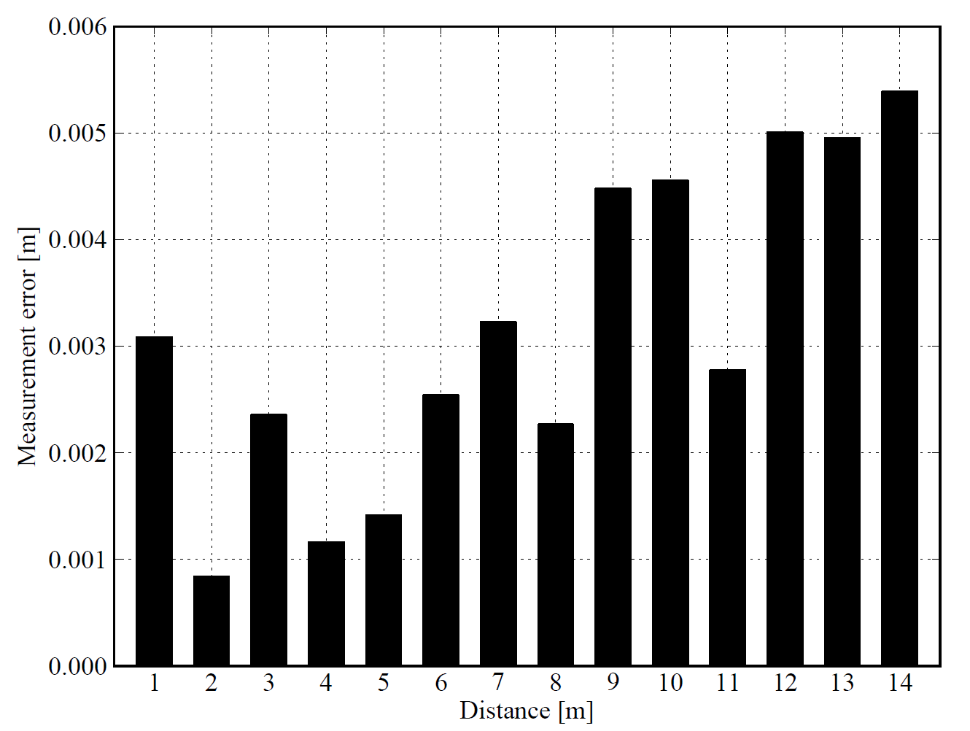
Accuracy of Distance Measurements
Measurement errors are in the order of a few millimeters
Std. dev of error is 5.39 mm (0.21 inch) at 14 m (45.9 feet)

Slide 15
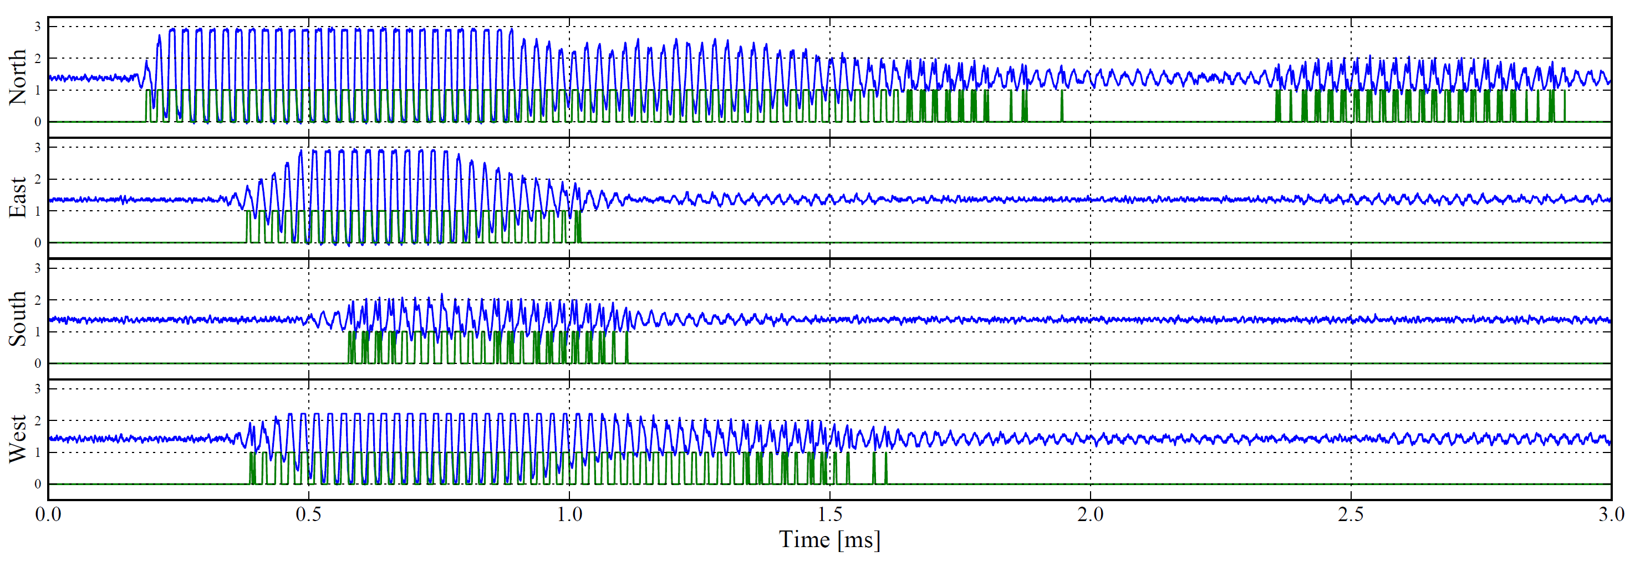
Angle-of-Arrival Measurements with SpiderBat
Receiver
Sender
West
South
North
East
Tn
Te,Tw
Ts

Slide 16
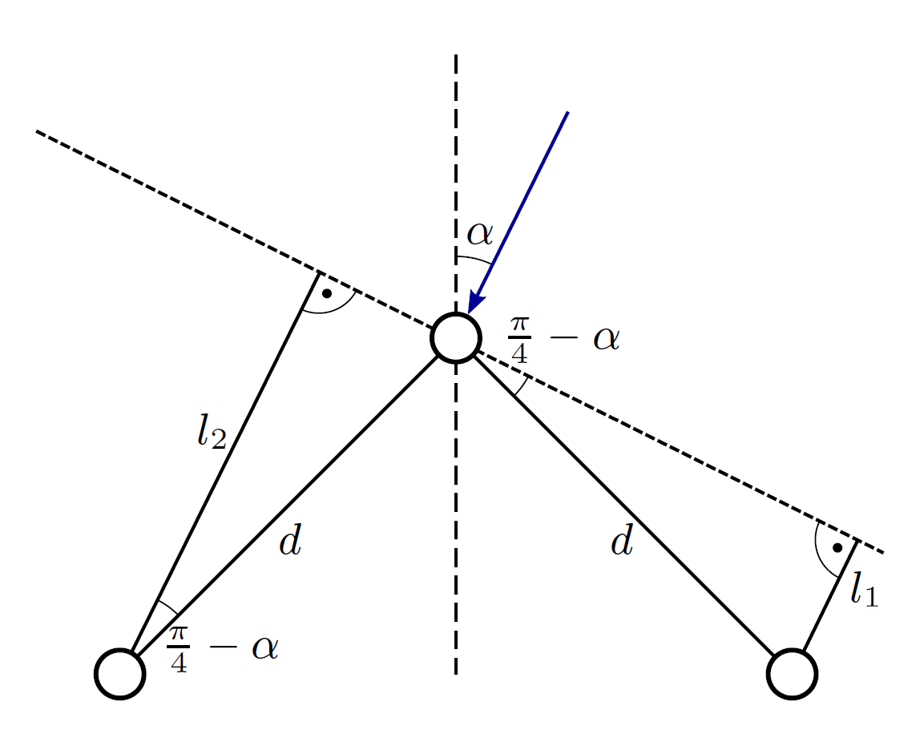
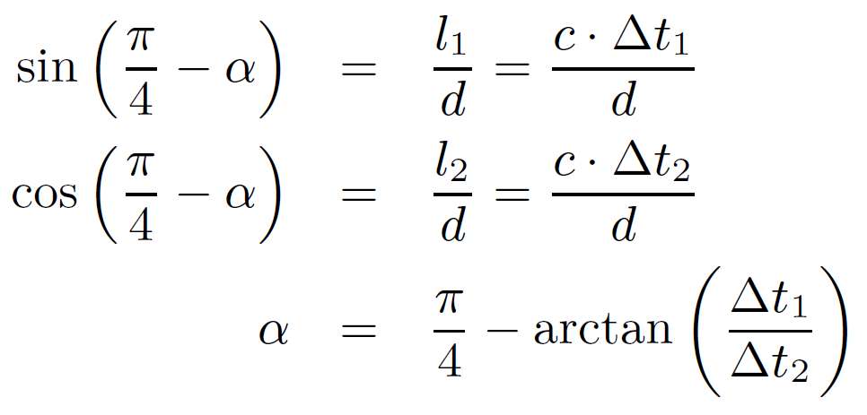
Angle-of-Arrival Estimation
We can calculate the angle based on the TDoA at the receivers

Slide 17
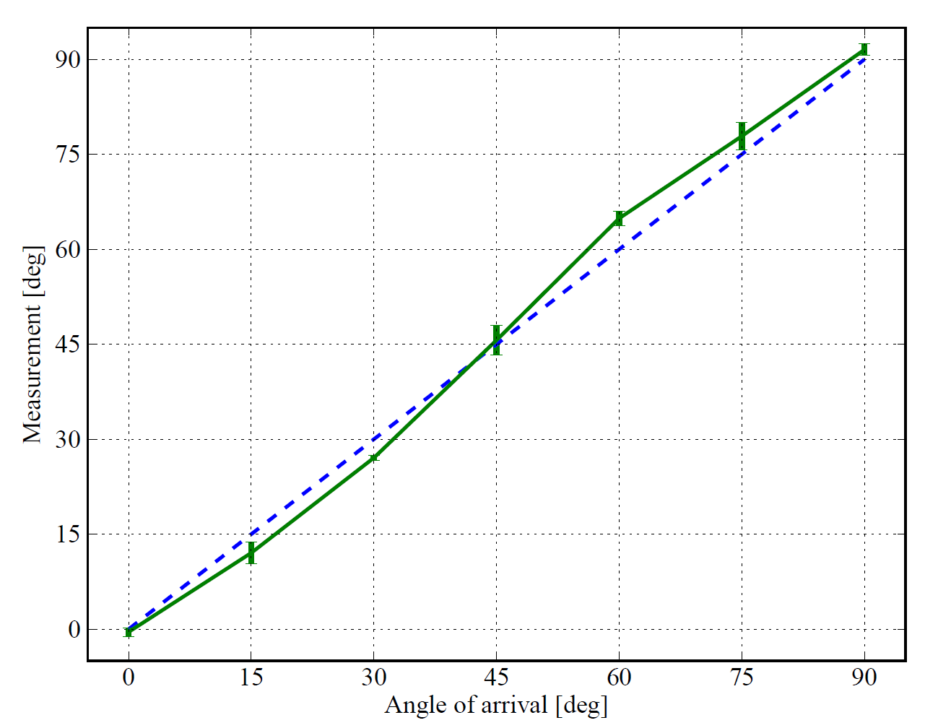
Accuracy of Angle Measurements
Estimation of the angle-of-arrival within a few degrees
Error is less than 5° for short distances between sender and receiver

Slide 18
Indoor Experiments
4 nodes placed in a gym hall, single anchor node (Node 1)
200 measurements for each node
Anchor
Anchor
Step 1: Distance + angle to nearest neighbor
Step 2: Minimize distance errors (method of least squares)
Std. dev. < 15.5 cm (6.1 inch)
Std. dev. < 5.7 cm (2.2 inch)

Slide 19
Non Line-of-Sight Propagation
What if the direct path between two nodes is obstructed?
Two nodes are in line-of-sight if:
Node 1
Node 2

Slide 20
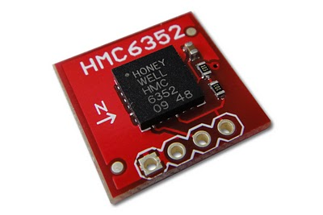
Non Line-of-Sight Propagation
We use the digital compass to get the node orientation
Magnetic North
North
Angle of arrival
Honeywell HMC6352
We can use the digital compass to identify non-line of sight paths

Slide 21
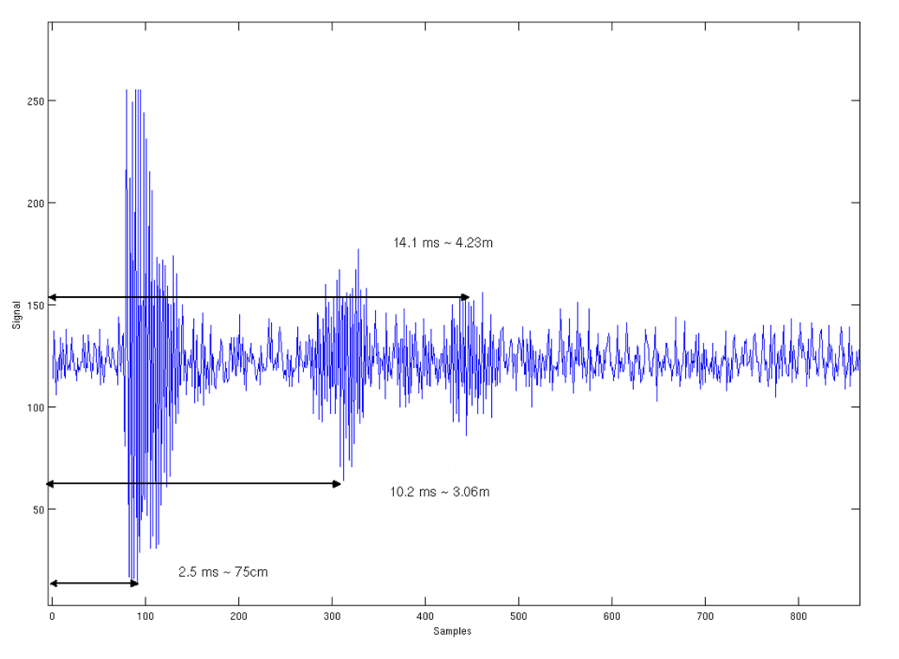
Outlook: Learning about the Proximity of Nodes
Sampling the received ultrasound signal
Idea: Identify reflection at nearby obstacles

Slide 22
Conclusions
SpiderBat platform
Ultrasound extension board for sensor nodes
Distance and angle measurements
Digital compass
Experiments
Std. dev. of localization error below 5.7 cm (indoor setup)
Non-line of sight propagation
Detect obstacles between nodes

