Slide 1
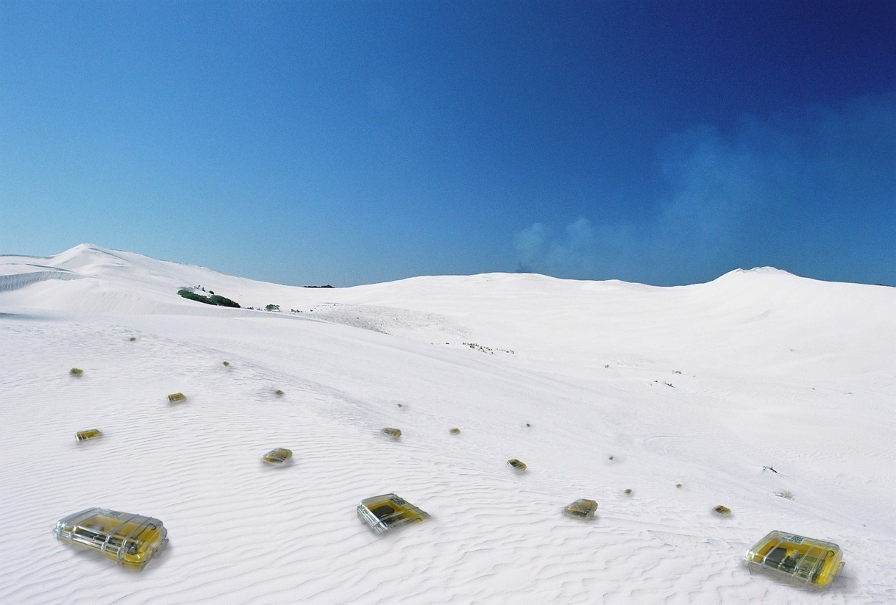

Capacity
Chapter 12
TexPoint fonts used in EMF.
Read the TexPoint manual before you delete this box.: AAAAAAAAA

Slide 2
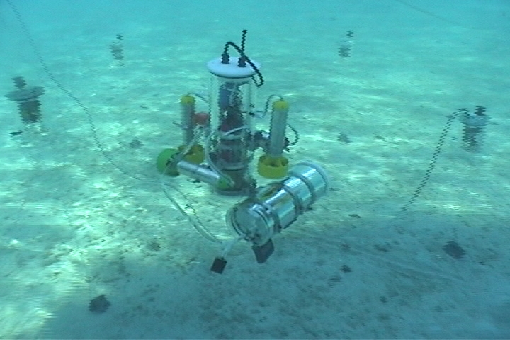

Underwater Sensor Networks
Static sensor nodes plus mobile robots
Dually networked
  optical point-to-point transmission at 300kb/s
  acoustical broadcast communication at 300b/s, over hundreds of meters range.
Project AMOUR
[MIT, CSIRO]
Experiments
  ocean
  rivers
  lakes

Slide 3
Rating
Area maturity
Practical importance
Theory appeal
First steps Text book
No apps Mission critical
Boooooooring Exciting

Slide 4
Overview
Capacity and Related Issues
Protocol vs. Physical Models
Capacity in Random Network Topologies
Achievable Rate of Sensor Networks
Scheduling Arbitrary Networks

Slide 5
Fundamental Questions
How much communication can you have in a wireless network?
How long does it take to meet a given communication demand?
How much spatial reuse is possible?
What is the capacity of a wireless network?
Many modeling issues are connected with these questions.
You can ask these questions in many different ways that all make perfect sense, but give different answers.
In the following, we look at a few results in this context, unfortunately only superficially.

Slide 6
Motivation
Spatial capacity is an indicator of the “data intensity” in a transmission medium.
The capacity of some well-known wireless technologies
  IEEE 802.11b 1,000 bit/s/m²
  Bluetooth 30,000 bit/s/m²
  IEEE 802.11a 83,000 bit/s/m²
  Ultra-wideband 1,000,000 bit/s/m²
The wireless capacity is a function of the physical layer characteristics such as available bandwidth or frequency, but also how well the protocols on top of the physical layer are implemented, in particular media access. As such capacity is a theoretical framework for MAC protocols.

Slide 7
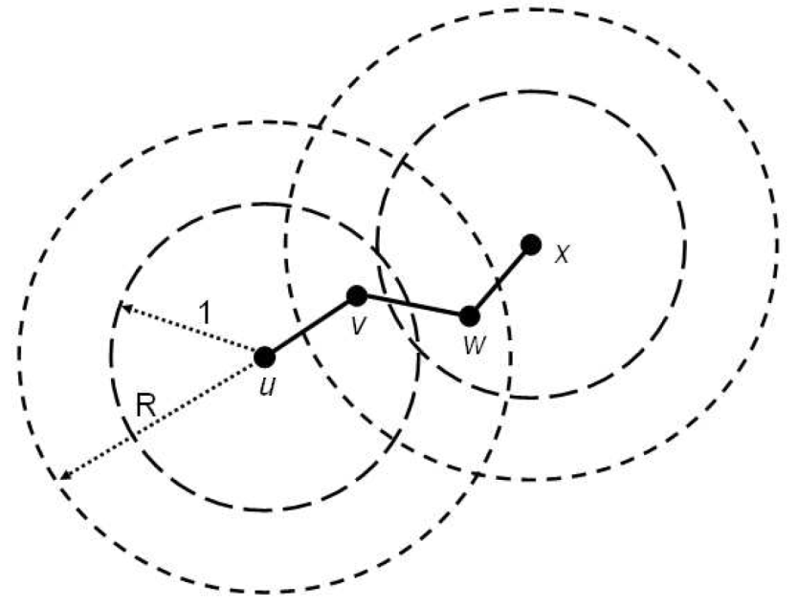
Protocol Model
For lower layer protocols, a model needs to be specific about interference. A simplest interference model is an extension of the UDG. In the protocol model, a transmission by a node in at most distance 1 is received iff there is no conflicting transmission by a node in distance at most R, with R ¸ 1, sometimes just R = 2.
+ Easy to explain
– Inherits all major drawbacks from the UDG model
– Does not easily allow for designing
distributed algorithms/protocols
– Lots of interfering transmissions just
outside the interference radius R do
not sum up
Can be extended with the same
extensions as UDG, e.g. QUDG

Slide 8
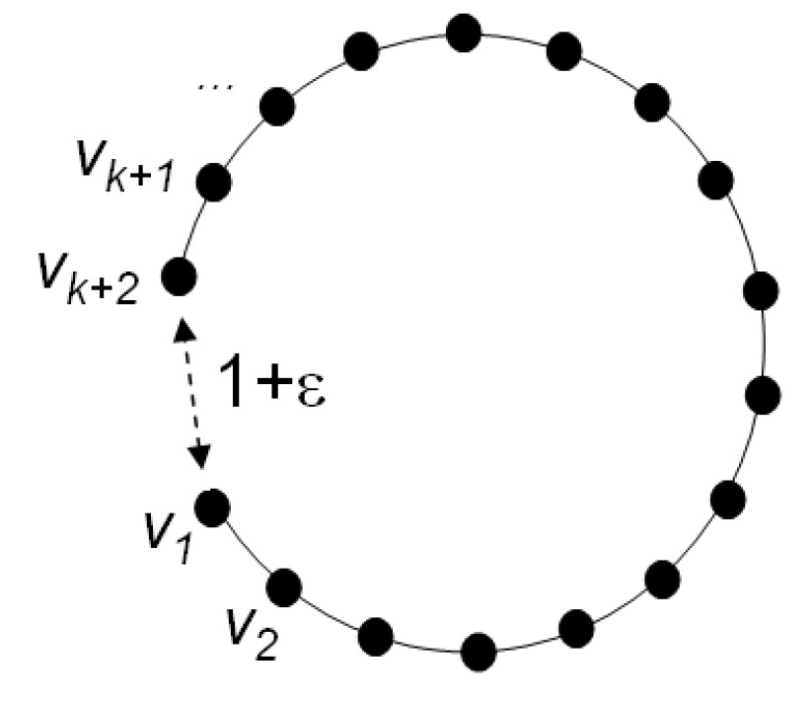
Hop Interference (HI)
An often-used interference model is hop-interference. Here a UDG is given. Two nodes can communicate directly iff they are adjacent, and if there is no concurrent sender in the k-hop neighborhood of the receiver (in the UDG). Sometimes k = 2.
Special case of the protocol model,
inheriting all its drawbacks
+ Simple
+ Allows for distributed algorithms
– A node can be close but not
produce any interference
(see picture)
Can be extended with the same
extensions as UDG, e.g. QUDG

Slide 9
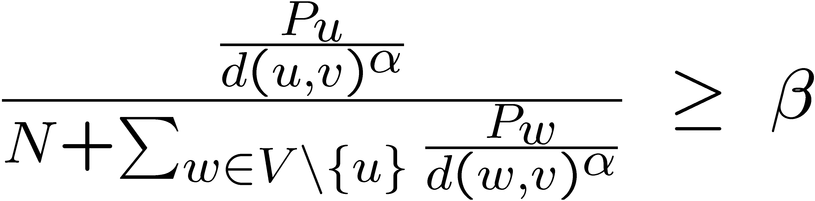
Physical (SINR) Model
We look at the signal-to-noise-plus-interference (SINR) ratio.
Message arrives if SINR is larger than β at receiver
Mind that the SINR model is far from perfect as well.
Power level of sender u
Path-loss exponent, ® = 2,...,6
Noise
Minimum signal-to-interference ratio, depending on quality of hardware, etc.
Distance between
transmitter w and receiver v

Slide 10
SINR Discussion
+ In contrast to other low-layer models such as PM the SINR model allows for interference that does sum up. This is certainly closer to reality. However, SINR is not reality. In reality, e.g., competing transmissions may even cancel themselves, and produce less interference. In that sense the SINR model is pessimistic (interference summing up) and optimistic (if we remove the “I” from the SINR model, we have a UDG, which we know is not correct) at the same time.
– SINR is “complicated”, hard to analyze
– Similarly as PM, SINR does not really allow for distributed algorithms
– Also, in reality, e.g. the signal fluctuates over time. Some of these issues are captured by more complicated fading channel models.

Slide 11
More on SINR
Often there is more than a single threshold ¯, that decides whether reception is possible or not. In many networks, a higher S/N ratio allows for more advanced modulation and coding techniques, allowing for higher throughput (e.g. Wireless LAN 802.11)
However, even more is possible: For example, assume that a receiver is receiving two signals, signal S₁ being much stronger than signal S₂. Then S₂ has a terrible S/N ratio. However, we might be able to “subtract” the strong S₁ from the total signal, and with “S – S₁ = S₂” also get S₂.
These are just two examples of how to get more than you expect.

Slide 12
Model Overview
[Algorithmic Models for Sensor Networks, Schmid et al., 2006]
Try to proof correctness in an as “high” as possible model
For efficiency, a more optimistic (“lower”) model is fine
Lower bounds should be proved in “low” models.

Slide 13
Measures for Network Capacity
Throughput capacity
  Number of successful packets delivered per time
  Dependent on the traffic pattern
  E.g.: What is the maximum achievable, over all protocols, for a random node distribution and a random destination for each source?
Transport capacity
  Network transports one bit-meter when one bit has been transported a distance of one meter
  Number of bit-meters transported per second
  What is the maximum achievable, over all node locations,
  and all traffic patterns, and all protocols?

Slide 14
Transport Capacity
n nodes are arbitrarily located in a unit disk
We adopt the protocol model with R=2, that is a transmission is successful if and only if the sender is at least a factor 2 closer than any interfering transmitter. In other words, each node transmits with the same power, and transmissions are in synchronized slots.
What configuration and traffic pattern will yield the highest
transport capacity?
Idea: Distribute n/2 senders uniformly in the unit disk. Place the n/2 receivers just close enough to senders so as to satisfy the threshold.

Slide 15
Transport Capacity: Example
sender
receiver

Slide 16
Transport Capacity: Understanding the example
Sender-receiver distance is £(1/√n). Assuming channel bandwidth W [bits], transport capacity is £(W√n) [bit-meter], or per node: £(W/√n) [bit-meter]
Can we do better by placing the source-
destination pairs more carefully? Not really:
Having a sender-receiver pair at distance d
inhibits another receiver within distance up
to 2d from the sender. In other words, it kills
an area of £(d²).
We want to maximize n transmissions with distances d₁, d₂, …, d_{n} given that the total area is less than a unit disk. This is maximized if all d_{i} = £(1/√n). So the example was asymptotically optimal.
  BTW, a fun geometry problem: Given k circles with total
  area 1, can you always fit them in a circle with total area 2?
d

Slide 17
More capacities…
The throughput capacity of an n node random network is
There exist constants c and c‘ such that
Transport capacity:
  Per node transport capacity decreases with
  Maximized when nodes transmit to neighbors
Throughput capacity:
  For random networks, decreases with
  Near-optimal when nodes transmit to neighbors
In one sentence: local communication is better...

Slide 18
Even more capacities…
Similar claims hold in the physical (SINR) model as well…
Results are unchanged even if the channel can be broken into
subchannels
There are literally thousands of results on capacity, e.g.
  on random destinations
  on power-law traffic patterns
  (probability to communicate to a close-by destination is higher)
  communication through relays
  communication in mobile networks
  etc.
Problem: The model assumptions are sometimes quite
optimistic, if not unrealistic…
Q: What is the capacity of non-random networks?

Slide 19


Data Gathering in Wireless Sensor Networks
Data Gathering & Aggregation
  Classic application of sensor networks
  Sensor nodes periodically sense environment
  Relevant information needs to be transmitted to sink
Functional Capacity of Sensor Networks
  Sink periodically wants to compute a function f_{n} of sensor data
  At what rate can this function be computed?
(1)
(2)
(3)
f_{n}
,f_{n}
,f_{n}
sink
Notes:
19

Slide 20
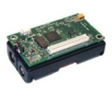

The Simple Round-Robin Scheme
Each sensor reports its results directly to the sink (one after another).
Sink can compute one
function per n rounds
→ Achieves a rate of 1/n
sink
x₁=7
x₂=6
x₃=4
(1)
f_{n}
(2)
f_{n}
x₄=3
(3)
x₈=5
f_{n}
(4)
x₇=9
f_{n}
t
x₅=1
x₆=4
x₉=2
Notes:
20

Slide 21
Is there a better scheme?!?
Multi-hop relaying
In-network processing
Spatial Reuse
Pipelining
…?!?
sink
(1)
f_{n}
(2)
f_{n}
(3)
f_{n}
(4)
f_{n}
t
Notes:
21

Slide 22
Capacity in Wireless Sensor Networks
At what rate can sensors transmit data to the sink?
Scaling-laws → how does rate decrease as n increases…?
Θ(1/n)
Θ(1/√n)
Θ(1/log n)
Θ(1)
Answer depends on
Function to be computed
Coding techniques
Network topology
Wireless model
Only simple functions
(max, min, avg,…)
No network coding
Notes:
22

Slide 23
Practical relevance?
Efficient data gathering!
Efficient MAC layer!
This (and related) problem is studied theoretically:
The Capacity of Wireless Networks
Gupta, Kumar, 2000
[Arpacioglu et al, IPSN’04]
[Giridhar et al, JSAC’05]
[Barrenechea et al, IPSN’04]
[Liu et al, INFOCOM’03]
[Grossglauser et al, INFOCOM’01]
[Toumpis, TWC’03]
[Gamal et al, INFOCOM’04]
[Kyasanur et al, MOBICOM’05]
[Kodialam et al, MOBICOM’05]
[Gastpar et al, INFOCOM’02]
[Li et al, MOBICOM’01]
[Mitra et al, IPSN’04]
[Zhang et al, INFOCOM’05]
[Bansal et al, INFOCOM’03]
[Dousse et al, INFOCOM’04]
[Yi et al, MOBIHOC’03]
[Perevalov et al, INFOCOM’03]
etc…
Notes:
23

Slide 24
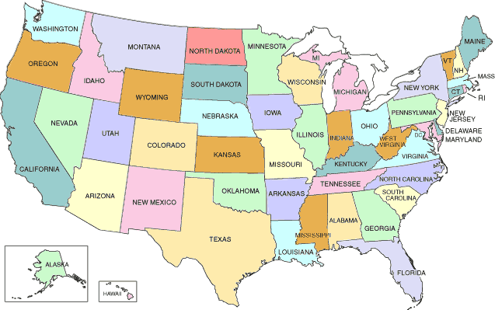
Network Topology?
Almost all capacity studies so far make very strong assumptions
on node deployment, topologies
  randomly, uniformly distributed nodes
  nodes placed on a grid
  etc.
What if a network
looks differently…?
Notes:
24

Slide 25
Capacity for Arbitrary/Worst-Case Network Topologies
What can one say about worst-case node distributions?
What can one say about arbitrary node distributions?
Real Capacity
How much information can be
transmitted in any network?
“Classic” Capacity
Worst-Case Capacity
How much information can be
transmitted in nice networks?
How much information can be
transmitted in nasty networks?
Notes:
25

Slide 26
Wireless Models
Several models for wireless communication
  Connectivity-only models (e.g. UDG, QUDG, BIG, UBG, etc.)
  Interference models
    Protocol models
      Two Radii model with constant power (e.g. UDG with interference radius R=2).
      Nodes may use power control (transmission and interference disks of different size)
    Physical models
      SINR with constant power (every node transmitting with the same power)
      SINR with power control (nodes can choose power)
      Etc.
Premise: Fundamental results should not depend on model!
  And indeed, classical capacity (assuming e.g. random or regular node distribution) results are similar in all the models above
  Are there any examples where results depend on model?!
Notes:
26

Slide 27

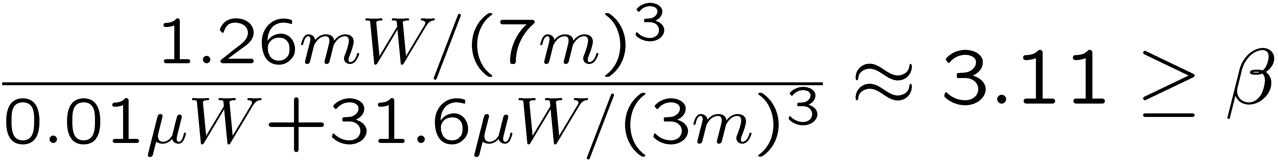

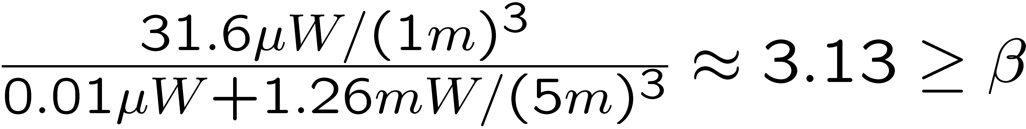
Simple Example
A sends to D, B sends to C:
A
B
C
D
4m
1m
2m
Assume a single frequency (and no fancy decoding techniques!)
Let α=3, β=3, and N=10nW
Transmission powers: P_{B}= -15 dBm and P_{A}= 1 dBm
SINR of A at D:
SINR of B at C:
NO
In almost all models…
Is spatial reuse possible?
YES
SINR w/ power control
Notes:
27

Slide 28
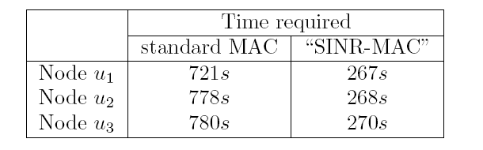
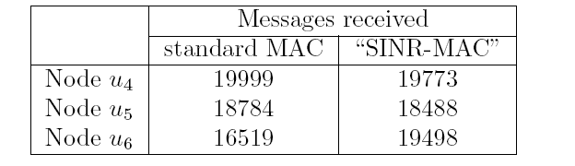
This works in practice!
[Moscibroda et al., Hotnets 2006]
Measurements using mica2 nodes
Replaced standard MAC protocol by a (tailor-made) „SINR-MAC“
Measured for instance the following deployment...
u₁
u₂
u₃
u₄
u₅
u₆
Time for successfully transmitting 20,000 packets:
Speed-up is almost a factor 3

Slide 29

Worst-Case Rate in Sensor Network: Protocol Model
Topology (worst-case!): Exponential node chain
Model: Protocol model, with power control
  Assume for simplicity that the interference radius is twice the transmission radius (however, this can be relaxed easily)
Whenever a node transmits to another node all nodes to its left are in its interference range. In other words, no two nodes can transmit.
Network behaves like a single-hop network!
Same result for SINR with constant power or P ~ d®.
sink
x_{i}
d(sink,x_{i}) = (1+1/Δ)^{i-1}
In the protocol model, the
achievable rate is Θ(1/n).
Notes:
29

Slide 30

Physical Model with Power Control
Original result was Ω(1/log³n). [Moscibroda et al, Infocom 2006]
Later improved to Ω(1/log²n). [Moscibroda, IPSN 2007]
Algorithm is centralized, complex → not practical
But it shows that high rates are possible even in worst-case networks
Basic idea: Enable spatial reuse by exploiting SINR effects.
In the physical model, the achievable rate is Ω(1/polylog n),
independent of the network topology.
Notes:
30

Slide 31
Scheduling Algorithm – High Level Procedure
High-level idea is simple
Construct a hierarchical tree T(X) that has desirable properties
1) Initially, each node is active
2) Each node connects to closest active node
3) Break cycles → yields forest
4) Only root of each tree remains active
loop until no
active nodes
Can be adjusted if
transmission power limited
Phase Scheduler:
How to schedule T(X)?
The resulting structure has some nice properties
→ If each link of T(X) can be scheduled at least once in L(X) time-slots
→ Then, a rate of 1/L(X) can be achieved
Notes:
31

Slide 32
Scheduling Algorithm – Phase Scheduler
How to schedule T(X) efficiently
We need to schedule links of different magnitude simultaneously!
Only possibility:
senders of small links must overpower their receiver!
R(x)
x
d
If we want to schedule both links…
… R(x) must be overpowered
→ Must transmit at power more than ~d^{α}
Subtle balance
is needed!
1)
2)
If senders of small links overpower their receiver…
… their “safety radius” increases (spatial reuse smaller)
Notes:
32

Slide 33
Scheduling Algorithm – Phase Scheduler
Partition links into sets of similar length
Group sets such that links a and
b in two sets in the same group
have at least d_{a} ¸ (cβ)^{c(τa-τb)} ¢d_{b}
→ Each link gets a τ_{ij} value → Small links have large τ_{ij} and vice versa
→ Schedule links in these sets in one outer-loop iteration
→ Intuition: Schedule links of similar length or very different length
Schedule links in a group → Consider in order of decreasing length
(I will not show details because of time constraints.)
small
Factor 2 between two sets
large
τ=3
τ=2
τ=1
Together with structure of T(x) → Ω(1/log³n) bound
Notes:
33

Slide 34
Rate in Wireless Sensor Networks: Summary
Worst-Case Capacity
Traditional Capacity
Networks
Max. rate in arbitrary,
worst-case deployment
Max. rate in random,
uniform deployment
Model
protocol model or
no power control
Θ(1/n)
Θ(1/log n)
[Giridhar, Kumar, 2005]
physical model
with power control
Ω(1/log²n)
Θ(1/log n)
Exponential gap
between protocol and
physical model!
The Price of Worst-Case Node Placement
Exponential in protocol model
Polylogarithmic in physical model
(almost no worst-case penalty!)
Notes:
34

Slide 35
Theoretical Implications
All MAC layer protocols we are aware of use either uniform or d^{α} power assignment.
  Thus, the theoretical performance of current MAC layer protocols is in theory as bad as scheduling every single node individually!
Faster polylogarithmic scheduling (faster MAC protocols) are theoretically possible in all (even worst-case) networks, if nodes choose their transmission power carefully.
  Theoretically, there is no fundamental scaling problem with scheduling.
  Theoretically efficient MAC protocols must use non-trivial power levels!
Well, the word theory appeared in every line... ☺

Slide 36
Possible Applications – Improved “Channel Capacity”
Consider a channel consisting of wireless sensor nodes
What is the throughput-capacity of this channel...?
time
Channel capacity is 1/3

Slide 37
Possible Applications – Improved “Channel Capacity”
A better strategy...
Assume node can reach 3-hop neighbor
time
Channel capacity is 3/7

Slide 38
Possible Applications – Improved “Channel Capacity”
All such (graph-based) strategies have capacity strictly less than 1/2!
For certain α and β, the following strategy is better!
time
Channel capacity is 1/2

Slide 39
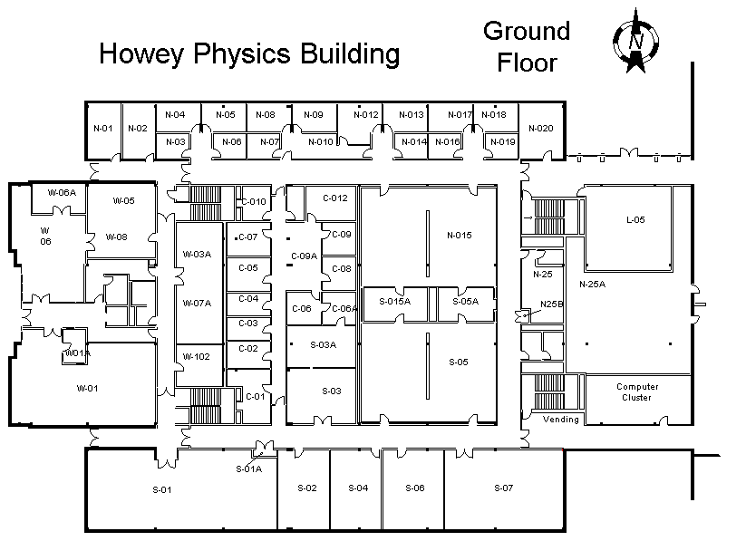

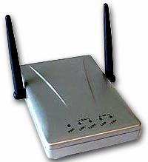
Possible Application – Hotspots in WLAN
Traditionally: clients assigned to (more or less) closest access point
→ far-terminal problem → hotspots have less throughput
Y
X
Z

Slide 40
Possible Application – Hotspots in WLAN
Potentially better: create hotspots with very high throughput
Every client outside a hotspot is served by one base station
→ Better overall throughput – increase in capacity!
Y
X
Z

Slide 41

Beyond Worst-/Best-Case: Scheduling Arbitrary Links?
Given: A set of arbitrary communication requests in the plane
  Each request is defined by position of source and destination
  Each communication request has the same demand; if some request has a higher demand, just add links between the same sender/receiver
  Just single-hop, no forwarding at intermediate nodes
  Model: SINR with constant power
Goal: Minimize the time to schedule all links!
  Those scheduled in the same time slot must obey SINR constraints
Example needs 3 time slots: 1,4,7 and 2,3,6 and 5,8
8
4
1
2
7
5
3
6

Slide 42
Some Results
Just checking whether some links can be scheduled in the same time slot is trivial. Simply test the SINR at each receiver.
  In fact, even with power control this is easy. Since distances are fixed the SINR feasibility boils down to a set of linear equations:
On the other hand, scheduling all links in minimum time is difficult (NP-complete), even with constant power. [Goussevskaia et al., 2007]
  With power control, the complexity of scheduling is still unknown.
What about approximation algorithms? Is it easy to schedule the maximum number of links in one slot? How much time do
you need to deliver a given communication demand?
  Some models are known, others not…
N

Slide 43
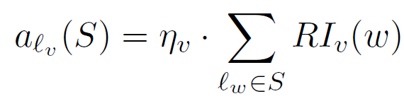
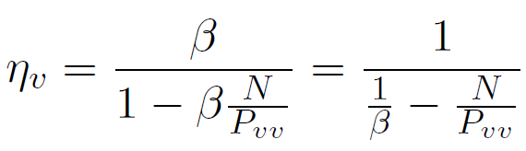
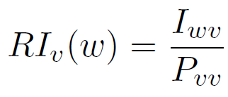
Definition: Affectance
The „affectance“ of link l_{v}, caused by a set of links S, is the sum of the relative interferences of the links in S on l_{v}. This can even be scaled with noise, using an additional constant ´_{v}. We have:
with and
(We simplify by omitting noise. This gives ´_{v} = ¯.)
A set S is SINR-feasible iff for all l_{v} in S we have a_{lv}(S) · 1.
Affectance is additive, i.e. a_{lv}(S₁) + a_{lv}(S₂) = a_{lv}(S₁ + S₂)
Interference of w on v
Signal from sender v

Slide 44
One-Slot Scheduling with Fixed Power Levels
Given a set L={l₁,…,l_{n}} of arbitrary links, we want to maximize
the number of links scheduled in one time-slot
Constant approximation algorithm:
  Input: L; Output: S;
  Repeat
    Add shortest link l_{v} in L to S;
    Delete all l_{w} in L, where d_{wv} ≤ c¢d_{vv};
    Delete all l_{w} in L, where a_{S}(l_{w}) ≥ 2/3;
  Until L=ø;
  Return S;
*Affectedness has a similar definition as affectance; it also tells how much interference a link can tolerate, i.e. a_{S}(l_{v}) = 1 if SINR_{S}(l_{v}) = β
Schedule “strong” links first
Constant c>2, c=f(α,β)
Links with receivers s_{w} too close to sender r_{v}
Links with high affectedness*
Set of links S is valid iff
a_{S}(l_{v}) ≤ 1 forall l_{v} in S

Slide 45
One-Slot Scheduling: Correctness Proof
We need to prove affectedness a_{S}(l_{v}) ≤ 1 for all l_{v} in S
All senders in set S_{v}⁺ have pair wise distance ± = (c-1)d_{vv}.
We partition the space in infinitely many rings of thickness ±.
  There is no sender in S_{v}⁺ in circle R₀
  A sender in ring R_{k} has at least distance k±
  The number of senders in ring R_{k} is O(k)
  Affectedness from ring R_{k} is O(¯k^{1-®}±^{-®})
  Total affectedness is O(§_{k¸1}¯k^{1-®}±^{-®})
  · 1/3, for ® > 2 and large enough
  constant c = f(α,β)
S_{v}⁻:set of shorter (≤) links in S, i.e., added before l_{v}
S_{v}⁺:set of longer (≥) links in S, i.e., added after l_{v}
a_{Sv-}(l_{v}) ≤ 2/3 (OK! by algo)
a_{Sv+}(l_{v}) ≤ 1/3 (? See below!)
…
R_{k}
R₂
R₁
±
r_{v}
±

Slide 46

One-Slot Scheduling: Approximation Proof
Count the number of links deleted by ALG that could have been scheduled in the optimum solution OPT: OPT’ = OPT \ ALG
Claim 1: |OPT₁| ≤ ½₁|ALG|, with ½₁ = f(c)
Proof: If the optimal wants to schedule
more than ½₁ links around receiver r_{v},
then two of these links have to be very
close, and would not satisfy the SINR
condition (since their length is at least
the length of link l_{v}).
OPT’ = OPT₁ + OPT₂
OPT₁: links deleted in step 1
OPT₂: links deleted in step 2
r_{v}
cd_{vv}

Slide 47
Helper Lemma: Blue-Dominant Centers Lemma
Consider two disjoint sets B and R of blue and red points in the plane. If |B| > 5q|R| then at least one point b in B is q-blue-dominant.
Definition: a point b in B is q-blue-dominant (q in Z⁺) if, for every ball of radius d around b, there are q times more blue than red points.
Proof: for each red point r in R, remove
q “guarding sets” of r, i.e., q times the
5 closest blue points in all directions.
After processing all the red points,
at least one blue point b* is left,
since |B| > 5q|R|. Point b* is
blue-dominant, since all red
points in R are “guarded” by
at least q blue points from
all directions.

Slide 48
One-Slot Scheduling: Approximation Proof (Part 2)
Claim 2: |OPT₂| ≤ ½₂|ALG|, ½₂=10
  Proof: Let B = OPT₂ (senders) and R = ALG (senders also)
  Assume for the sake of contradiction that |B|>10|R|.
  By the blue dominant centers lemma, there is a 2-blue-dominant point b in OPT₂. Since b is 2-blue-dominant, it is twice as much affected by OPT₂ than by ALG. (Really, it is the receiver of link l_{b} that is affected but thanks to the clearing of the neighborhood, the receiver is “close” to the sender; some nasty details omitted).
  In other words, we have a_{ALG}(l_{b}) < ½¢a_{OPT2}(l_{b}). With a_{OPT2}(l_{b}) ≤ 1 we have a_{ALG}(l_{b}) < ½. This contradicts that link l_{b} has been deleted by step 2 of the algorithm, since step 2 only deletes links with a_{S}(l_{b}) ≥ 2/3.
In summary, (½₁+½₂)¢|ALG| ¸ |OPT₁| + |OPT₂| = |OPT’| = |OPT \ ALG| ¸ |OPT| – |ALG|. That is, |ALG| ¸ |OPT| /(½₁+½₂+1) = Ω(|OPT|).

Slide 49
SINR Robustness
Given a set of scheduling requests S. We can schedule the set in T time, iff we can partition the set in T SINR-feasible subsets S₁,…, S_{T}
What happens if we change the parameters a bit, e.g. what if we now need to deal with a different ¯? Can it be that changing ¯ by some constant factor will lead to a totally different solution?
In general, what if the world is not perfect?!
  What if antennas are not perfectly omnidirectional?
  What if signals are not perfectly summing up?
  What if signal-to-noise ratio is not perfectly equal to ¯?
Luckily the SINR model is robust against minor (constant) changes

Slide 50
General Robustness Algorithm
A set S is SINR_{Á}-feasible iff for all l_{v} in S we have a_{lv}(S) · Á. A schedule is SINR_{Á}-feasible if all its slots are SINR_{Á}-feasible.
  This generalized feasibility essentially covers all model changes
From a SINR-feasible schedule to a SINR_{Á}-feasible schedule:
For each slot S in a SINR-feasible schedule, process links of S in decreasing order of their length, i.e., l₁, l₂, …, l_{k} 2 S, with l_{v} ¸ l_{v+1}. For each link l_{v}, assign l_{v} to S_{j} with minimum j with a_{lv}(S_{j}) · Á/2.
Then, the affectance on l_{v} by longer links is at most Á/2.
By additivity of affectance, the number of sets is at most d2/Áe.
For each set S_{j}, do the process in reverse order (short links first), getting sets S_{j1}, S_{j2}, …, S_{jk}. Now, the affectance on l_{v} by shorter links is at most Á/2. Thus, the total affectance is at most Á for each link. Also each original set S is partitioned into at most d2/Áe² sets.

Slide 51
SINR Robustness Discussion
We have constructively shown: If we can schedule a set of links in T slots in SINR, then we need at most O(T/Á²) slots if we adapt the model by a factor Á < 1.
  This also holds if the scenario is “mixed”, e.g.,
  if some antennas are a factor Á stronger than others, or
  if the antenna gain in one direction is a factor Á stronger, or
  if walls dampen transmissions by a factor Á.
In other words, if Á is constant, the SINR model is robust as solutions will continue to be valid up to constant factors.

Slide 52
Open problem
This is an area with more open than closed problems. The biggest open problem is scheduling with power control. Formally, the problem can be defined as follows:
A communication request consists of a source and a destination, which are arbitrary points in the Euclidean plane. Given n communication requests, assign a color (time slot) to each request. For all requests sharing the same color specify power levels such that each request can be handled correctly, i.e., all colors are SINR-feasible. The goal is to minimize the number of colors.
Pretty much nothing is known about this problem.

