Slide 1
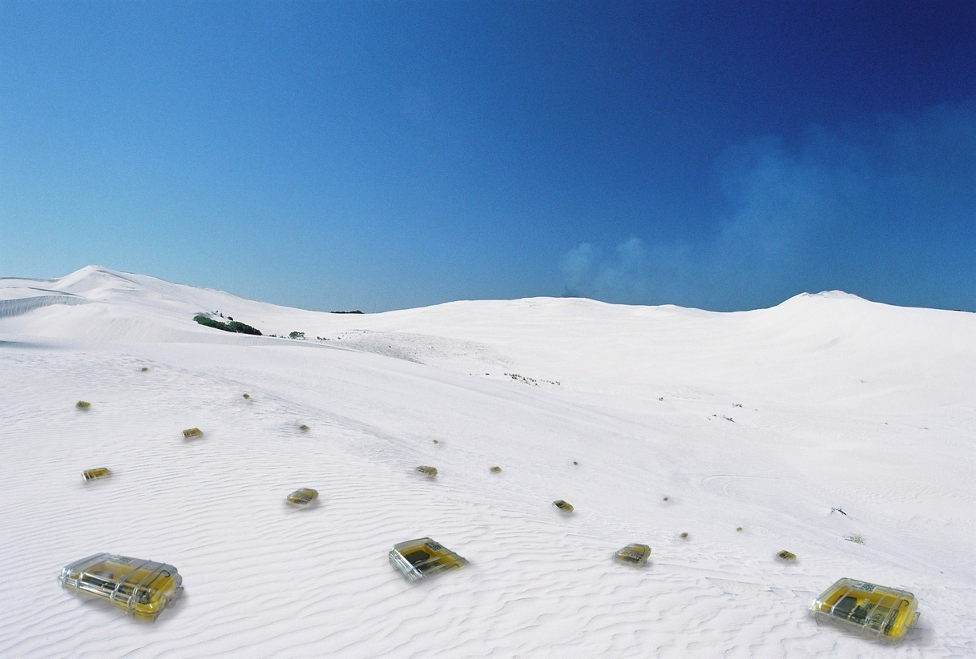

Clock Synchronization
Chapter 8
TexPoint fonts used in EMF.
Read the TexPoint manual before you delete this box.: AAAAA

Slide 2

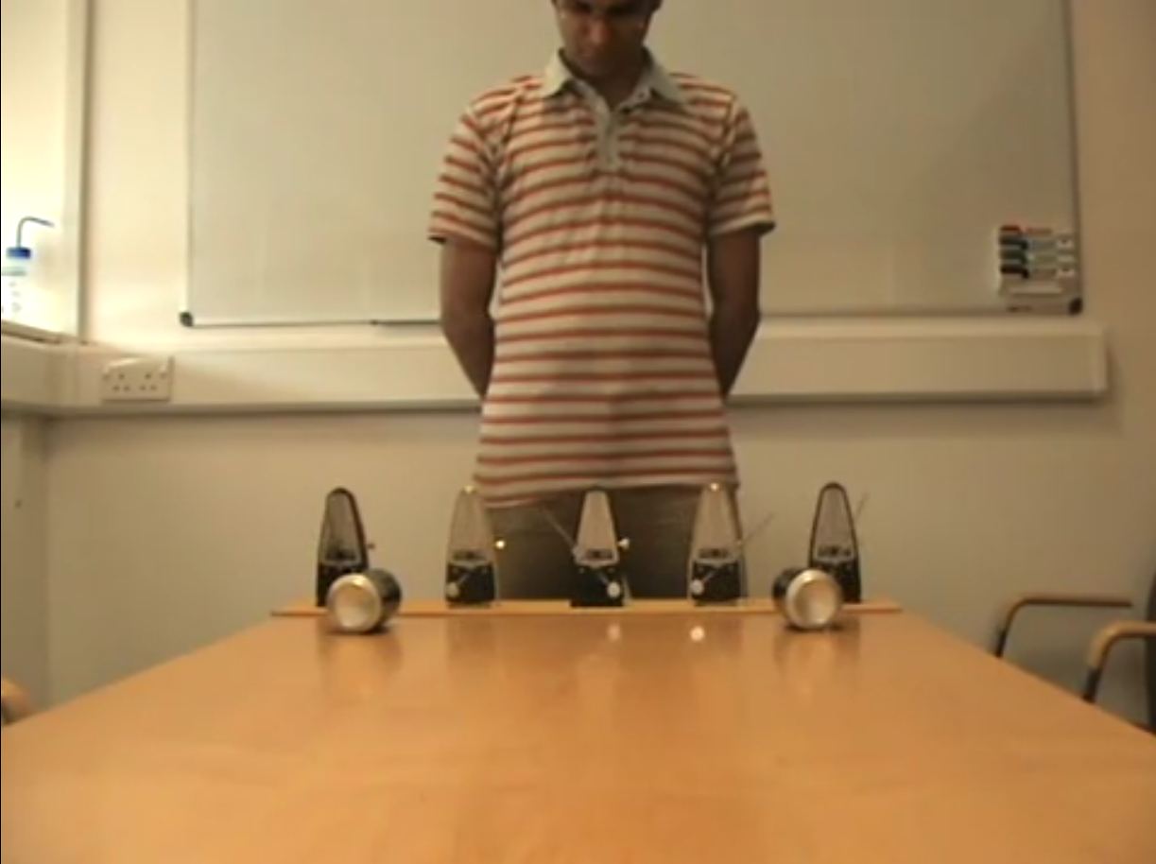

Clock Synchronization

Slide 3
Rating
Area maturity
Practical importance
Theory appeal
First steps Text book
No apps Mission critical
Boooooooring Exciting

Slide 4
Overview
Motivation
Clock Sources & Hardware
Single-Hop Clock Synchronization
Clock Synchronization in Networks
Protocols: RBS, TPSN, FTSP, GTSP
Theory of Clock Synchronization
Protocol: PulseSync
Notes:
4

Slide 5
Motivation
Synchronizing time is essential for many applications
  Coordination of wake-up and sleeping times (energy efficiency)
  TDMA schedules
  Ordering of collected sensor data/events
  Co-operation of multiple sensor nodes
  Estimation of position information (e.g. shooter detection)
Goals of clock synchronization
  Compensate offset between clocks
  Compensate drift between clocks
Localization
Sensing
Duty-Cycling
TDMA
Time Synchronization
Notes:
5

Slide 6
Properties of Clock Synchronization Algorithms
External versus internal synchronization
  External sync: Nodes synchronize with an external clock source (UTC)
  Internal sync: Nodes synchronize to a common time
    to a leader, to an averaged time, ...
One-shot versus continuous synchronization
  Periodic synchronization required to compensate clock drift
A-priori versus a-posteriori
  A-posteriori clock synchronization triggered by an event
Global versus local synchronization (explained later)
Accuracy versus convergence time, Byzantine nodes, …

Slide 7
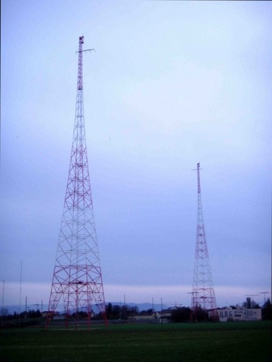

Clock Sources
Radio Clock Signal:
  Clock signal from a reference source (atomic clock) is transmitted over a long wave radio signal
  DCF77 station near Frankfurt, Germany transmits at 77.5 kHz with a transmission range of up to 2000 km
  Accuracy limited by the distance to the sender, Frankfurt-Zurich is about 1ms.
  Special antenna/receiver hardware required
Global Positioning System (GPS):
  Satellites continuously transmit own position and time code
  Line of sight between satellite and receiver required
  Special antenna/receiver hardware required

Slide 8
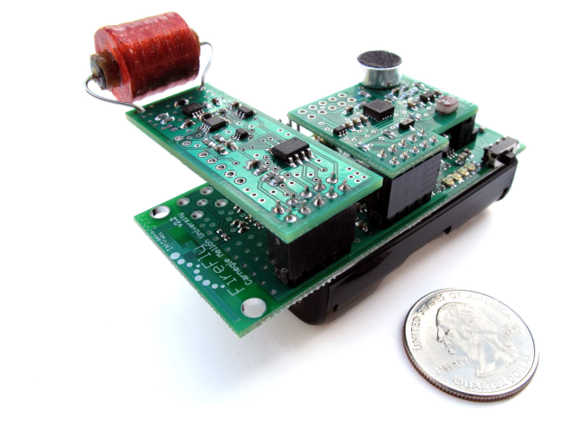
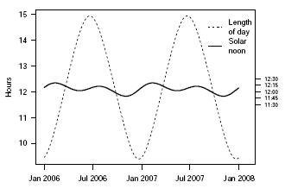
Clock Sources (2)
AC power lines:
  Use the magnetic field radiating from electric AC power lines
  AC power line oscillations are extremely stable
  (10⁻⁸ ppm)
  Power efficient, consumes only 58 μW
  Single communication round required to correct
  phase offset after initialization
Sunlight:
  Using a light sensor to measure the length of a day
  Offline algorithm for reconstructing global
  timestamps by correlating annual solar patterns
  (no communication required)

Slide 9
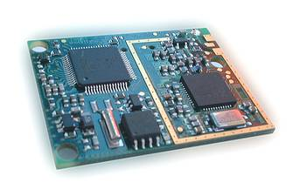
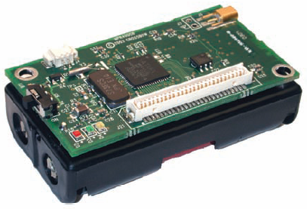
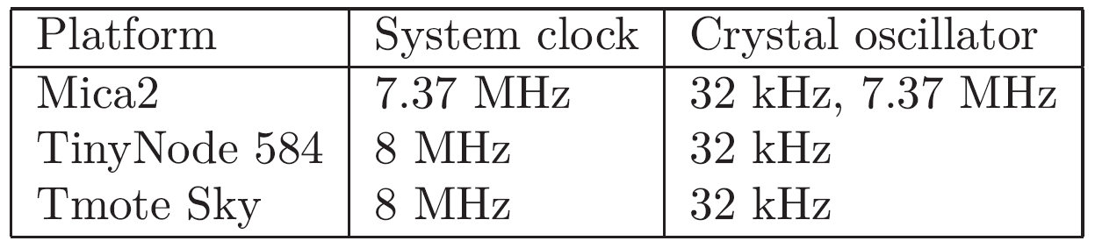
Clock Devices in Sensor Nodes
Structure
  External oscillator with a nominal frequency (e.g. 32 kHz or 7.37 MHz)
  Counter register which is incremented with oscillator pulses
  Works also when CPU is in sleep state
7.37 MHz quartz
32 kHz quartz
TinyNode
Mica2
32 kHz quartz

Slide 10
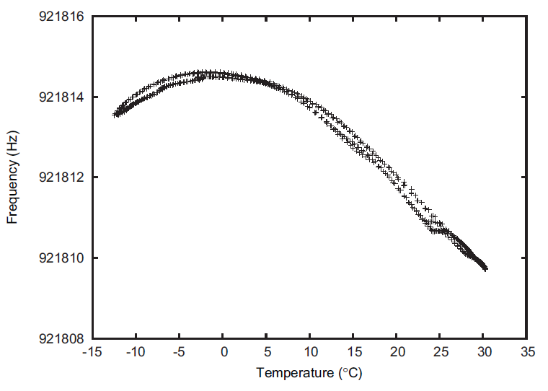
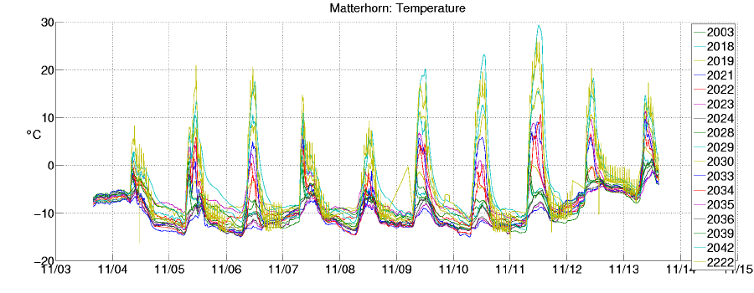
Clock Drift
Accuracy
  Clock drift: random deviation from the nominal rate dependent on power supply, temperature, etc.
  E.g. TinyNodes have a maximum drift of 30-50 ppm at room temperature
rate
1+²
This is a drift of up to 50 μs per second
or 0.18s per hour
1
1-²
t

Slide 11
Sender/Receiver Synchronization
Round-Trip Time (RTT) based synchronization
Receiver synchronizes to sender‘s clock
Propagation delay δ and clock offset θ can be calculated
B
t
Time accor-
t
2
ding to B
3
Request
Answer
from A
from B
A
t
Time accor-
t
1
ding to A
4

Slide 12

Messages Experience Jitter in the Delay
Problem: Jitter in the message delay
  Various sources of errors (deterministic and non-deterministic)
Solution: Timestamping packets at the MAC layer [Maróti et al.]
  → Jitter in the message delay is reduced to a few clock ticks
0-100 ms
0-500 ms
1-10 ms
timestamp
SendCmd
Access
Transmission
Reception
Callback
timestamp
0-100 ms
t

Slide 13
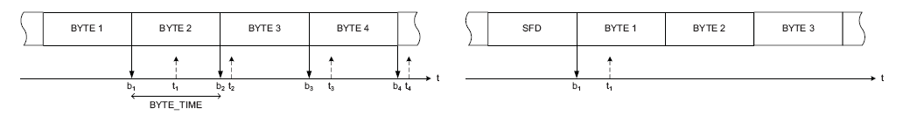
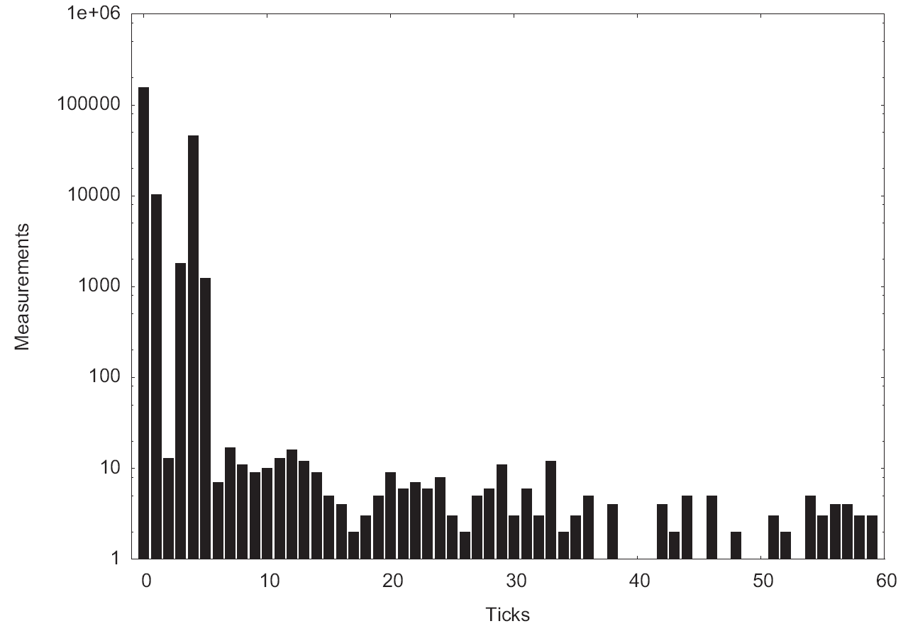
Some Details
Different radio chips use different paradigms:
  Left is a CC1000 radio chip which generates an interrupt with each byte.
  Right is a CC2420 radio chip that generates a single interrupt for the packet after the start frame delimiter is received.
In sensor networks propagation
can be ignored (<1¹s for 300m).
Still there is quite some variance
in transmission delay because of
latencies in interrupt handling
(picture right).

Slide 14
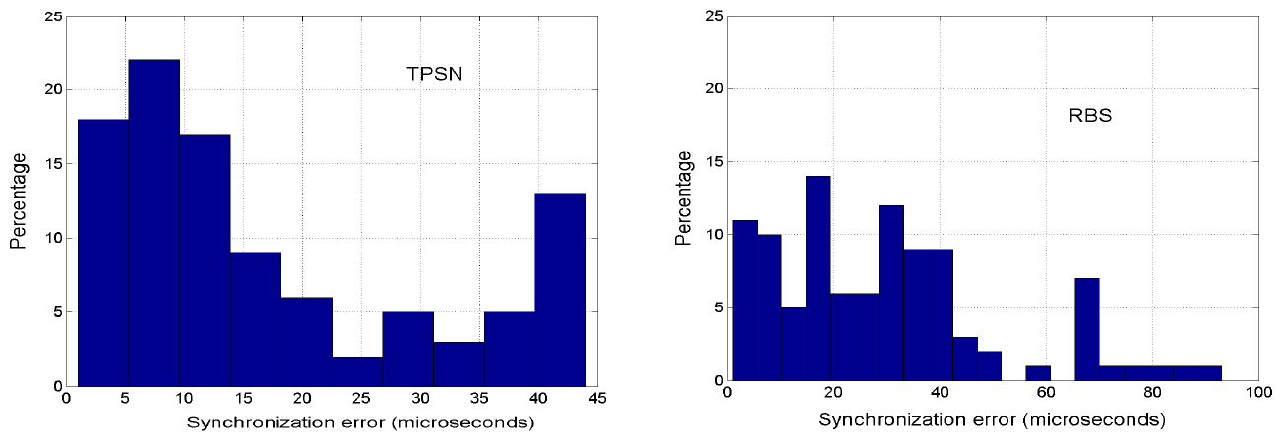
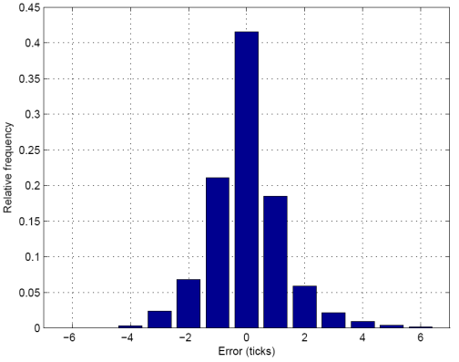
Symmetric Errors
Many protocols don’t even handle single-hop clock synchronization well. On the left figures we see the absolute synchronization errors of TPSN and RBS, respectively. The figure on the right presents a single-hop synchronization protocol minimizing systematic errors.
Even perfectly symmetric errors will sum up over multiple hops.
  In a chain of n nodes with a standard deviation ¾ on each hop, the expected error between head and tail of the chain is in the order of ¾√n.

Slide 15
Reference-Broadcast Synchronization (RBS)
A sender synchronizes a set of receivers with one another
Point of reference: beacon’s arrival time
t
=
+
+
+
+
A
t
S
A
P
R
2
1
S
S
S
,
A
A
t
=
+
+
+
+
t
S
A
P
R
3
1
S
S
S
,
B
B
S
θ
=
−
=
−
+
−
B
t
t
(
P
P
)
(
R
R
)
2
3
S
,
A
S
,
B
A
B
Only sensitive to the difference in propagation and reception time
Time stamping at the interrupt time when a beacon is received
After a beacon is sent, all receivers exchange their reception times to calculate their clock offset
Post-synchronization possible
E.g., least-square linear regression to tackle clock drifts
Multi-hop?
Notes:
15

Slide 16
Time-sync Protocol for Sensor Networks (TPSN)
Traditional sender-receiver synchronization (RTT-based)
Initialization phase: Breadth-first-search flooding
  Root node at level 0 sends out a level discovery packet
  Receiving nodes which have not yet an assigned level set their level
  to +1 and start a random timer
  After the timer is expired, a new level discovery packet will be sent
  When a new node is deployed, it sends out a level request packet after a random timeout
              Why this random timer?
0
1
1
1
2
2
2
2
Notes:
16

Slide 17
Time-sync Protocol for Sensor Networks (TPSN)
Synchronization phase
  Root node issues a time sync packet which triggers a random timer at all level 1 nodes
  After the timer is expired, the node asks its parent for synchronization using a synchronization pulse
  The parent node answers with an acknowledgement
  Thus, the requesting node knows the round trip time and can calculate its clock offset
  Child nodes receiving a synchronization pulse also start a random timer themselves to trigger their own synchronization
Time Sync
0
B
1
Sync pulse
ACK
1
2
A
2
2

Slide 18
Time-sync Protocol for Sensor Networks (TPSN)
t
=
+
+
+
+
t
S
A
P
R
0
2
1
A
A
A
,
B
B
t
=
+
+
+
+
t
S
A
P
R
B
1
4
3
B
B
B
,
A
A
(
−
+
−
+
−
+
−
S
S
)
(
A
A
)
(
P
P
)
(
R
R
)
1
2
θ
=
A
B
A
B
A
,
B
B
,
A
B
A
Time stamping packets at the MAC layer
In contrast to RBS, the signal propagation time might be negligible
Authors claim that it is “about two times” better than RBS
Again, clock drifts are taken into account using periodical synchronization messages
Problem: What happens in a non-tree topology (e.g. grid)?
  Two neighbors may have bad synchronization?
2
A
2
2
Notes:
18

Slide 19
Flooding Time Synchronization Protocol (FTSP)
Each node maintains both a local and a global time
Global time is synchronized to the local time of a reference node
  Node with the smallest id is elected as the reference node
Reference time is flooded through the network periodically
Timestamping at the MAC Layer is used to compensate for deterministic message delays
Compensation for clock drift between synchronization messages using a linear regression table
0
reference node
5
4
1
7
6
3
2

Slide 20
Best tree for tree-based clock synchronization?
Finding a good tree for clock synchronization is a tough problem
  Spanning tree with small (maximum or average) stretch.
Example: Grid network, with n = m² nodes.
No matter what tree you use, the maximum
stretch of the spanning tree will always be
at least m (just try on the grid figure right…)
In general, finding the minimum max
stretch spanning tree is a hard problem,
however approximation algorithms exist
[Emek, Peleg, 2004].

Slide 21
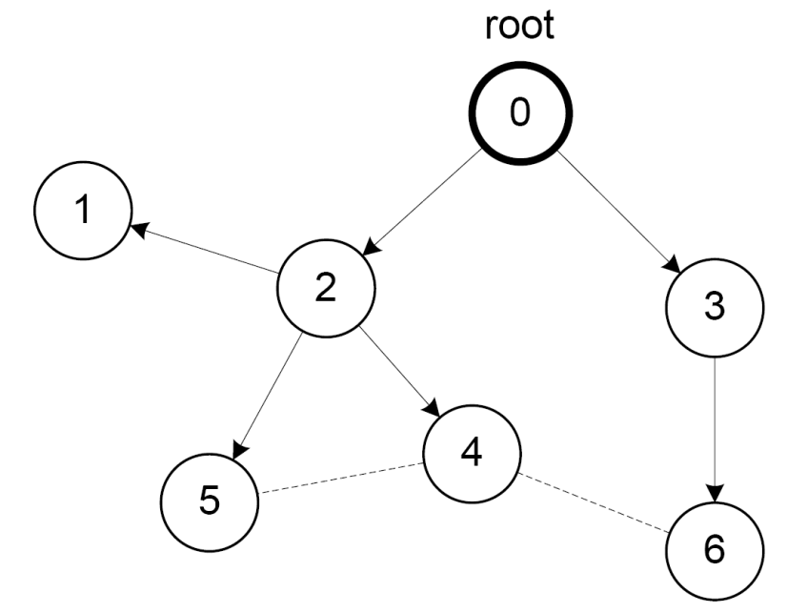
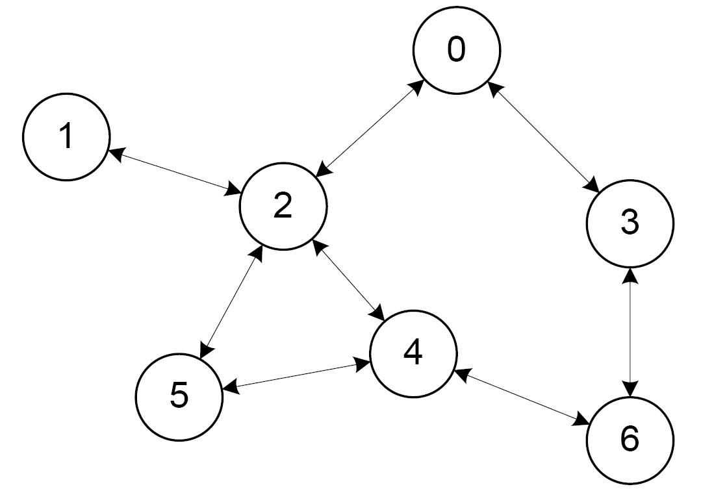
Variants of Clock Synchronization Algorithms
Tree-like Algorithms Distributed Algorithms
e.g. FTSP e.g. GTSP
Bad local skew
All nodes consistently average errors to all neigbhors

Slide 22
FTSP vs. GTSP: Global Skew
Network synchronization error (global skew)
  Pair-wise synchronization error between any two nodes in the network
FTSP (avg: 7.7 μs)
GTSP (avg: 14.0 μs)

Slide 23
FTSP vs. GTSP: Local Skew
Neighbor Synchronization error (local skew)
  Pair-wise synchronization error between neighboring nodes
Synchronization error between two direct neighbors:
FTSP (avg: 15.0 μs)
GTSP (avg: 2.8 μs)

Slide 24
Global vs. Local Time Synchronization
Common time is essential for many applications:
  Assigning a timestamp to a globally sensed event (e.g. earthquake)
  Precise event localization (e.g. shooter detection, multiplayer games)
  TDMA-based MAC layer in wireless networks
  Coordination of wake-up and sleeping times (energy efficiency)
Global
Local
Local
Local

Slide 25
Theory of Clock Synchronization
Given a communication network
  Each node equipped with hardware clock with drift
  Message delays with jitter
Goal: Synchronize Clocks (“Logical Clocks”)
  Both global and local synchronization!
worst-case (but constant)

Slide 26

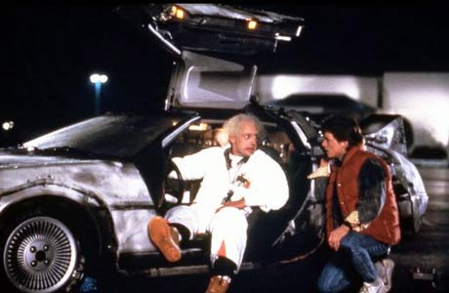

Time Must Behave!
Time (logical clocks) should not be allowed to stand still or jump
Let’s be more careful (and ambitious):
Logical clocks should always move forward
  Sometimes faster, sometimes slower is OK.
  But there should be a minimum and a maximum speed.
  As close to correct time as possible!

Slide 27

Formal Model
Hardware clock H_{v}(t) = s_{[0,t]} h_{v}(¿) d¿
with clock rate h_{v}(t) 2 [1-²,1+²]
Logical clock L_{v}(∙) which increases
at rate at least 1 and at most ¯
Message delays 2 [0,1]
Employ a synchronization algorithm
to update the logical clock according
to hardware clock and
messages from
neighbors
Clock drift ² is typically small, e.g.
² ¼10⁻⁴ for a cheap quartz oscillator
Logical clocks with rate less than 1 behave differently (“synchronizer”)
Neglect fixed share of delay, normalize jitter
H_{v}
Time is 152
Time is 140
Time is 150
L_{v}?

Slide 28
Synchronization Algorithms: An Example (“A^{max}”)
Question: How to update the logical clock
based on the messages from the neighbors?
Idea: Minimizing the skew to the fastest neighbor
  Set the clock to the maximum clock value received from any neighbor
  (if larger than local clock value)
  forward new values immediately
Optimum global skew of about D
Poor local property
  First all messages take 1 time unit…
  …then we have a fast message!
Allow ¯ = 1
Fastest Hardware Clock
New time is D+x
New time is D+x
skew D!
Time is D+x
Time is D+x
Time is D+x
…
Clock value:
D+x
Old clock value:
D+x-1
Old clock value:
x+1
Old clock value:
x

Slide 29
Synchronization Algorithms: A^{max’}
The problem of A^{max} is that the clock is always increased to the maximum value
Idea: Allow a constant slack γ between the maximum neighbor clock value and the own clock value
The algorithm A^{max’} sets the local clock value L_{i}(t) to
→ Worst-case clock skew between two neighboring nodes is still Θ(D) independent of the choice of γ!
How can we do better?
  Adjust logical clock speeds to catch up with fastest node (i.e. no jump)?
  Idea: Take the clock of all neighbors into account by choosing the average value?

Slide 30
Local Skew: Overview of Results
Everybody‘s expectation, five years ago („solved“)
Blocking algorithm
All natural algorithms
[Locher et al., DISC 2006]
Lower bound of logD / loglogD
[Fan & Lynch, PODC 2004]
1 logD √D D …
Dynamic Networks!
[Kuhn et al., SPAA 2009]
Kappa algorithm
[Lenzen et al., FOCS 2008]
Tight lower bound
[Lenzen et al., PODC 2009]

Slide 31
Enforcing Clock Skew
Messages between two neighboring nodes may be fast in one direction and slow in the other, or vice versa.
A constant skew between neighbors may be „hidden“.
In a path, the global skew may be in the order of D/2.
u
2
3
4
5
6
7
v
2
3
4
5
6
7
vs
2
3
4
5
6
7
2
3
4
5
6
7
2
3
4
5
6
7
2
3
4
5
6
7

Slide 32

Local Skew: Lower Bound
h_{v} = 1
L_{v}(t) = x
h_{v} = 1+²
L_{v}(t) = x + l₀/2
Higher clock rates
l₀ = D
h_{w} = 1
L_{w}(t)
h_{w} = 1
L_{w}(t)
Add l₀/2 skew in l₀/(2²) time, messing with clock rates and messages
Afterwards: Continue execution for l₀/(4(¯-1)) time (all h_{x} = 1)
  → Skew reduces by at most l₀/4 → at least l₀/4 skew remains
  Consider a subpath of length l₁ = l₀·²/(2(¯-1)) with at least l₁/4 skew
  Add l₁/2 skew in l₁/(2²) = l₀/(4(¯-1)) time → at least 3/4·l₁ skew in subpath
Repeat this trick (+½,-¼,+½,-¼,…) log_{2(¯-1)/²} D times
Theorem: Ω(log_{(¯-1)/²} D) skew between neighbors

Slide 33
Local Skew: Upper Bound
Surprisingly, up to small constants, the Ω(log_{(¯-1)/²} D) lower bound can be matched with clock rates 2 [1,¯] (tough part, not included)
We get the following picture [Lenzen et al., PODC 2009]:
max rate ¯ | 1+² | 1+£(²) | 1+√² | 2 | large
local skew | 1 | £(log D) | £(log_{1/²} D) | £(log_{1/²} D) | £(log_{1/²} D)
We can have both smooth and accurate clocks!
... because too large clock rates will amplify the clock drift ².

Slide 34
Local Skew: Upper Bound
Surprisingly, up to small constants, the Ω(log_{(¯-1)/²} D) lower bound can be matched with clock rates 2 [1,¯] (tough part, not included)
We get the following picture [Lenzen et al., PODC 2009]:
In practice, we usually have 1/² ¼ 10⁴ > D. In other words, our initial
intuition of a constant local skew was not entirely wrong! ☺
max rate ¯ | 1+² | 1+£(²) | 1+√² | 2 | large
local skew | 1 | £(log D) | £(log_{1/²} D) | £(log_{1/²} D) | £(log_{1/²} D)
We can have both smooth and accurate clocks!
... because too large clock rates will amplify the clock drift ².

Slide 35
Back to Practice: Synchronizing Nodes
Sending periodic beacon messages to synchronize nodes
Beacon interval B
100
130
reference clock
t
0
t=100
t=130
t
1
J
J
jitter
jitter

Slide 36
How accurately can we synchronize two Nodes?
Message delay jitter affects clock synchronization quality
^
0
y
r
r
^
^
r
y(x) = r·x + ∆y
clock offset
relative clock rate
(estimated)
x
∆y
J
J
1
Beacon interval B

Slide 37
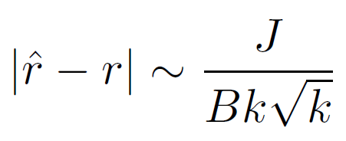
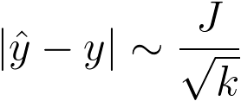
Clock Skew between two Nodes
Lower Bound on the clock skew between two neighbors
^
Error in the rate estimation:
Jitter in the message delay
Beacon interval
Number of beacons k
Synchronization error:
0
y
r
r
^
r
x
∆y
J
J
1
Beacon interval B

Slide 38
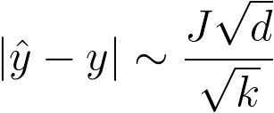
Multi-hop Clock Synchronization
Nodes forward their current estimate of the reference clock
  Each synchronization beacon is affected by a random jitter J
Sum of the jitter grows with the square-root of the distance
  stddev(J₁ + J₂ + J₃ + J₄ + J₅ + ... J_{d}) = √d×stddev(J)
0
1
2
3
4
...
d
J₁
J₂
J₃
J₄
J₅
J_{d}
Single-hop:
Multi-hop:

Slide 39
Linear Regression (e.g. FTSP)
FTSP uses linear regression to compensate for clock drift
  Jitter is amplified before it is sent to the next hop
0
y
r
Example for k=2
^
synchronization error
r
^
y(x) = r·x + ∆y
clock offset
relative clock rate
(estimated)
∆y
x
J
J
1
Beacon interval B

Slide 40
The PulseSync Protocol
Send fast synchronization pulses through the network
  Speed-up the initialization phase
  Faster adaptation to changes in temperature or network topology
Beacon time B
0
FTSP
1
2
Expected time
= D·B/2
3
4
t
Beacon time B
0
PulseSync
1
2
Expected time
= D·t_{pulse}
3
4
t
t_{pulse}

Slide 41
The PulseSync Protocol (2)
Remove self-amplification of synchronization error
  Fast flooding cannot completely eliminate amplification
0
y
r
Example for k=2
^
synchronization error
r
^
y(x) = r·x + ∆y
clock offset
relative clock rate
(estimated)
∆y
x
J
J
1
The green line is calculated using
k measurement points that are
statistically independent of the red line.
Beacon interval B

Slide 42
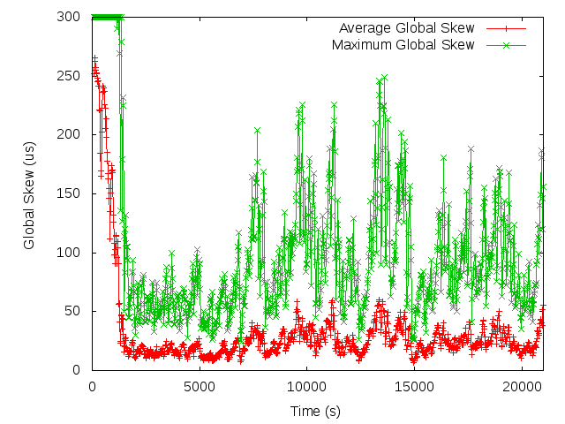
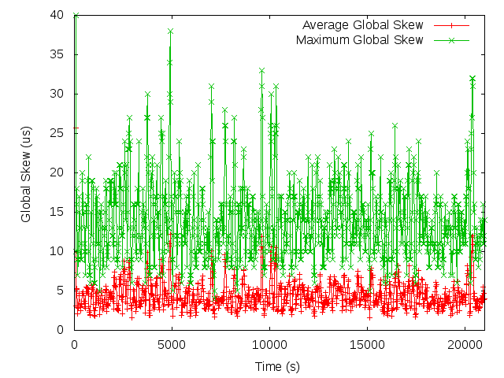
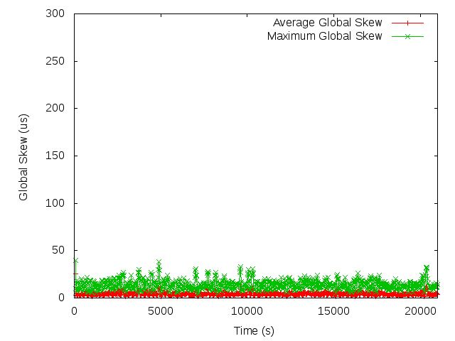
FTSP vs. PulseSync
Global Clock Skew
  Maximum synchronization error between any two nodes
FTSP
PulseSync
Synchronization Error | FTSP | PulseSync
Average (t>2000s) | 23.96 µs | 4.44 µs
Maximum (t>2000s) | 249 µs | 38 µs

Slide 43
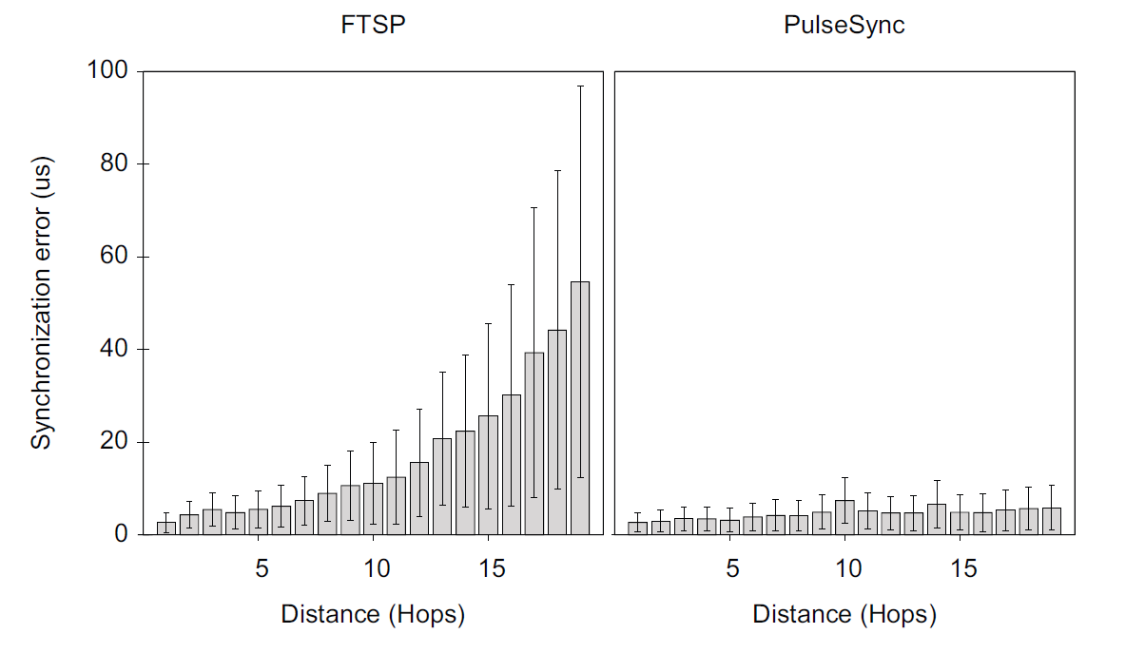
FTSP vs. PulseSync
Sychnronization Error vs. distance from root node
FTSP
PulseSync

Slide 44
Open Problem
As listed on slide 9/6, clock synchronization has lots of parameters. Some of them (like local/gradient) clock synchronization have only started to be understood.
Local clock synchronization in combination with other parameters are not understood well, e.g.
  accuracy vs. convergence
  fault-tolerance in case some clocks are misbehaving [Byzantine]
  clock synchronization in dynamic networks

