Slide 1
Computer Systems
Exercise Session 8

Slide 2
Last exercise
Assignment 7

Slide 3
Last Exercise - Paxos

Slide 4
Last Exercise - Paxos

Slide 5
Last Exercise - Paxos

Slide 6
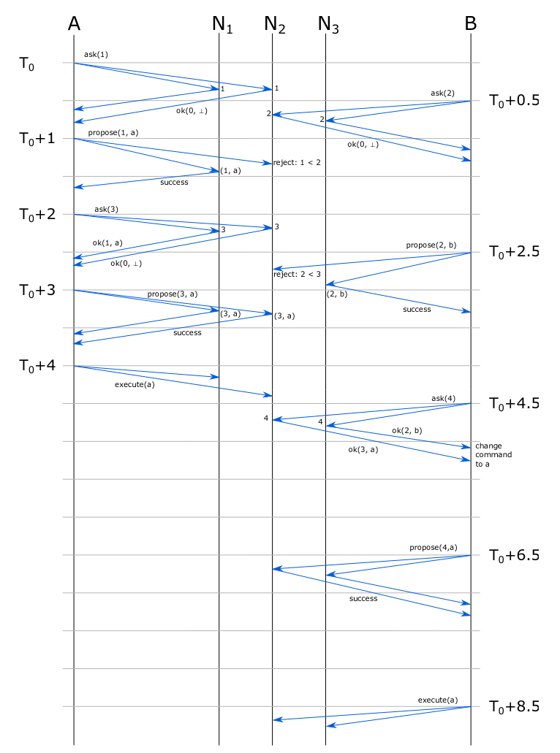

Slide 7
Last Exercise - Paxos

Slide 8
Last Exercise - Paxos

Slide 9
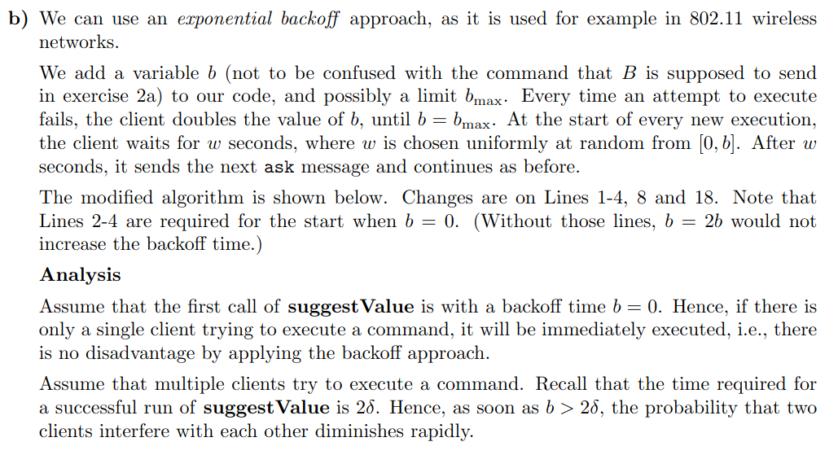
Last Exercise - Paxos

Slide 10
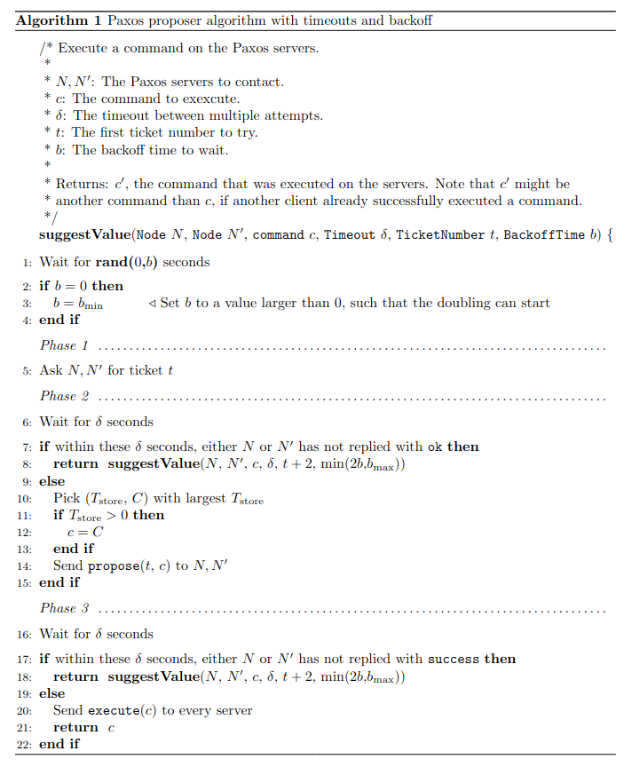

Slide 11
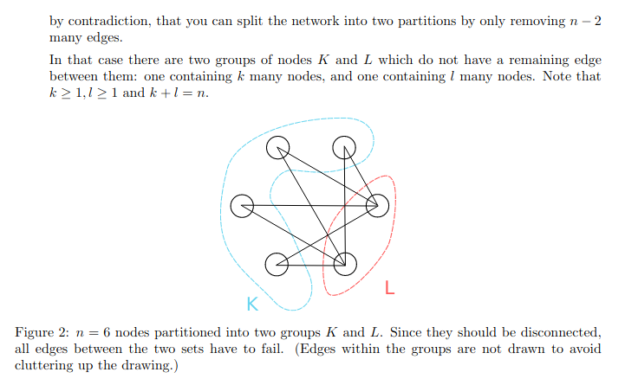
Last Exercise - Consensus

Slide 12
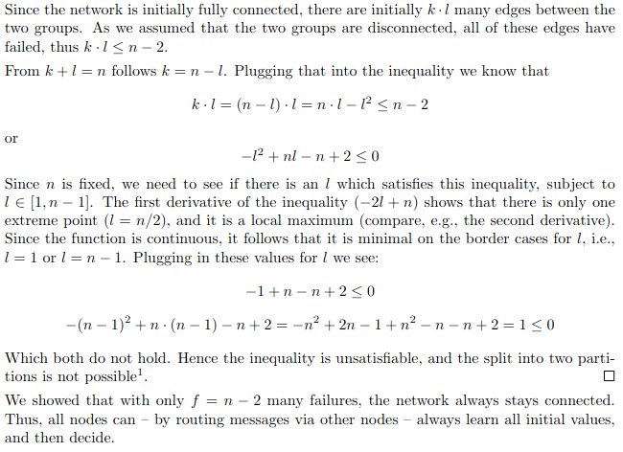
Last Exercise - Consensus

Slide 13
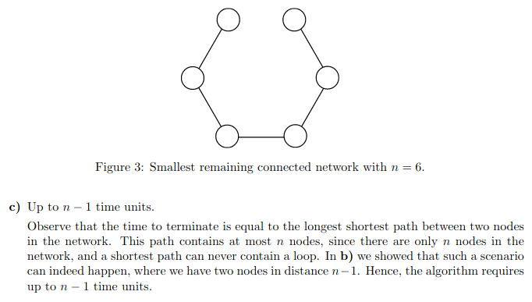
Last Exercise - Consensus

Slide 14
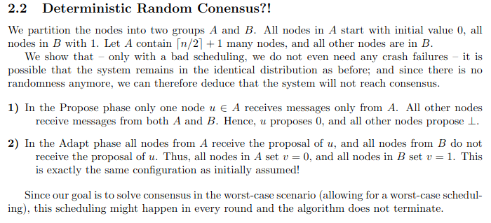
Last Exercise - Consensus

Slide 15
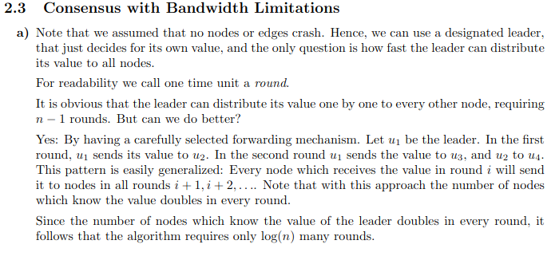
Last Exercise - Consensus

Slide 16
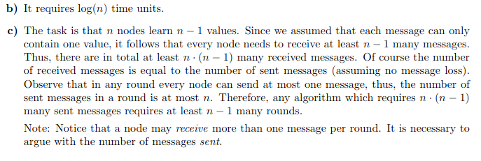
Last Exercise - Consensus

Slide 17
Chapter 17
Byzantine Agreement

Slide 18
Byzantine Node
Name comes from the paper “The Byzantine Generals Problem”
Node which has arbitrary behavior
So it can:
Decide not to send messages
Send different messages to different nodes
Send wrong messages
Lie about input value
Collude with other byzantine nodes
BUT:
It can’t impersonate another node (It can’t forge another node’s sender address)
If an algorithm works with f byzantine nodes, it is f-resilient

Slide 19
Different Validities
Any-input validity:
The decision value must be input of any node
That includes byzantine nodes, might not make sense
Correct-input validity:
The decision value must be input of a correct node
Difficult because byzantine node could behave like normal one just with different value
All-same validity:
if all correct nodes start with the same value, the decision must be that value
Median validity:
If input values are orderable, byzantine outliers can be prevented by agreeing on a value close to the median value of the correct nodes

Slide 20
Byzantine Agreement
in the synchronous model
Assumption:
nodes operate in synchronous rounds.
In each round, each node may send a message to each other node, receive the message by other nodes and do some computation.
-> runtime is easy, since it is only the number of rounds

Slide 21
King Algorithm
(syn. byz. agreement)
Do until at least one correct input node
Idea:
If not all correct input nodes have the same value, decide on value of one correct input node. Ensure this by doing f+1 rounds, since there must be at least one correct input node.
Send out own value
If some value received from
all nodes but byzantine ones (or at least
((n – f)- f) correct ones), propose that
value
If some value proposed by at
least one correct node,
set your value to that value
All-Same Validity
King of this phase broadcasts
its value
If didn’t get propose from all nodes
but byzantine ones (or at least
((n – f)- f) correct ones),
set your value to value of king

Slide 22
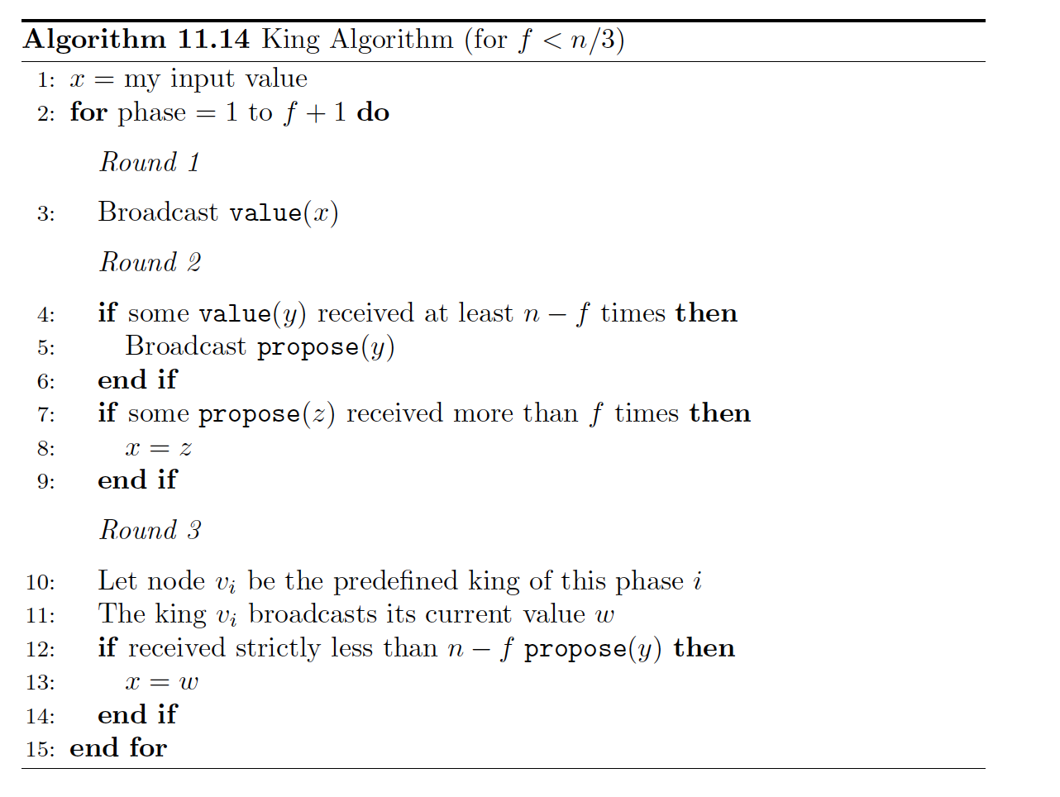
King Algorithm
(syn. byz. agreement)
Why f+1?
Because there are f byzantine nodes, at least one of the kings will be a correct node

Slide 23
King Algorithm
(syn. byz. agreement)

Slide 24
King Algorithm
(syn. byz. agreement)
Why n-f?
Because there are n-f correct nodes, so we can’t wait for more. If we wait for less than f + 1 nodes, all the input values could be fake.
Because 3f < n, n – f > f.
Ensures only one proposal: If one node sees n-f values v, then every other node sees at least n-2f times v. Because n- (n-2f) = 2f < n-f, there can be no proposal for another value.
All same validity ensured here!

Slide 25
King Algorithm
(syn. byz. agreement)
Why more than f?
If we just waited for <= f propose messages, they all could be byzantine.

Slide 26
King Algorithm
(syn. byz. agreement)
Why n-f propose messages?
Similar as for n-f broadcast messages. We can wait for at most n-f ones because those are the correct nodes, and we have to wait for at least f+1 ones.
After a correct king, the correct nodes will not change their values anymore! Why?
If all of them have less than n-f propose messages, all correct nodes will have the king value and then “all same validity” holds. If one does not adapt, this means that it got n-f propose messages. This means, every other message got at least n-f-f > f propose messages, so it adapted its value to the propose. So the king also adapted it’s value and again all nodes have the same value.

Slide 27
King Algorithm - example
Example: n = 4, f=1
Phase 1:
0* = “Propose 0” 1* = “Propose 1”
All processes choose the king’s value
“Propose 1”
0,0,1,1
0,1,1,1
2 propose 1
2 propose 1
1*
1
1
1
1
0
1
0
1*
0
1*
1*
1*
1
1
0
0*
1
0
0
1
0,0,1,1
1 proposal each
Round 1
Round 2
Round 3

Slide 28
King Algorithm - example
Example: n = 4, f=1
Phase 2:
0* = “Propose 0” 1* = “Propose 1”
Consensus!
“Propose 1”
I take the king’s value!
0,0,1,1
0,1,1,1
2 propose 1
2 propose 1
1*
1
0
1
1
1
1
1
0
1*
1
1
1*
1*
1
1
1*
1*
1
1
1
0,1,1,1
“Propose 1”
3 propose 1
I keep my own value!
Round 1
Round 2
Round 3

Slide 29
King Algorithm
(syn. byz. agreement)
Does it solve byzantine agreement?
Validity: All same validity!
Agreement: They agree at least after
the first correct king.
Termination: After (f+1)*3 rounds
Kings order has to be predefined!

Slide 30
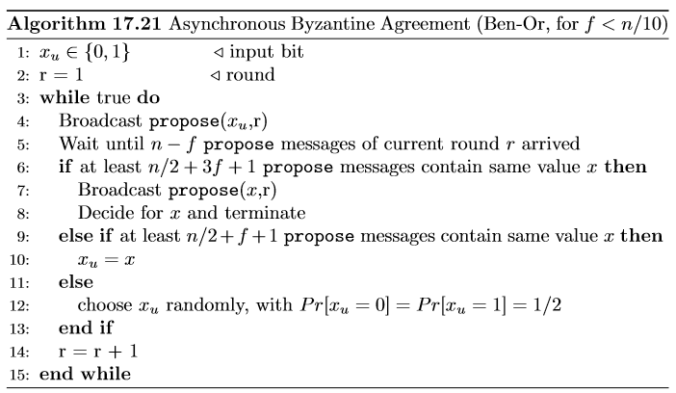
Asynchronous Byzantine Agreement
Assumption: Messages do not need to arrive at the same time anymore. They have variable delays.
-> Also works, but is a lot more complicated.
-> Algorithm in script is proof of concept, so don’t worry about it too much.
-> Asynchronity changes messages you have to wait for, but not principle
Do for f +1 Rounds
Broadcast own value
Wait
If big enough amount agrees, propose and terminate
If some agree, adapt your value
If no popular value, decide randomly
SLOW! Exponential runtime!
Notes:
Why only proof of concept

Slide 31
Theorem 17.23: Byzantine Agreement
(Student Mail)

Slide 32
Asynchronous Byzantine Agreement
(with Oracle)
Now, if no popular value, all correct nodes will decide on same oracle value.
Constant runtime
Problem: oracle does not exist
Do for f +1 Rounds
Broadcast own value
Wait for enough messages
If big enough amount agrees, propose and terminate
If some agree, adapt your value
If no popular value, ASK ORACLE

Slide 33
Asynchronous Byzantine Agreement
(with Random Bitstring)
New idea: generate a random bitstring and take next value of bitstring instead of asking oracle
Problem: byzantine nodes know “random” value and can adapt their behavior
Do for f +1 Rounds
Broadcast own value
Wait for enough messages
If big enough amount agrees, propose and terminate
If some agree, adapt your value
If no popular value, LOOK AT BITSTRING

Slide 34
Asynchronous Byzantine Agreement
(with Blackboard)
Back to the roots! – shared coin
Implement it by writing values to a public blackboard, after seeing a certain amount of values nodes decide on coin value
Constant probability that value is the same for all
Similar to shared coin but works asynchronously
Byzantine nodes don’t know value of shared coin in advance
Do for f +1 Rounds
Broadcast own value
Wait for enough messages
If big enough amount agrees, propose and terminate
If some agree, adapt your value
If no popular value, GENERATE SHARED COIN

Slide 35
Ben-Or Algorithm: Example – All-Same Validity
Example: n = 11, f=1
Byzantine node has no power
1
1
1
Consensus!
1
1
1
1
0
1
0
1
1

Slide 36
Ben-Or Algorithm: Example – Shared Coin
Example: n = 11, f=1
0
0
0
0
0
1
1
0
1
1
1
1

Slide 37
Ben-Or Algorithm: Example – Shared Coin
Example: n = 11, f=1
Byzantine node has no power
I will ask the oracle!
0
0
0
0
0
I will ask the oracle!
1
1
0
1
1
1
1

Slide 38
Ben-Or Algorithm: Example – Voting
Example: n = 11, f=1
Different views: Inputs do not change
0,0,0,0,1,1,1,1,1,1
0
0
0
I will ask the oracle!
1
propose 1
1
1
0
1
1
1
1
0
0,0,0,1,1,1,1,1,1,1

Slide 39
Ben-Or Algorithm: Example – Voting
Example: n = 11, f=1
Different views: Inputs flip
0,0,0,1,1,1,1,1,1,1
0
0
I will ask the oracle!
0
propose 1
1
1
1
0
1
1
1
1
0
0,0,0,0,1,1,1,1,1,1

Slide 40
Chapter 18
Broadcast & Shared Coin

Slide 41
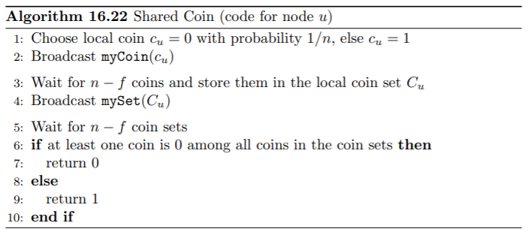
Shared Coin - Recap
(Student Mail)
a random variable
0 for all nodes with constant probability
1 with constant probability

Slide 42
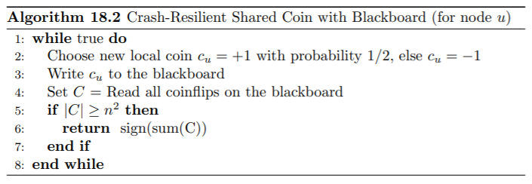
Blackboard Model
Is a trusted authority
A node can write/read to it
Not even one Byzantine Node
Trusted Authority? not Practical

Slide 43
Reliable Broadcast
Best effort broadcast
Best effort broadcast ensures that a message that is sent from a correct node v to another correct node w will be received and accepted by w
Reliable broadcast
Reliable broadcast ensures that the nodes eventually agree on all accepted messages. That is, if a correct node v considers message m as accepted, then every other node will eventually consider message m as accepted.
FIFO (reliable) broadcast
The FIFO (reliable) broadcast defines an order in which the messages are accepted in the system. If a node u broadcasts message m1 before m2, then any node v will accept the message m1 first.
Atomic broadcast
Atomic broadcast makes sure that all messages are always received in the same order. So for two random nodes u1 and u2 and two random messages m1 and m2, if u1 sees m1 first, u2 will also see m1 first.

Slide 44
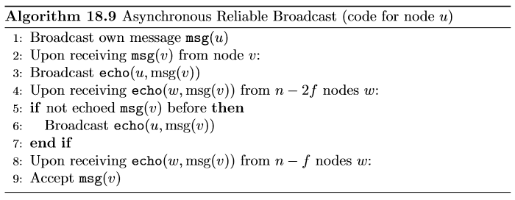
Reliable Broadcast
Broadcast own value
If message received from node directly, broadcast it together with your own name
If you do not get message from node directly, but from a reasonable amount of others also broadcast with own name
If you get enough forwarded messages, accept message

Slide 45
Reliable Broadcast
Guarantees:
If a node broadcasts a value reliably, all correct nodes will eventually accept that value
If a correct node has not broadcast a value, it will not be accepted by any other correct node
If a correct node accepts a message from a (byzantine) node, it will be eventually accepted by every correct node
Problem:
Does only tolerate <= n/5 byzantine nodes
This is better if we use the FIFO assumption
Notes:
Why not terminate

Slide 46
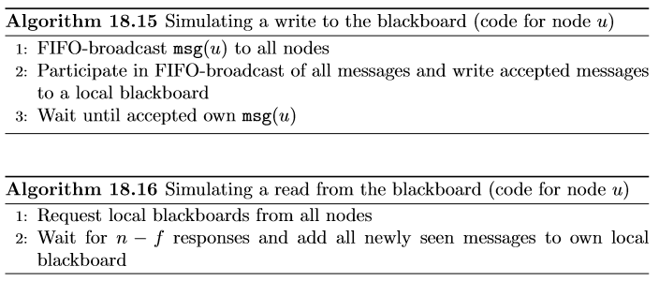
Blackboard with Message Passing
Failures + Worst-Case Scheduling
Byzantine?
Crypto!
Notes:
Why not terminate

Slide 47
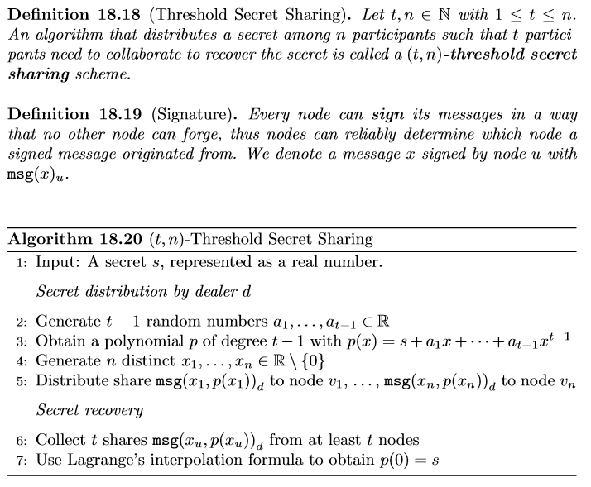
Using Cryptography
Notes:
Why not terminate

